Slide 1
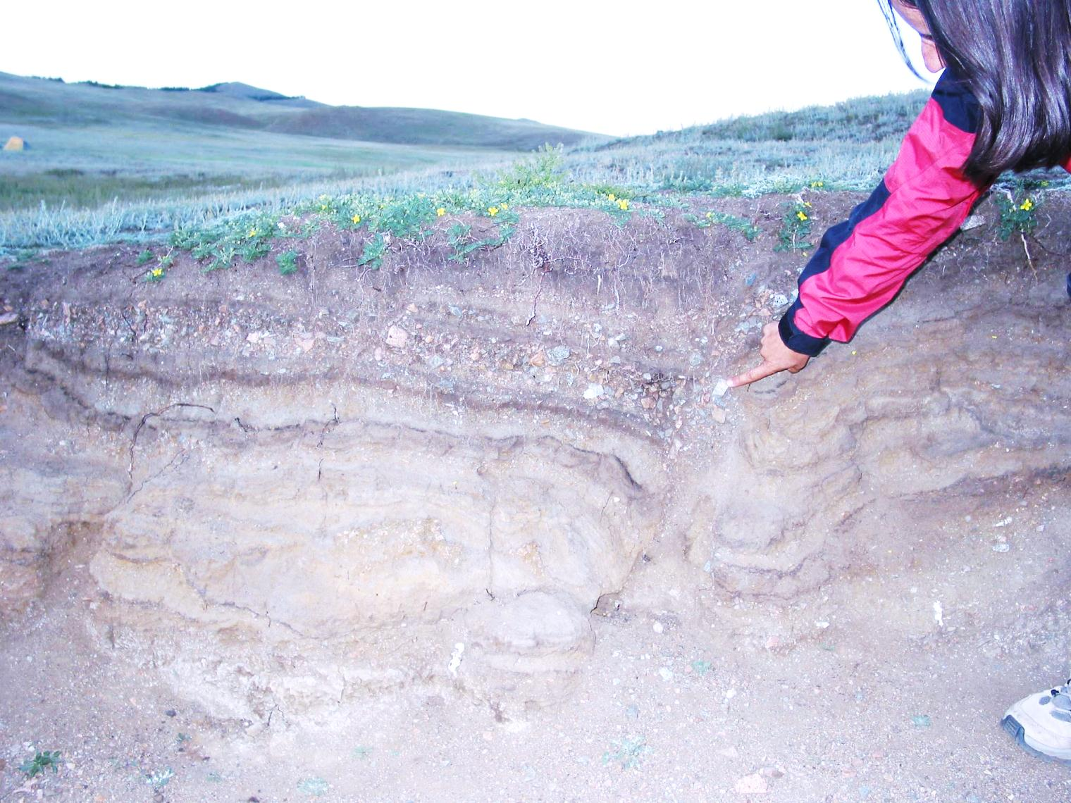


Paleoseismology: reading the geological book in search for earthquakes and tsunamis of the past
Daniela Pantosti
Istituto Nazionale di Geofisica e Vulcanologia
Sezione Sismologia e Tettonofisica, Roma (Italy)

Slide 2
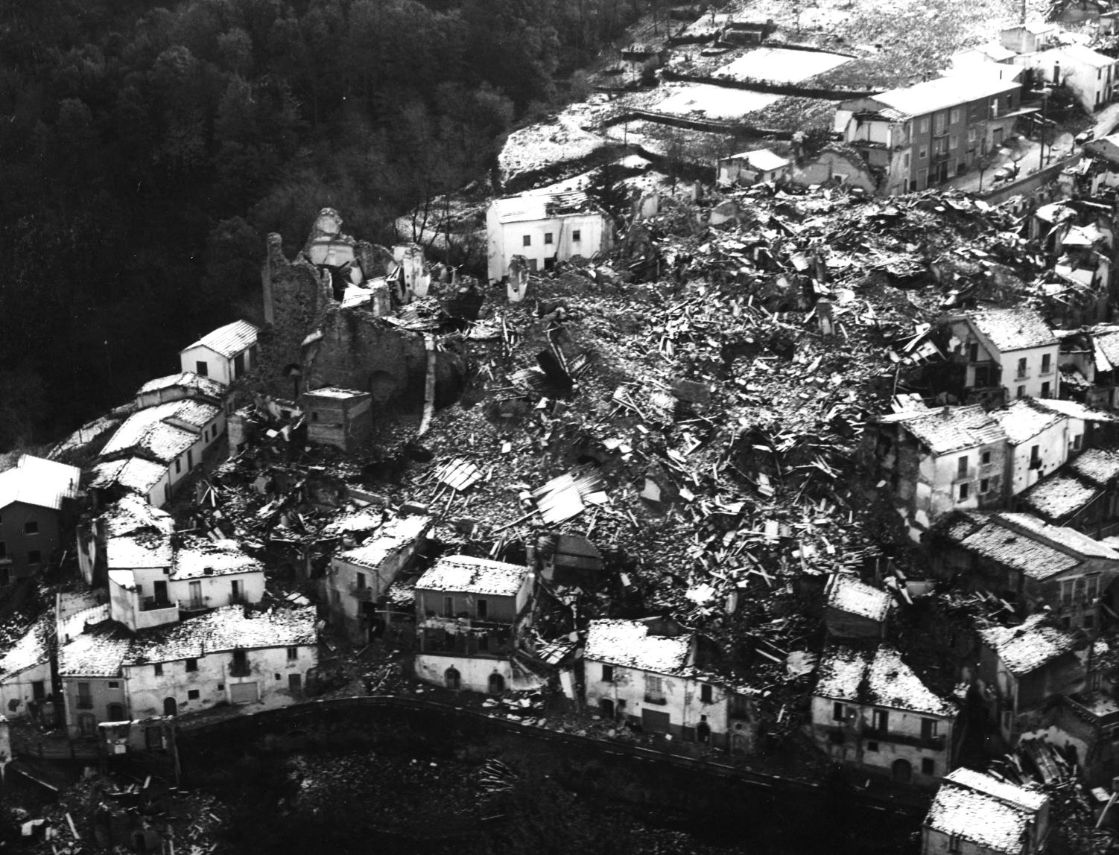
Extreme natural events can cause
disasters and produce important
lives and economic losses.
To undertake effective prevention
actions we should
know well what
we are facing.

Slide 3

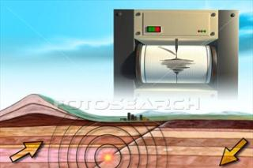
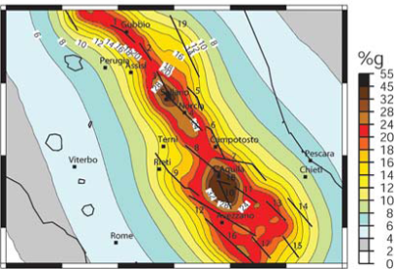
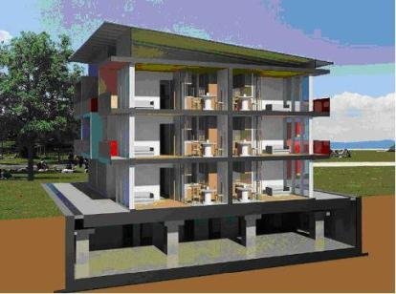
Learning process
experience
experience
observation
observation
conceptualization
conceptualization
application
Notes:
esempio bibmo che si brucia il dito toccando la pentola calda. tocco l a pentola, mi faccio male perche’ mi brucio, se tocco mi brucio, uso un panno per prendere la pentola .
Because natural events are so variable,

Slide 4
Large events such as earthquakes and tsunamis are
quite rare so limited experiences are available to develop
our learning process
this is why the past is a key to
forecast the future
experience
observation
conceptualization
experience
observation
conceptualization
experience
observation
conceptualization
experience
observation
conceptualization
experience
observation
conceptualization
experience
observation
conceptualization
experience
observation
conceptualization
experience
observation
conceptualization
experience
observation
conceptualization

Slide 5
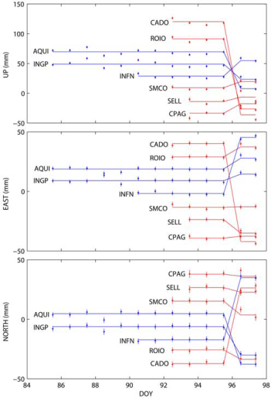
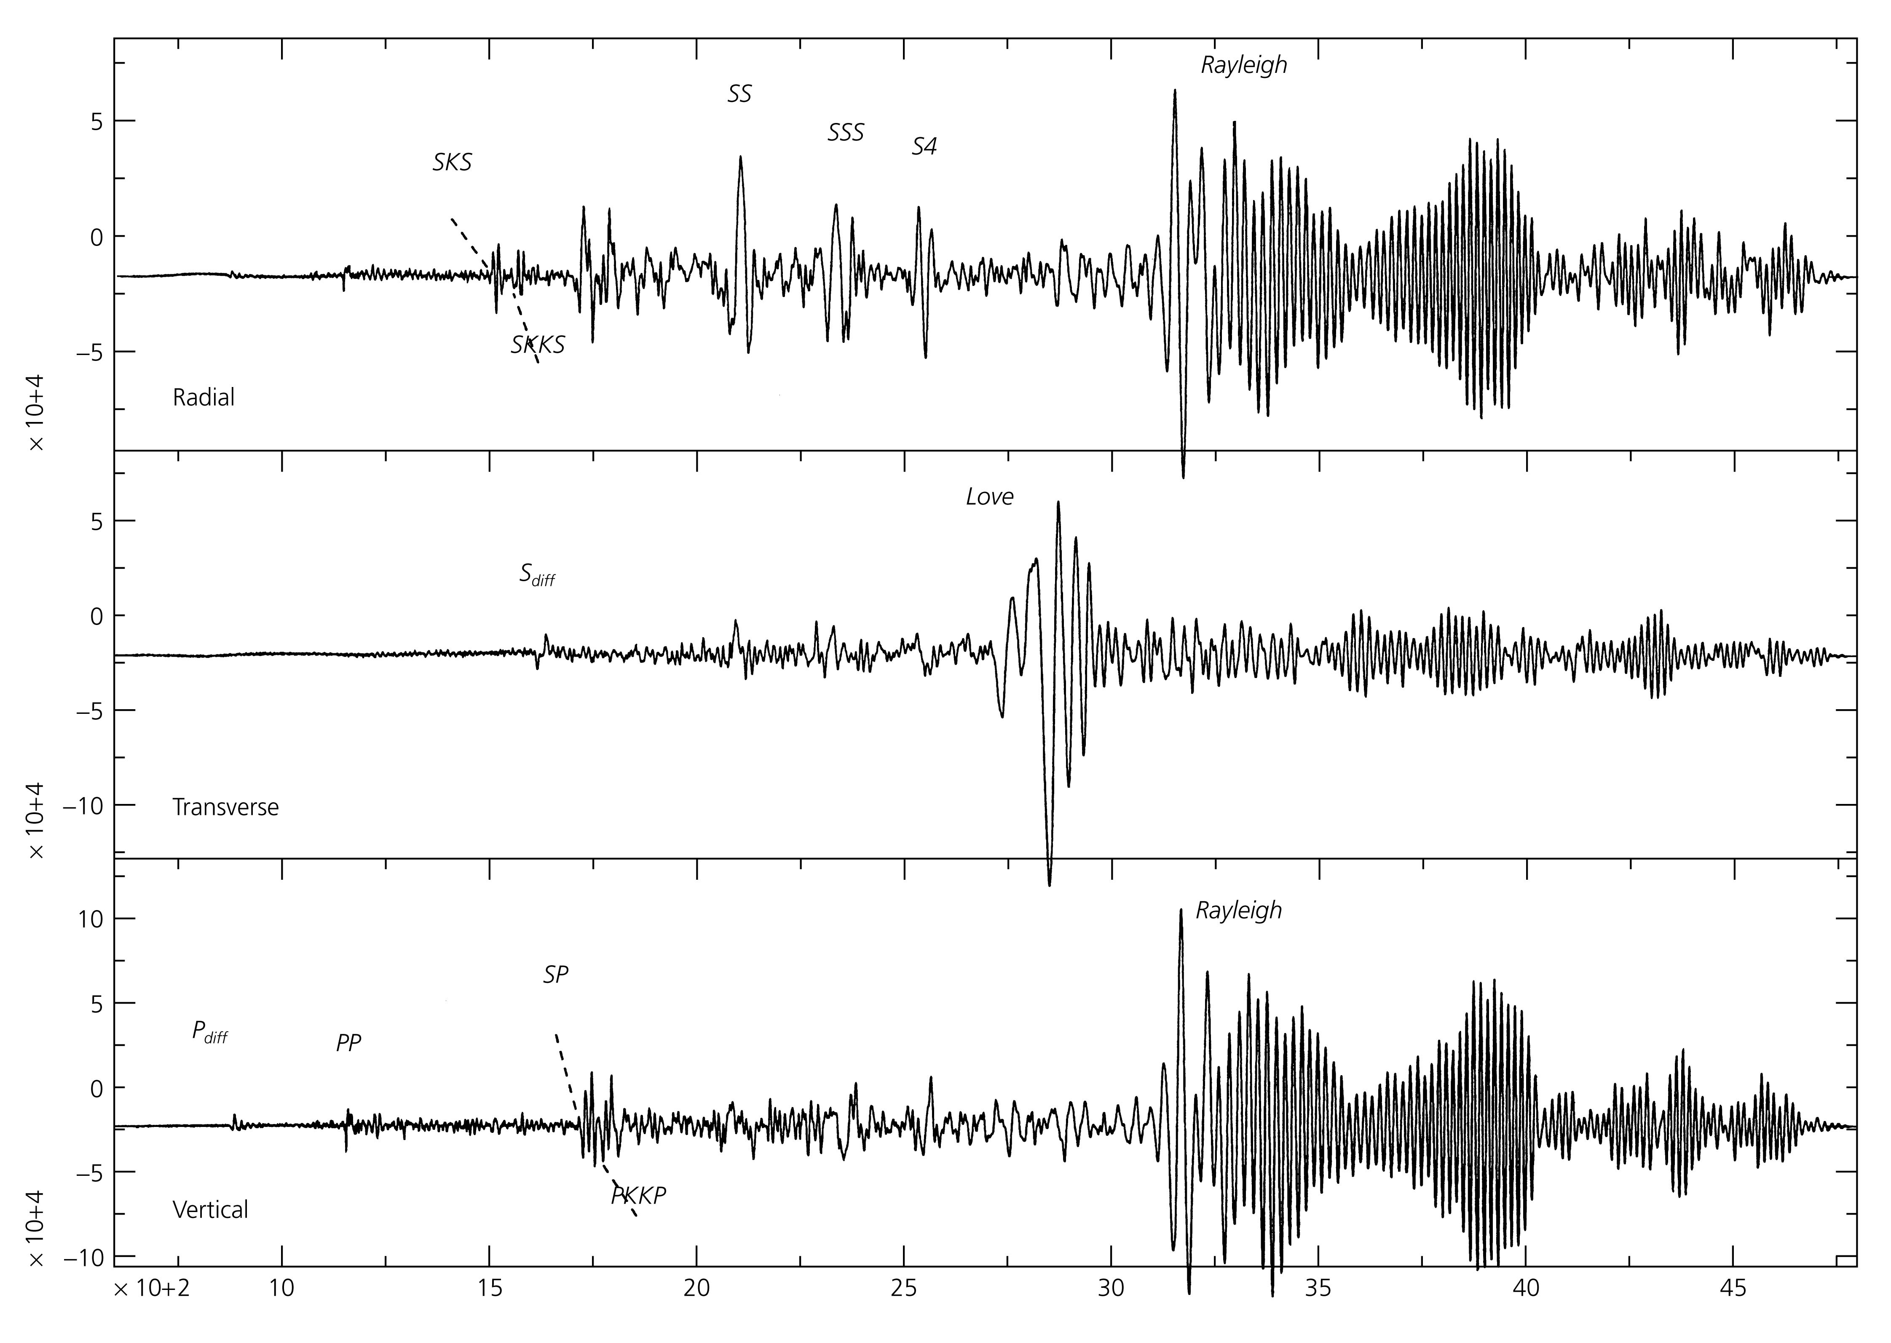
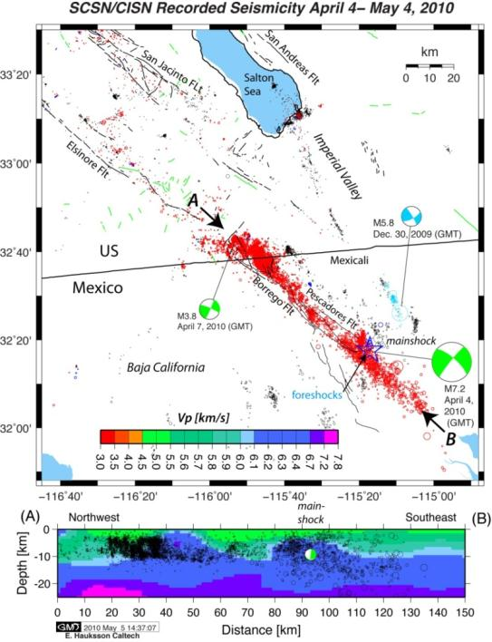
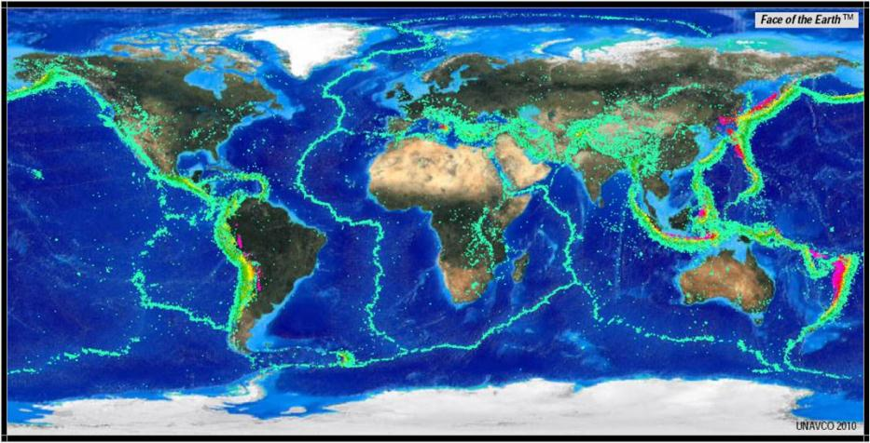
Traditionally we learn about events of the past from:
instrumental data

Slide 6
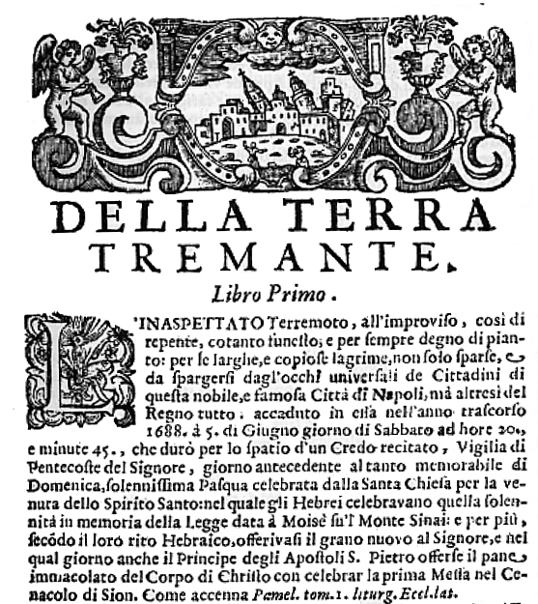
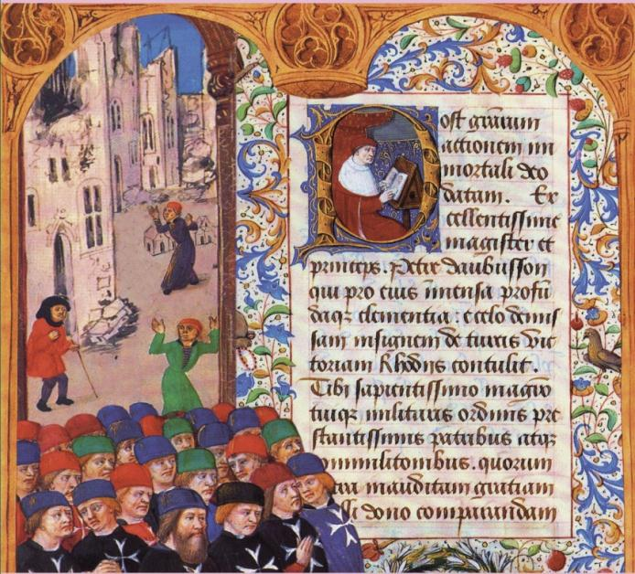
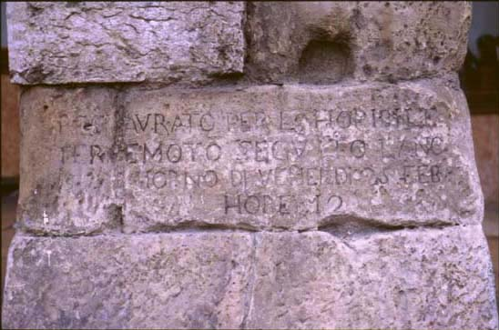
Traditionally we learn about events of the past from:
instrumental data
historical records

Slide 7
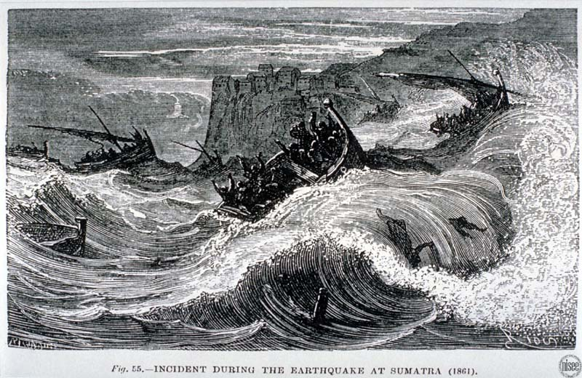
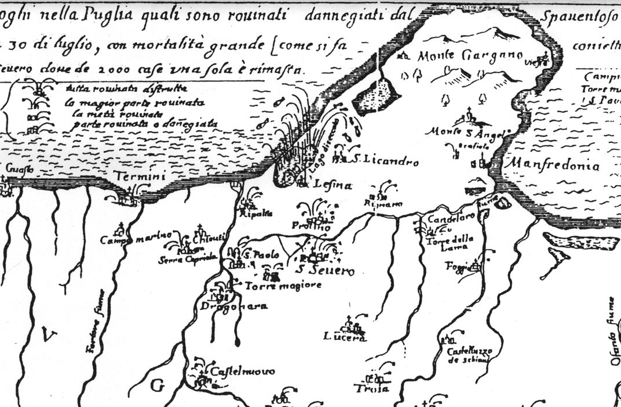
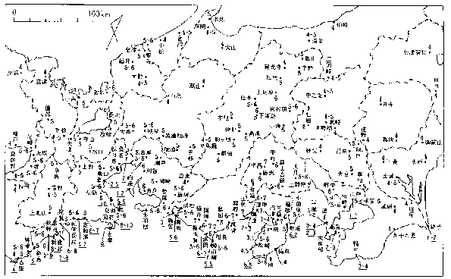
Traditionally we learn about events of the past from:
instrumental data
historical records

Slide 8
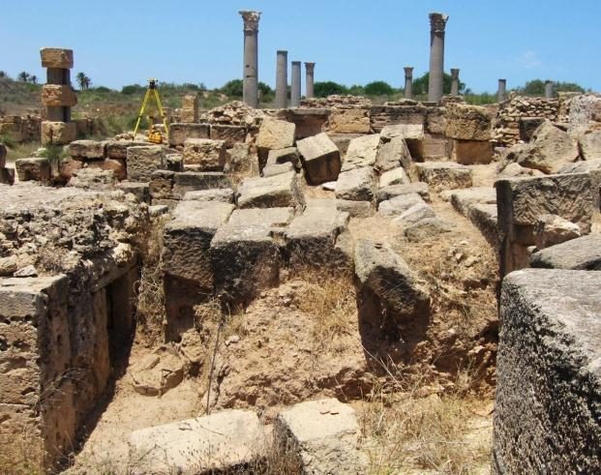
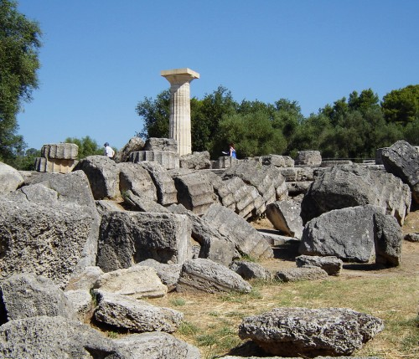
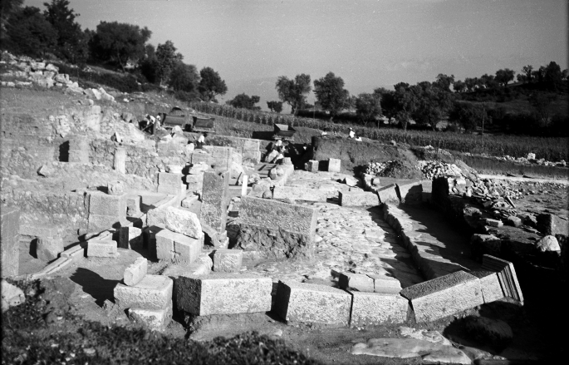
Traditionally we learn about events of the past from:
instrumental data
historical records
archaeology
Leptis Magna
Alba Fucens
Olympia

Slide 9
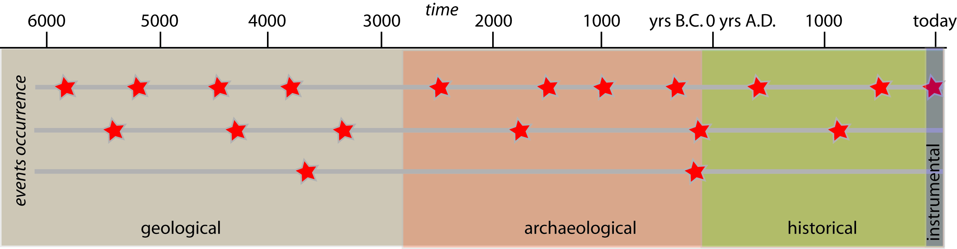
Time windows of records vs. occurrence of large events
(earthquakes and tsunamis)
geology has a larger chance
1. to preserve the record of several events even with
long average recurrence time
2. to associate earthquakes of the past with
their actual source

Slide 10
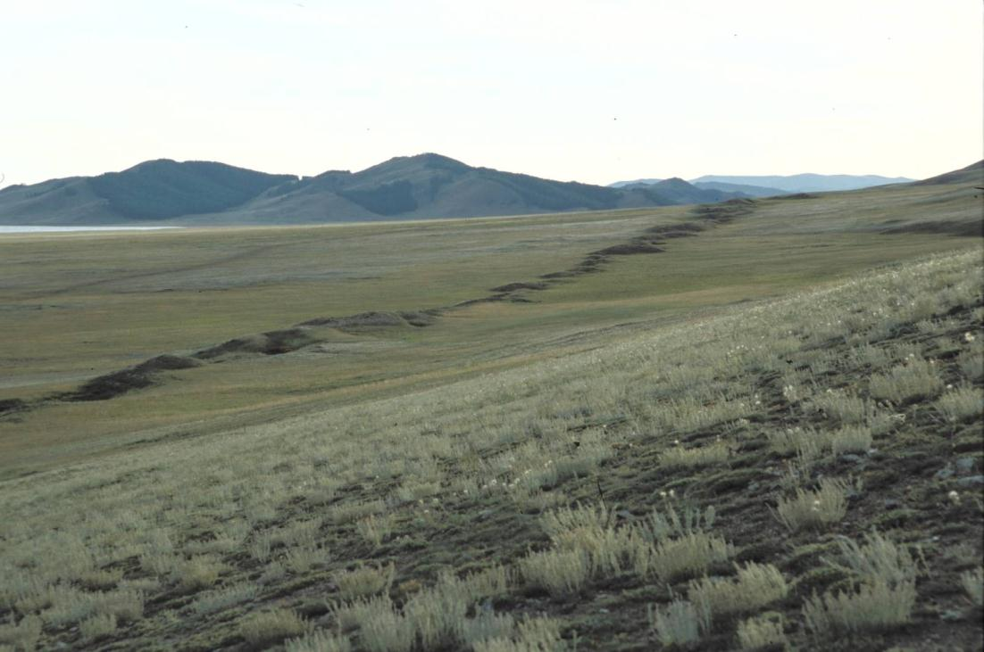
The starting point to use geology to define earthquakes of the past is the observation that large and moderate earthquakes produce permanent effects on the natural environment (i.e. earthquake geological records).
Bulnay earthquake, 1905

Slide 11
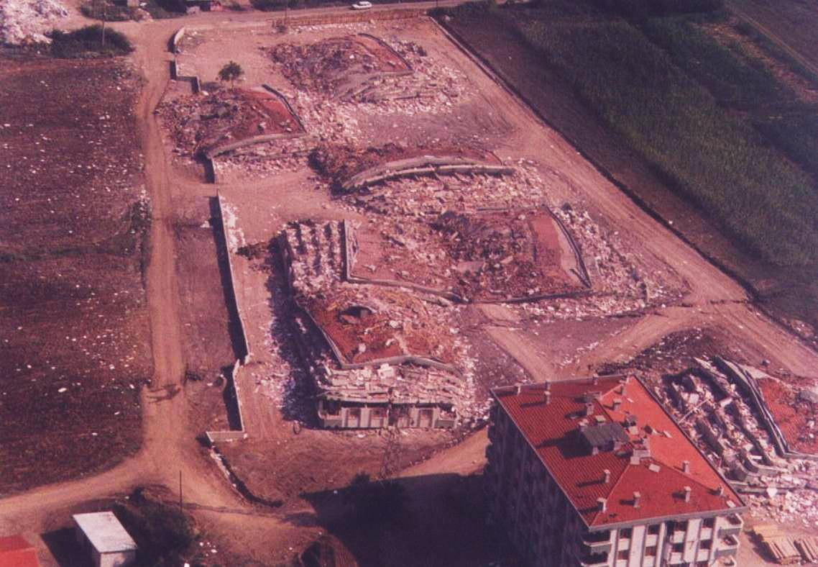
Izmit earthquake, 1999

Slide 12
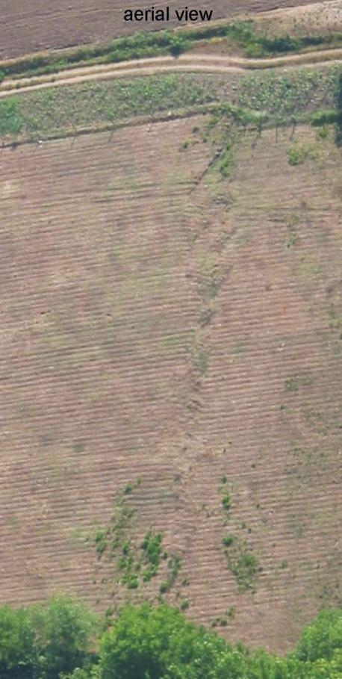
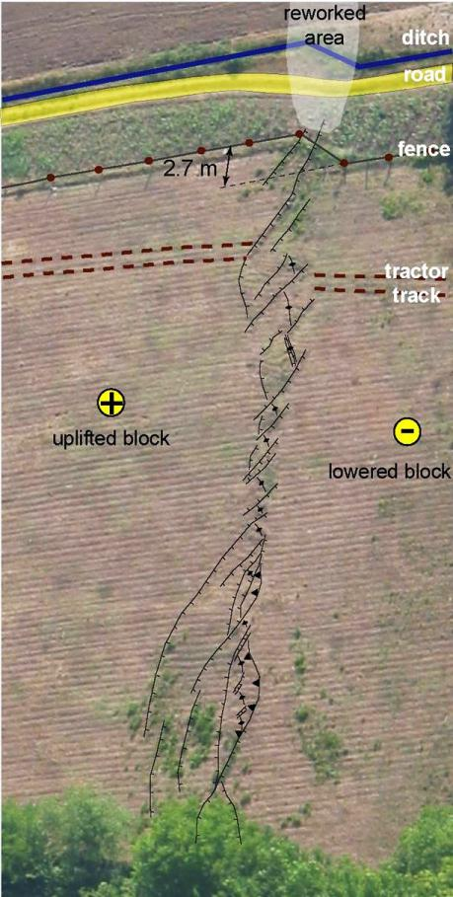
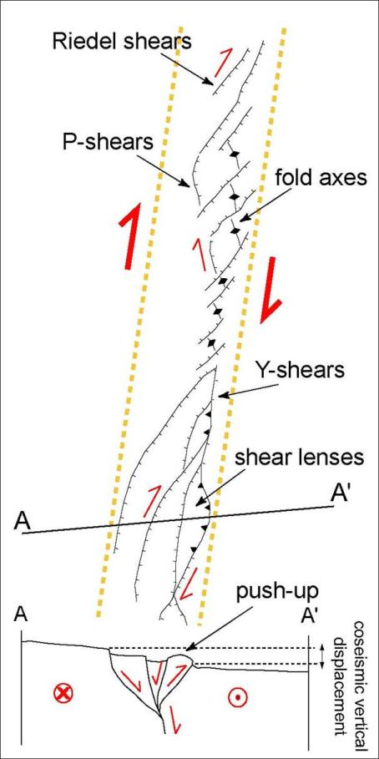
Duzce earthquake, 1999

Slide 13
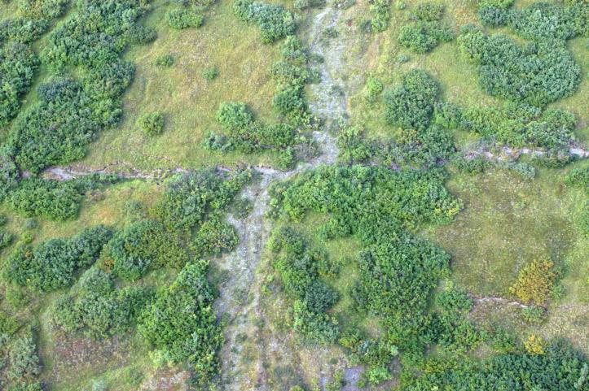
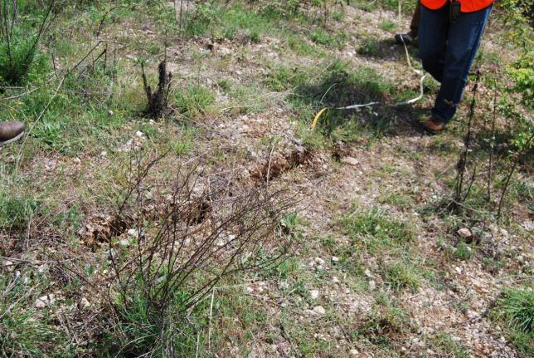
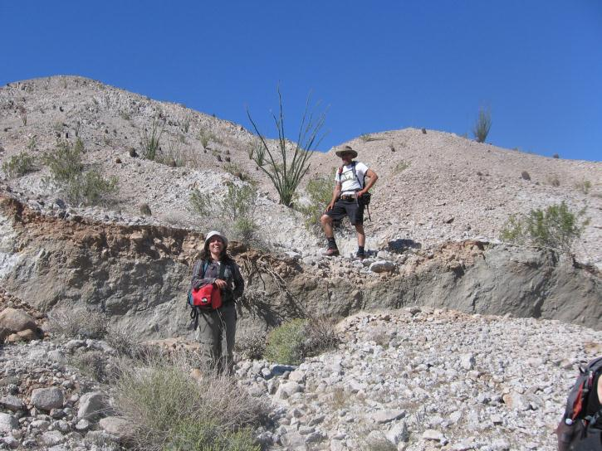
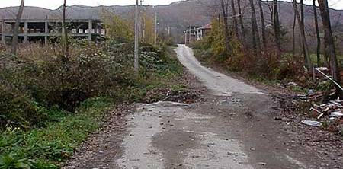
geometry, kinematics and strike

Slide 14
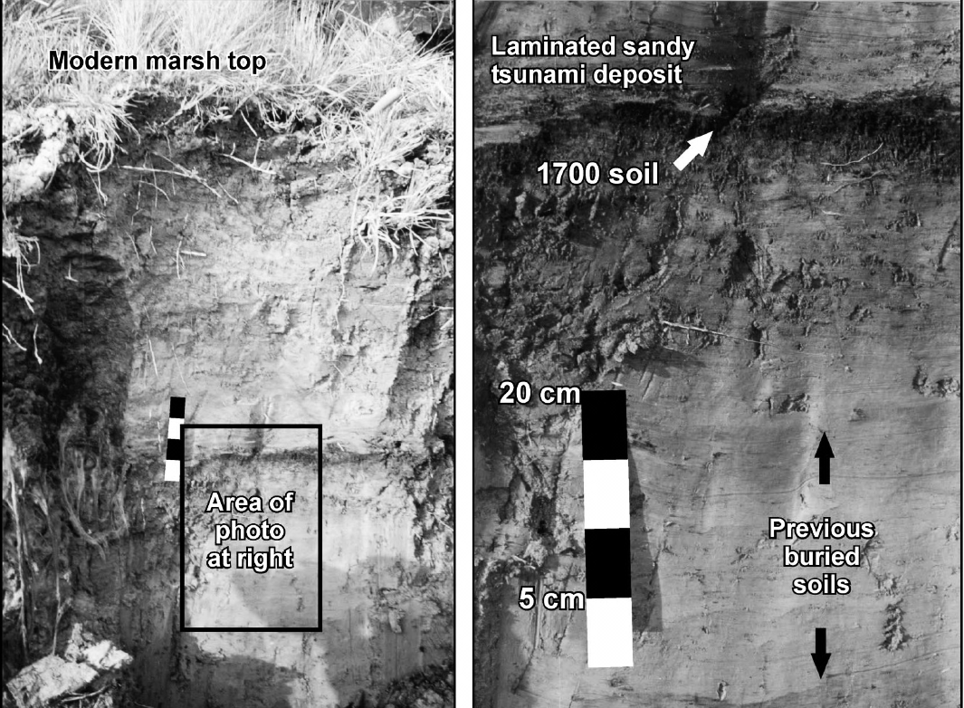
subsidence
Cascadia earthquake, 1700
Leonard et al., 2004

Slide 15
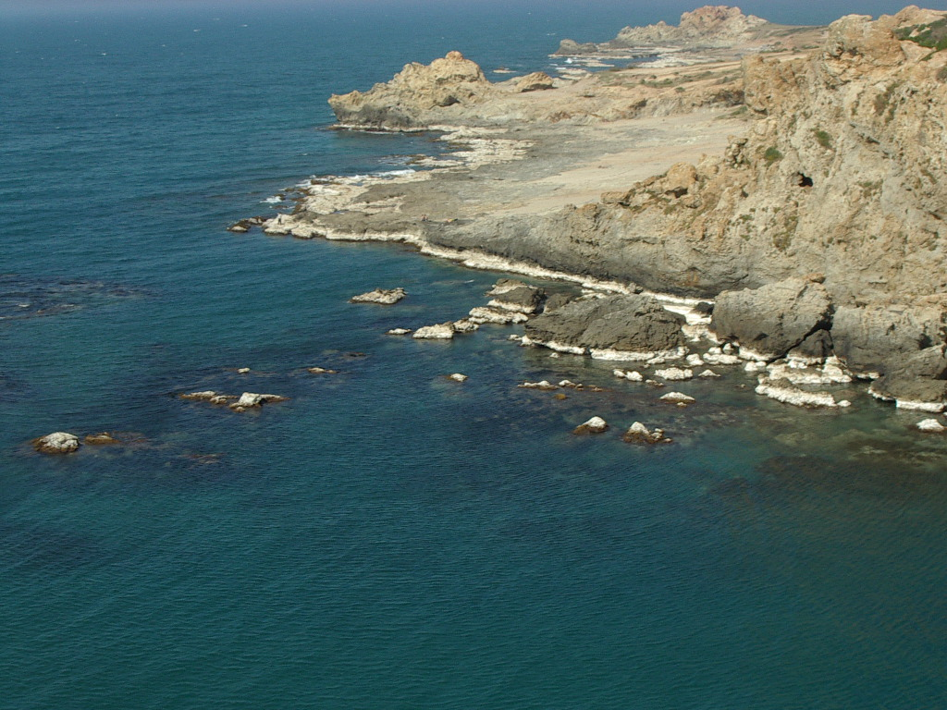
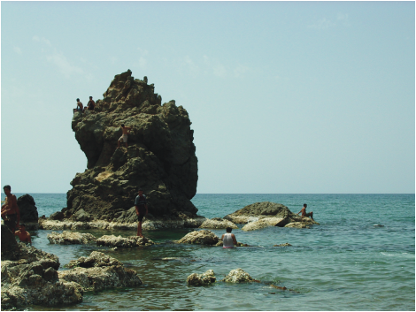
Uplift
Zemmouri earthquake, 2003
courtesy of M. Meghraoui

Slide 16
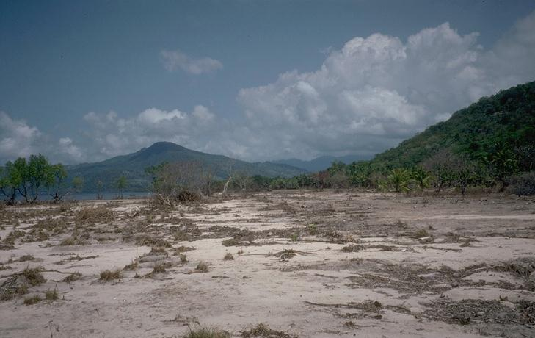
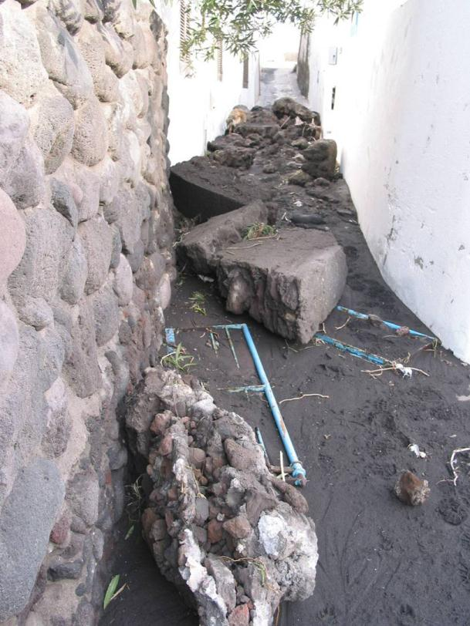
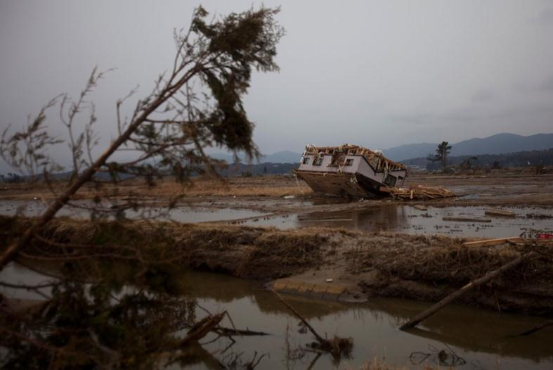
Tsunamis
Indonesia 1992
Stromboli 2002
Sendai 2011

Slide 17
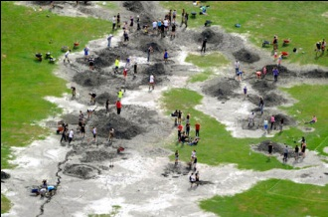
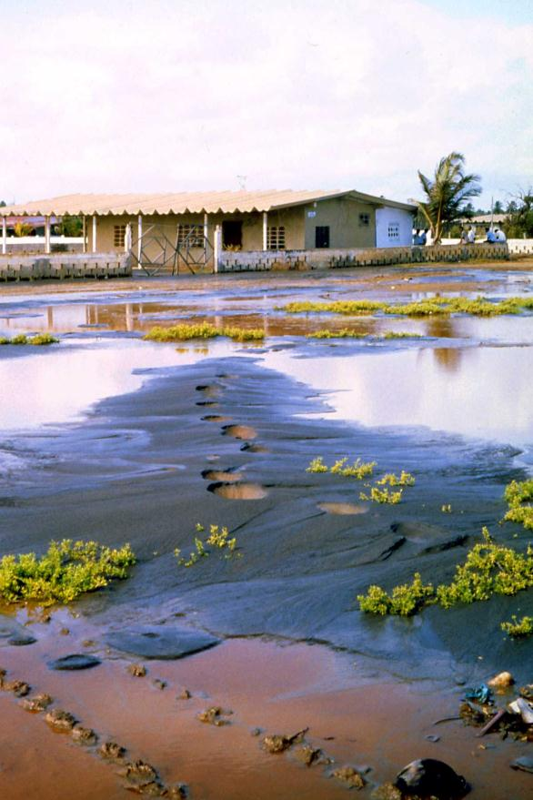
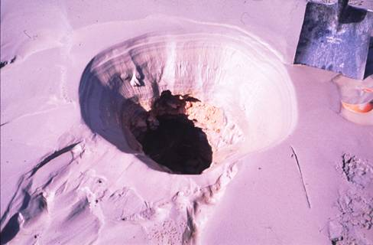
Liquefaction

Slide 18
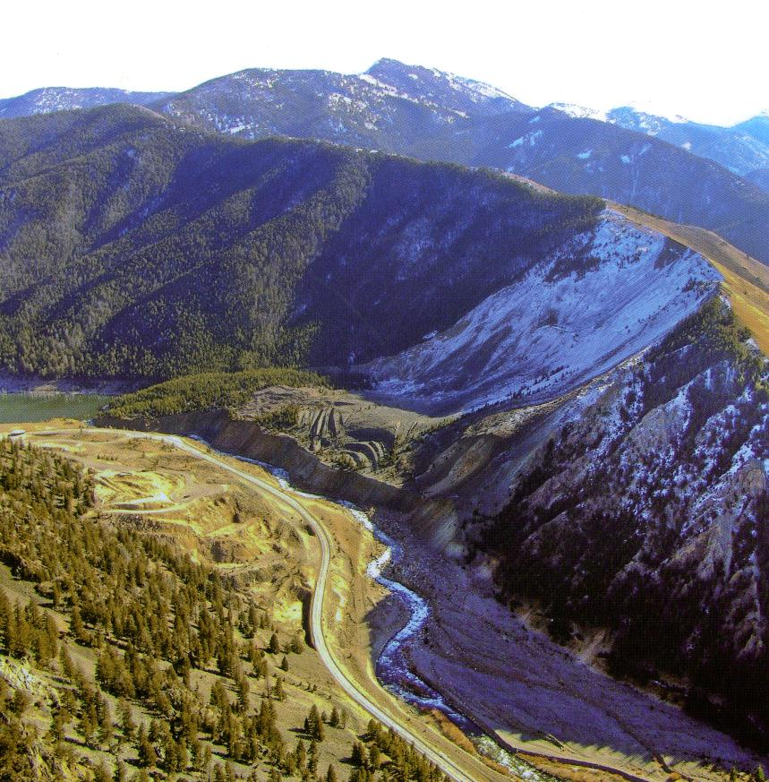
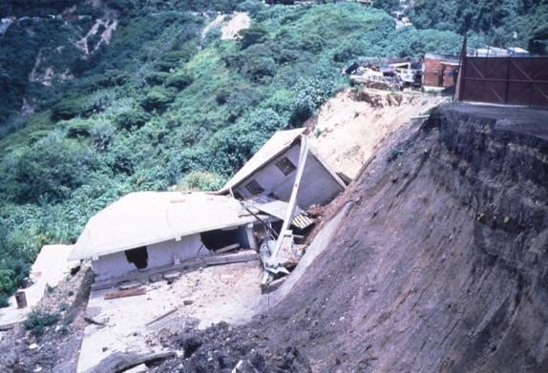
Landslides

Slide 19
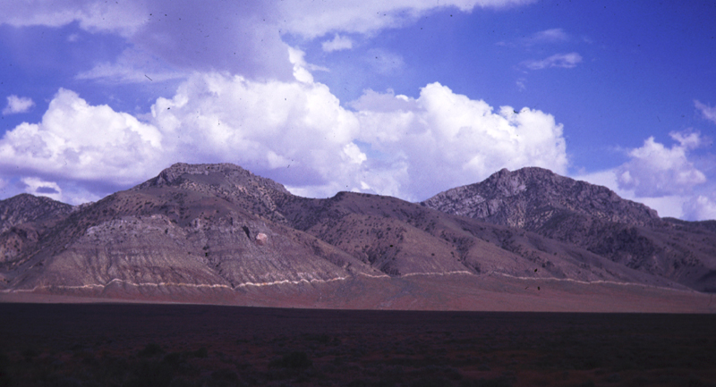

Earthquakes repeat along the same faults , their coseismic effects cumulate through time, and create geological structures.
These are the geological books we can read in search for the earthquakes of the past that concurred to their growth.
PALEOSEISMOLOGY
Pleasent valley (Nevada), 1915 eq.

Slide 20
Paleoseimology
is a young discipline, born about 30 yr ago
is highly multidisciplinary employing among the others geomorphology, stratigraphy, sedimentology, tectonics, geochronology, paleontology, geophysics, geochemistry etc.
Where, When, How Big?

Slide 21
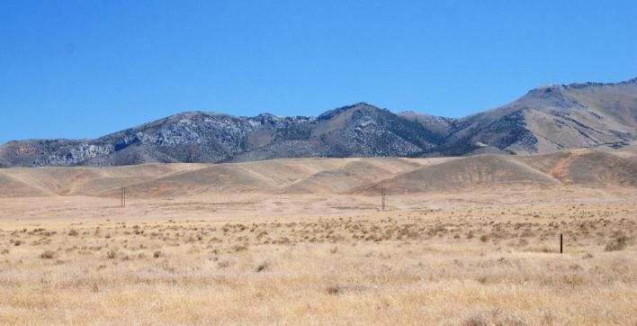
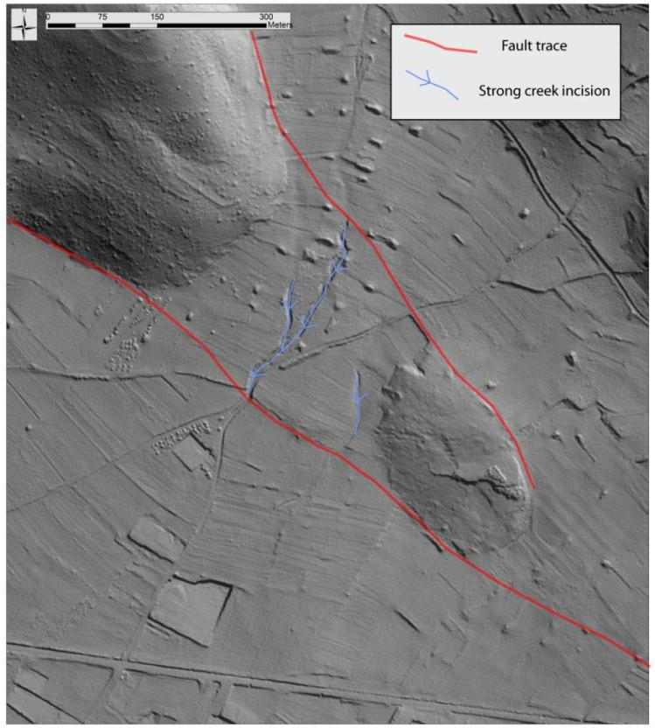
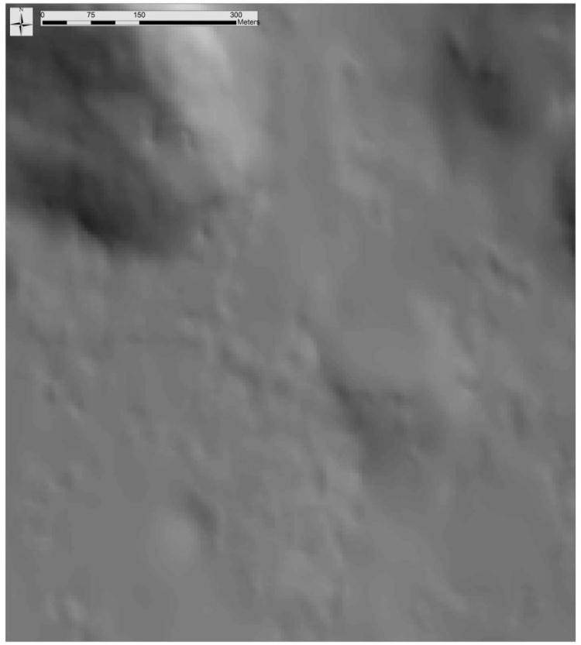
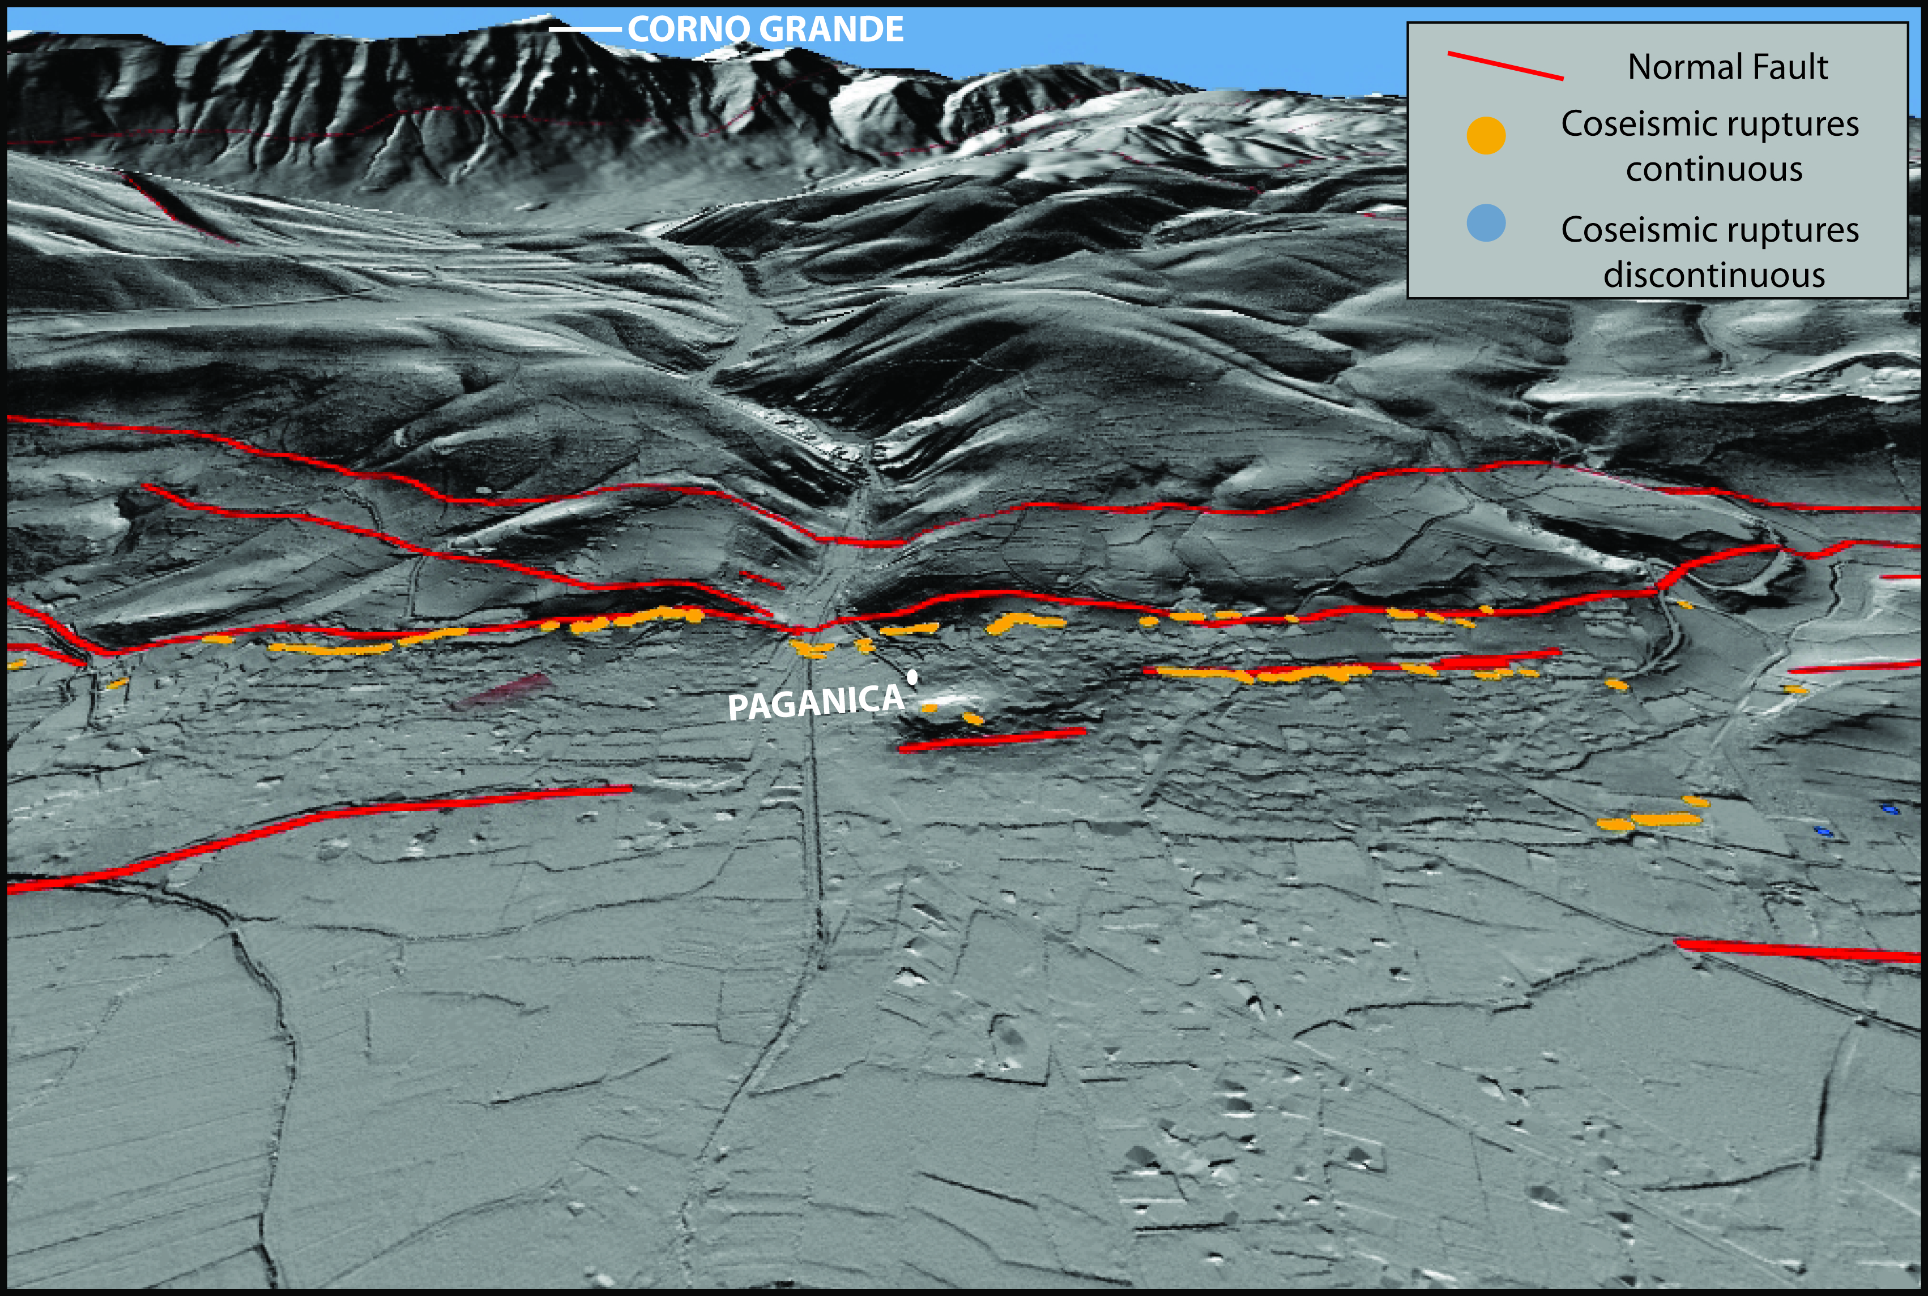
Where? How big?
Fault trace
Displaced Alluvial Fan

Slide 22
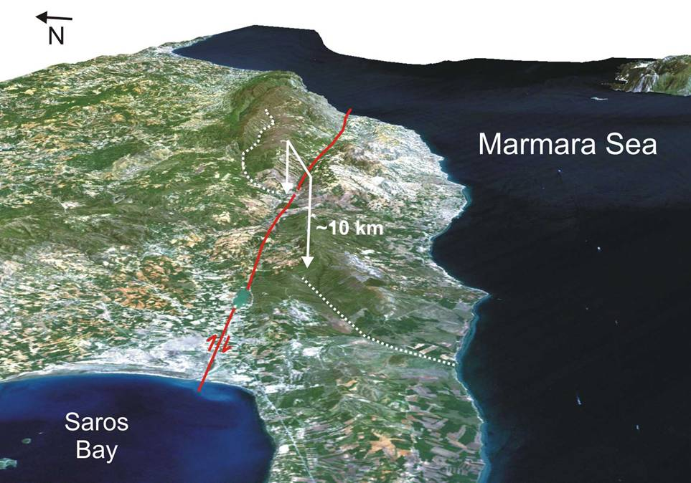
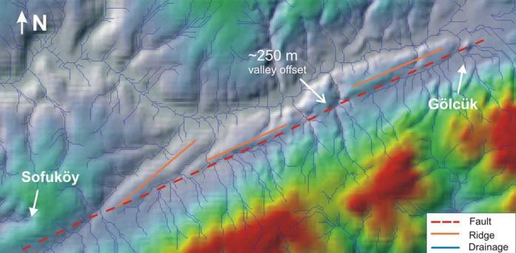
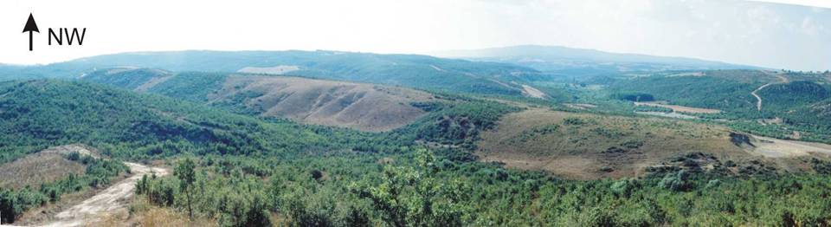
Where? How big?
Black Sea
Istanbul
NAFZ
N
the events we may face.
the events we may face.
Ganos fault

Slide 23
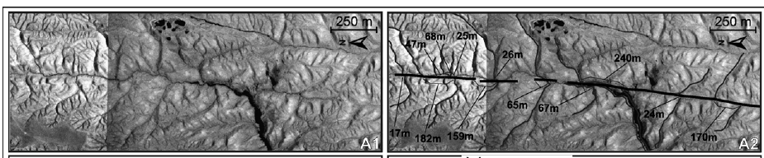
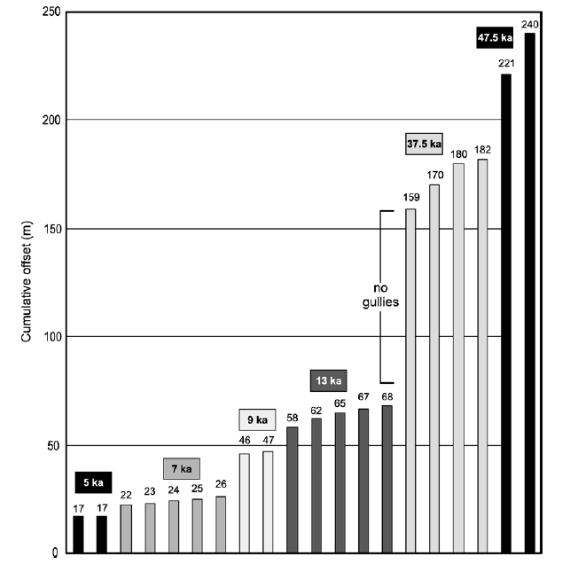
Where? How big?
Ferry et al, 2007

Slide 24
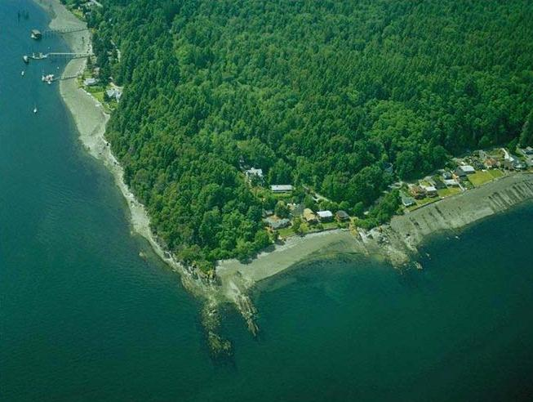

Where? How big?
LiDAR in forested areas – Puget Sound courtesy of J. McCalpin

Slide 25



Where? How big?
landslides
southern Bainbridge Island
courtesy of J. McCalpin

Slide 26



Where? How big?
High resolution resistivity profiling
High resolution seismic profiling
Very high resolution seismic profiling
(Bruno et al. 2010)
Improta et al.

Slide 27


Where? How big?
Offshore
Carboneras Fault, Alboran Sea
IBERIAN PENINSULA
IM-16
Adra F.Z.
Carboneras F.
(Gràcia et al., 2006; Muñoz et al., 2007; MediMap, 2008)
EAB
Al-Mansour F.
Yussuf F.
WAB
Al-Hoceima F.
Alboran Ridge F.
Notes:
The Carboneras Fault offshore (100 km long) was first mapped using swath-bathymetry, sidescan sonar TOBI and parametric echosounder during the HITS-2001 cruise (Fig. 1). We imaged seafloor ruptures, deflected channels, pressure ridges, water gaps and push-ups, typically found on active transpressional fault systems. The observed segmentation allowed us to know that the fault is capable of generating up to Mw 7.4 earthquakes (Gràcia et al., 2006).

Slide 28

Where? How big?
Offshore
Carboneras Fault, Alboran Sea
NW-SE
(Moreno et al., in prep.)
TWTT (s)
81
Notes:
The Carboneras Fault offshore (100 km long) was first mapped using swath-bathymetry, sidescan sonar TOBI and parametric echosounder during the HITS-2001 cruise (Fig. 1). We imaged seafloor ruptures, deflected channels, pressure ridges, water gaps and push-ups, typically found on active transpressional fault systems. The observed segmentation allowed us to know that the fault is capable of generating up to Mw 7.4 earthquakes (Gràcia et al., 2006).

Slide 29

When? How big?
Trenching

Slide 30


Slide 31

Borah Peak 1983 colluvial wedges
When? How big?
... and previous one

Slide 32


When? How big?
increasing displacement
with depth
displacement 1
displacement 2

Slide 33


When? How big?
time
Irpinia fault
5 events in 6500 yr

Slide 34


When? How big?
exceptionally long sequence of surface faulting events:
10-13 events in 12 kyr
Daeron et al., 2007

Slide 35


When? How big?
Wairau Fault
Vernon Fault
Courtesy of P. Barnes

Slide 36



When? How big?
Vertical Displacement History
Wairau
Fault
Courtesy of P. Barnes

Slide 37


When? How big?
Repeated subsidence events
Hagstrum et al., 2004

Slide 38








repeated footwall uplift events
Palyvos et al. 2007

Slide 39


When? How big?
Repeated liquefaction events
Courtesy of Marco

Slide 40



When? How big?
paleotsunami deposits research

Slide 41


When? How big?
paleotsunami deposits research
Notes:
cores investigations more detailed

Slide 42




paleotsunami deposits research
Augusta site
clay to silt deposits with few gravel and bioclastic layers

Slide 43













OPR-S11 core
Priolo site
X-Ray
high energy event with a marine inlet
PR 01
high energy event
(few reworked forams)
PR 02
lagoonal environment

Slide 44


Physical and chemical properties

Slide 45

Dating
When?
Isotopic methods are the most commonly used
Radiocarbon
Cosmonucleides
K/Ar
U series
Pb210 and Cs137
But also
Tephrochronology
Magnetostratigraphy
Lichenometry
Dendrochronology
Archaeology
event 2
event 1

Slide 46



Dating
When?
radiocarbon
AMS 20 mgr
conventional 10-100 gr

Slide 47


Dating
When?

Slide 48

Dating
When?
Repeated tsunami inundations
in the Augusta bay from
Smedile et al. 211

Slide 49
Levant fault, Lebanon
Dearon et al 2007
average recurrence time:1127±135 yr

Slide 50
Dating
When?
Repeated fault damming
Events in Hokuri Creek NZ
Berryman et al. In prep

Slide 51
What we learn from paleoseismology
about Where, When, How Big?
.

Slide 52
Seismogenic Parameters derived from paleoseismology
Elapsed time: time elapsed since the most recent event
Inter-event intervals: time elapsed betwen two subsequent
events
Average recurrence time: average interevent period calculated
over a number of cycles or from other parameters
Slip-rate: is a measure of the fault activity (net cumulative
slip/time)
Slip per event: net slip occurred during an event (min, max, avg)
Max rupture length: potential length of rupture in a single event
M: generally obtained from empirical relations (M vs. length or Avg. slip)

Slide 53




Seismogenic Parameters derived from paleoseismology

Slide 54


Segmentation Models
!
Gracias!

Slide 55

Segmentation Models
Armijo, et al 2005

Slide 56


Surface faulting hazard
April 6, 2009
Emergeo, 2009

Slide 57

Ground Motion simulations
M₀ [Nm] | L x W [km] | strike | dip | rake | Vr [km/s] | rise time τ [s]
~4.10¹⁸ | 22 x 12 | 135° | 42° | 270° | 2.2 | 1
Sulmona alluvial basin
seismic source M_{W}6.4
Stupazzini et al 2009

Slide 58





Ground Motion simulations
Sulmona town
L1
2
1
3
hypocenter 2
hypocenter 1
hypocenter 3
_{m/s}
Stupazzini et al 2009

Slide 59


Recurrence Models
Can we use a quasi-periodic recurrence???
Stress Loading
Stress Loading
Stress Loading
Stress Loading
EQ
EQ
EQ
EQ
Time
How much more more
noisy is the
System?

Slide 60
Introducing memory in SHA
Poissonian
Time-Dependent
Pace et al. 2007

Slide 61

Paleoseismological Catalogue of Italy since 19Kyr – 56 records
Galli et al. 2008

Slide 62
Learning process
experience
experience
observation
observation
conceptualization
conceptualization
application
There is an incredible potential to learn more about future hazards from geology
Notes:
esempio bibmo che si brucia il dito toccando la pentola calda. tocco l a pentola, mi faccio male perche’ mi brucio, se tocco mi brucio, uso un panno per prendere la pentola .
Because natural events are so variable,

Slide 63
But we have to decipher more “geological” books
i.e., more data gathering!
Thank You!
Pleasent valley (Nevada), 1915 eq.

