Slide 1
The reliability of a natural hazard system
ESF Research Conference Understanding Extreme Geohazards: The Science of the Disaster Risk Management Cycle
M. Khaleghy Rad
S.G. Evans
Natural Disaster Systems Research Group, Department of Earth and Environmental Sciences, University of Waterloo, Ontario,CANADA
Van Earthquake, Turkey, 2011 (Baz Ratner/Reuters)

Slide 2
Outline
What is Risk?
Societal Risk Assessment, FN-curves
What is reliability?
Earthquake example
Reliability-based criteria
Discussion

Slide 3
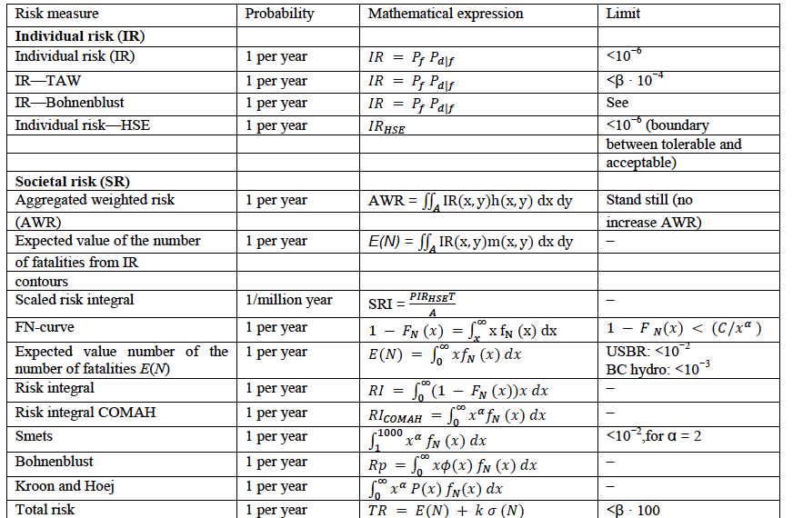
What is Risk?
Deterministic View
Prediction of losses
Probabilistic View
Uncertainty of the prediction of losses
Jonkman et al. (2003)

Slide 4
Risk in different discipline
Landslide risk assessment
Engineering
Flood risk assessment
Chemical risk assessment
Risk: An expression for the danger that undesirable events represent for humans, the environment(ecosystem) or material values. Risk is expressed as the probability and the consequences of undesirable events.

Slide 5
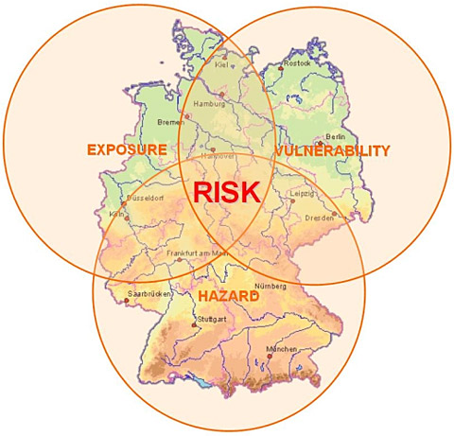
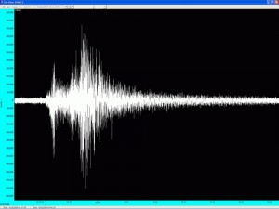
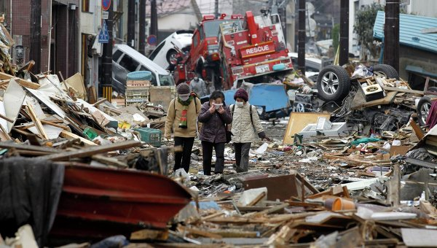
Conceptual Model

Slide 6
Main goal of risk assessment?
1) Criteria for a further assessment!
2) Prediction of loss for mitigation and early warning

Slide 7
Societal Risk Assessment (Industrial basis)

Slide 8
F-N based Criteria
Acceptable risk compared to earthquake disasters : 2 orders of magnitude difference too conservative!
Nishenko & Barton (1994)
Hungr & Wong (2007)

Slide 9
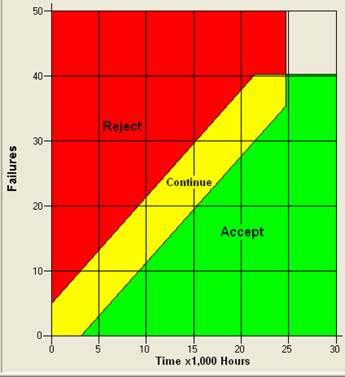
What about Reliability!?
Reliability: The ability of a system or a component to perform its required functions under stated conditions for a specified period of time
higher failures in time => less reliable system
Risk and Reliability are brothers!

Slide 10
Reliability
Probability that a system will perform well in a period of time.
f(x): failure probability density function
time (t) captured in resistance (r)
Resistance
defined resistance
Notes:
Cumulative distribution function of the system

Slide 11
Reliability
In natural disaster context:
The higher the resistance the lower the losses
Reliable: No losses due to a natural disaster
Our refined definition: complementary cumulative distribution function of a certain Resistance

Slide 12
Is it applicable?
Global earthquake disaster system as an example!
What is needed?
failure probability distribution function, f(r)
Resistance distribution function

Slide 13
Earthquake Example
To Calculate Resistance:
1) Hazard: Yearly earthquake occurrence; Poisson distribution (independent in time)
2) Past losses: Earthquake disaster life loss (earthquakes with more than 1,000 fatalities)
3) Exposed Population : Population of the world at the year of event as a proxy

Slide 14
Reliability Criteria!
1000 | 1.63E+06 | 0.7805
2000 | 8.15E+05 | 0.68355
3000 | 5.43E+05 | 0.61958
4000 | 4.07E+05 | 0.57199
5000 | 3.26E+05 | 0.5343
6000 | 2.72E+05 | 0.50326
7000 | 2.33E+05 | 0.47699
8000 | 2.04E+05 | 0.45431
9000 | 1.81E+05 | 0.43443
10000 | 1.63E+05 | 0.41678
11000 | 1.48E+05 | 0.40096
12000 | 1.36E+05 | 0.38666
13000 | 1.25E+05 | 0.37363
14000 | 1.16E+05 | 0.3617
15000 | 1.09E+05 | 0.35071
16000 | 1.02E+05 | 0.34054
15,839 fatalities from 2011 Tohoku earthquake alone!
Death/ExpPop:10⁻⁶

Slide 15
Discussion
Reliability criteria?
Reliability Plus FN-criteria!
Normalization Plus Reliability!
Individual Plus Societal Plus….
Special thanks to ESF for conference travel grant

Slide 16
Other Criteria!
Hagon, 1984
Porske, 2008
Hagon, 1984

Slide 17
FN curves and Natural Hazards
FN diagrams: industrial risk assessment tool since 1960s
log-log plots: F cumulative annual frequency of N or more consequences versus the value of consequences
Useful for comparative risk assessment
Fatalities: consequence of Natural Hazards

