Slide 1
Rapid Source Inversion using GPS and Strong-Motion Data
-
A case Study on the 2011 Mw 9.0 Tohoku-Oki Earthquake
R. Wang, S. Parolai, M. Ge, M. Jin, T.R. Walter, J. Zschau
Helmholtz Centre Potsdam
GFZ German Research Centre for Geosciences
wang@gfz-potsdam.de
ESF-COST High-Level Research Conference
27 November - 2 December 2011
Sant Feliu de Guixols, Spain

Slide 2
Introduction
Near-field ground-motion information
Strong constraint on fault size and rupture distribution
Less sensitive to earth structure than teleseismic data
⇒ Most useful for early warning and rapid response systems
Strong motion data
Real-time, simple data processing
Fine resolution at high frequencies
Baseline errors
High-rate GPS data
Near real-time
High accuracy at low frequencies
Large noise at high frequencies
This study:
Comparison of GPS and strong-motion derived co-seismic displacement
Comparison of strong-motion and high-rate GPS records
Joint use of GPS and SM data for rapid source inversion

Slide 3
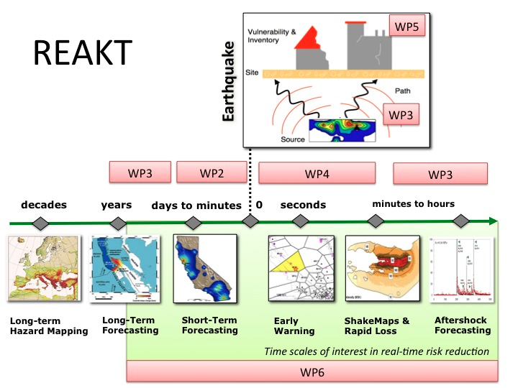
Strategies and Tools
for Real Time Earthquake Risk Reduction
From description of the REAKT project (2011)

Slide 4
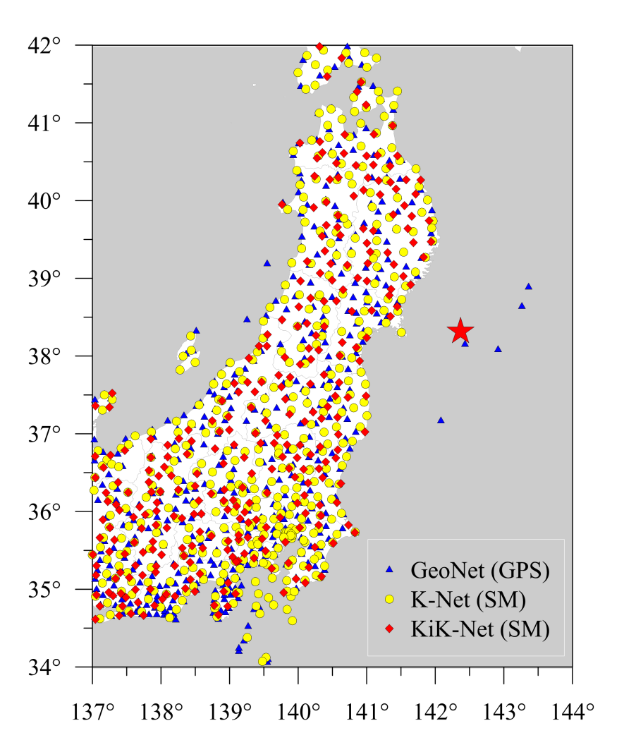
Japan has one of the densest geodetic and seismic networks of the world:
GeoNet
~ 1,200 permanent GPS stations
F-Net
84 broadband stations
Hi-Net
777 high-sensitivity borehole
seismic stations
K-Net
~ 1,000 strong-motion stations
Kik-Net
777 strong-motion stations (co-
installed with Hi-Net), each with
both surface & borehole sensors
(more details see: www.bosai.go.jp)
Data used in this study

Slide 5
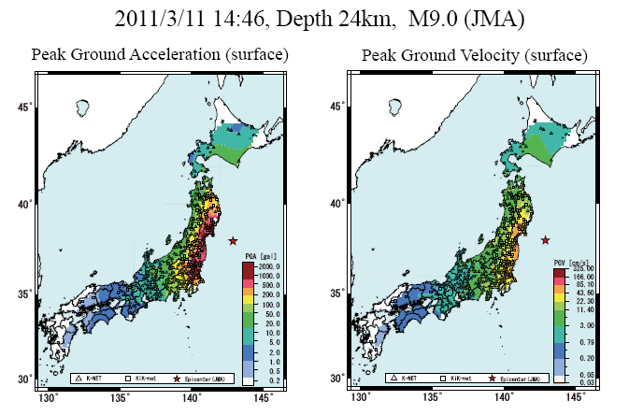
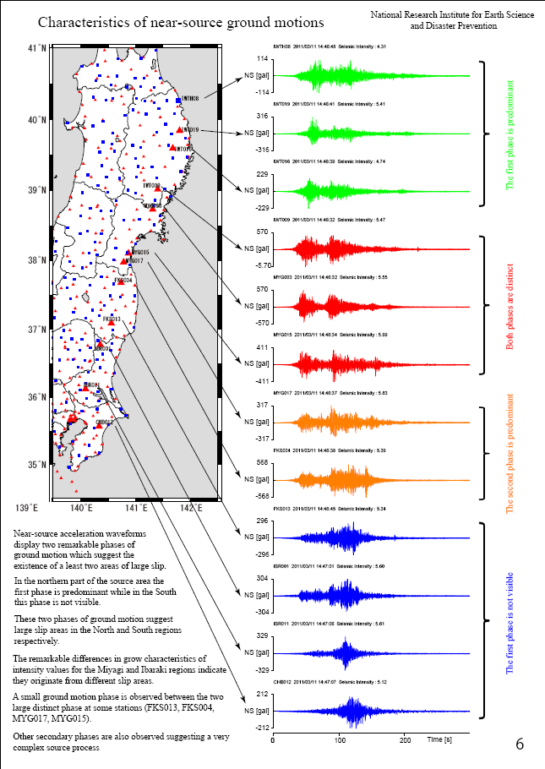
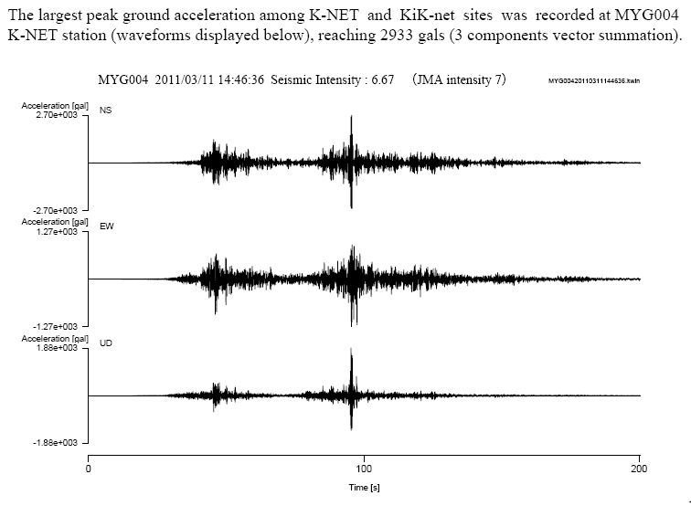
The 2011 Mw 9.0 Sendai (Japan) earthquake
PGA ~ 3g!
From the NIED report (2011)

Slide 6
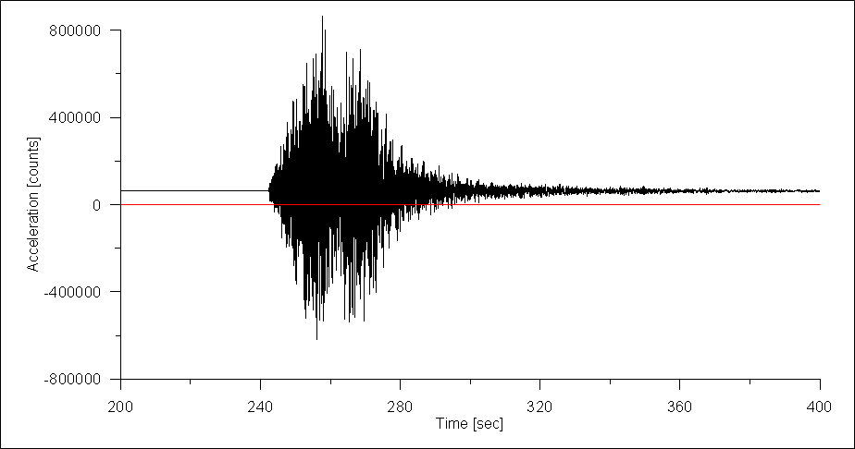
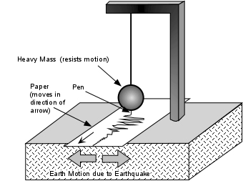
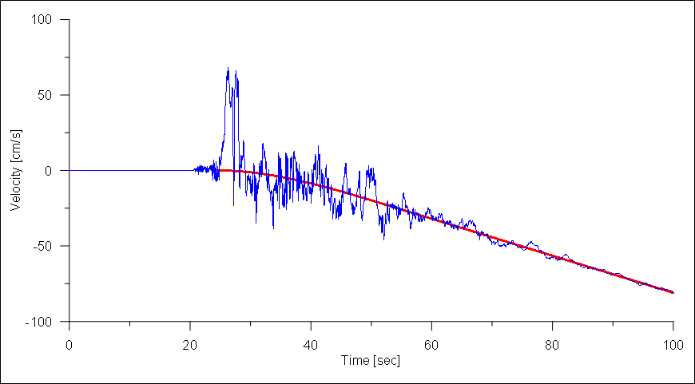
Baseline errors of digital strong-motion records
Dominantly by shaking induced ground tilt, but also by
Instrumental effect
Original strong-motion data
with pre-event baseline offset
All seismic sensors with a spring-mass
system do not measure the ground
motion directly but gravity and inertial force acting on the sensor.
Velocity seismogram
(integrated from the strong-motion data after correction of the pre-event offset)
Drift due to
co- and post-event baseline shifts
Inertia
Tilt
Gravity changes

Slide 7
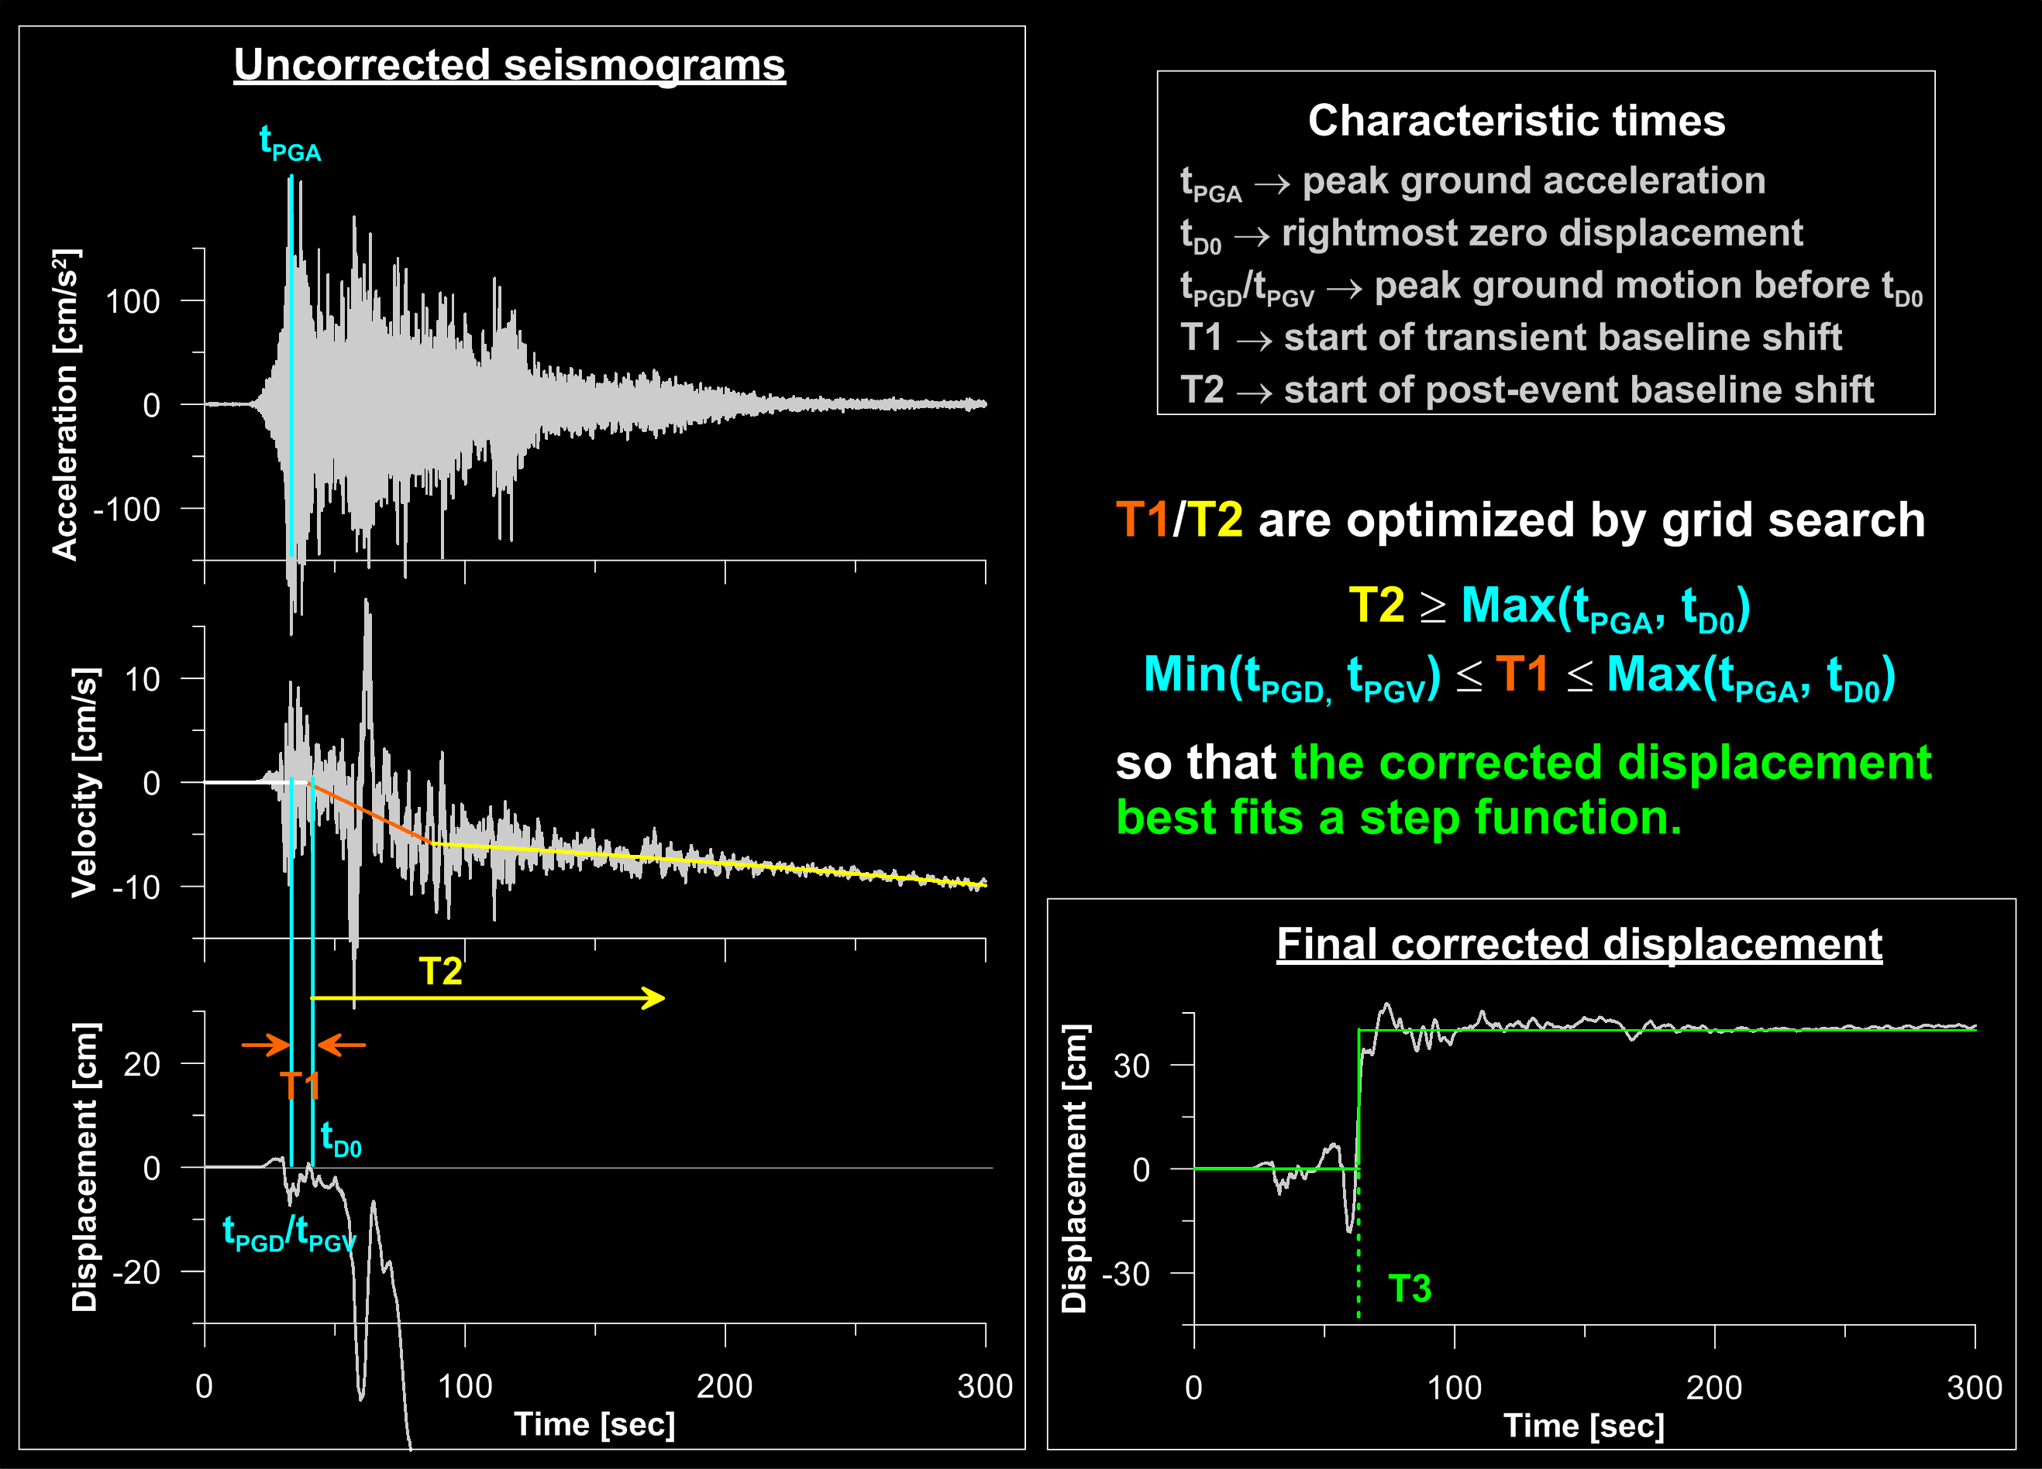
Empirical baseline correction based on Iwan’s idea
Wang et al. (BSSA, 2011)

Slide 8
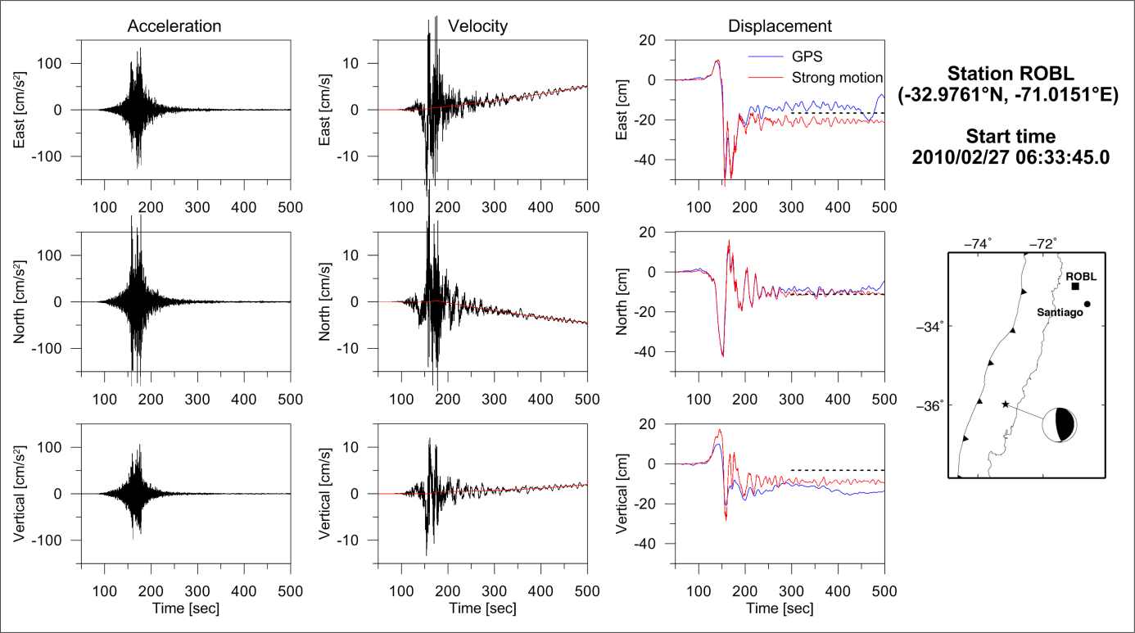
An example from 2010 Mw 8.8 Maule earthquake

Slide 9
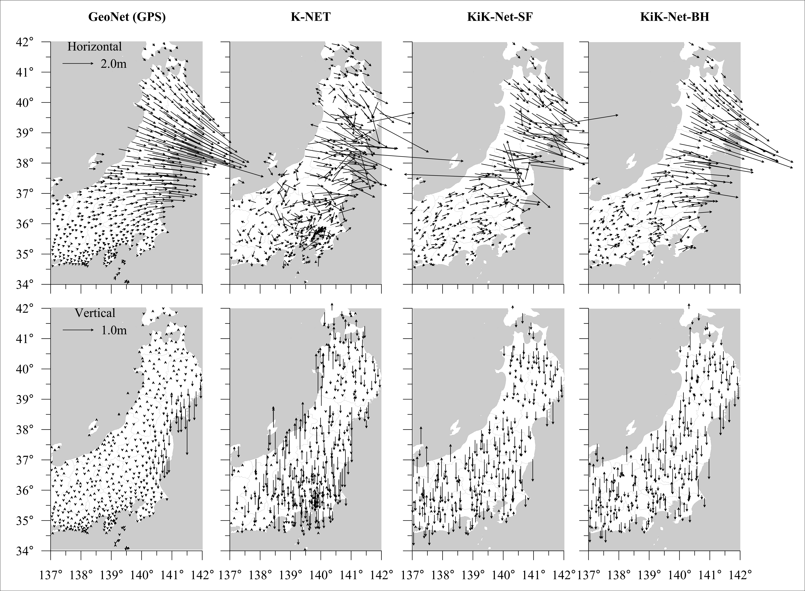
Comparison of coseismic static displacements
Comparison with GPS
K-Net: many stations on soft ground ⇒ large uncertainties
KiK-Net (surface): coherent spatial variability except for a few outliers
KiK-Net (borehole): most stable with less outliers

Slide 10
Source distribution
inverted from
GPS and SM-derived coseismic displacement data

Slide 11
SDM2008
A software code for slip inversion
based on the constrained least-squares method
⇔
Minimization of objective function by
Steepest Descent Method
Joint inversion of different datasets (d₁, d₂, …)
Green’s functions (M) based on layered half-space Earth model
Simultaneous determination of unknown offsets (d₁º, d₂º, …) included in the datasets
Optional slip (s) or stress-drop (τ) Smoothing (β) ⇒ weak constraint
A-priori conditions on slip amplitude and rake angle ⇒ hard constraint
Convex objective function ⇒ fast convergence to global minimum

Slide 12
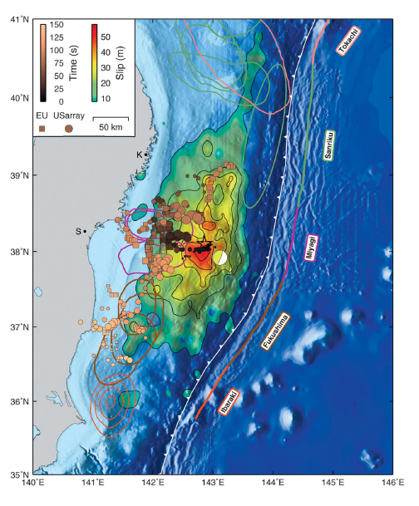
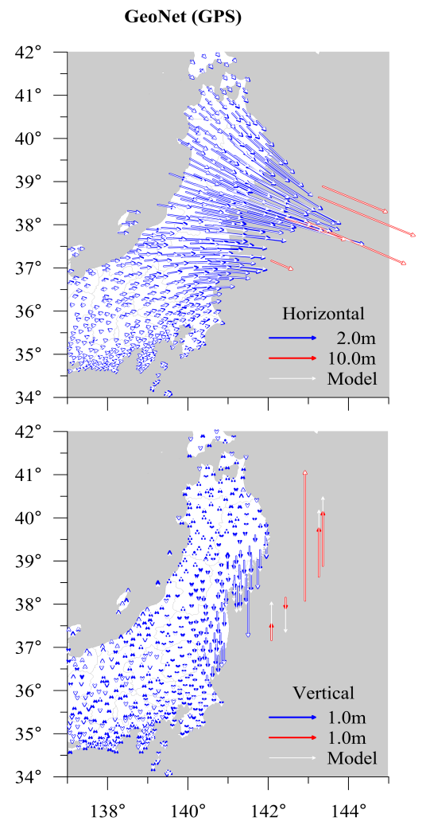
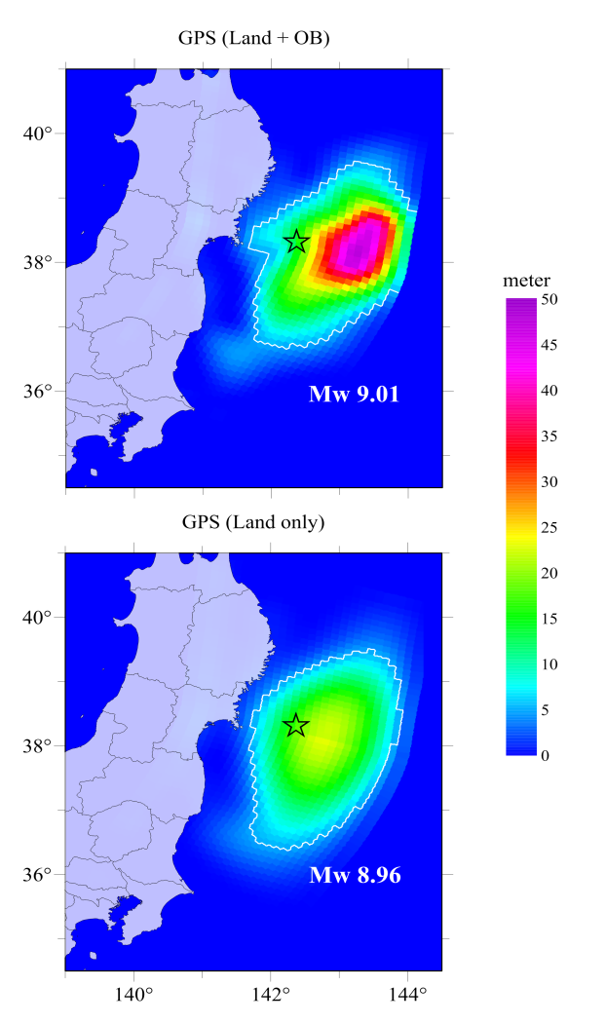
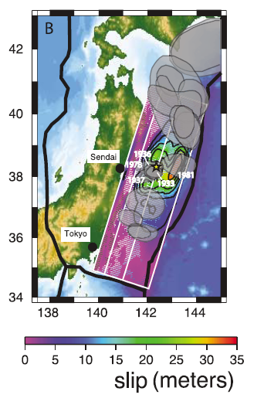
Geodetic slip models
This study
Simons et al. (2011)
Land GPS + Tsunami Data
Pollitz et al. (2011)
Land + OB GPS Data

Slide 13
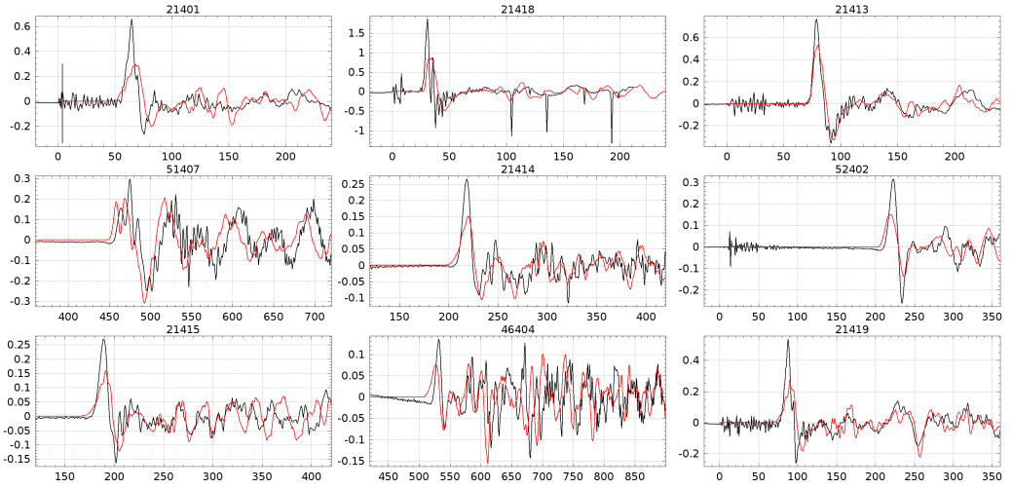
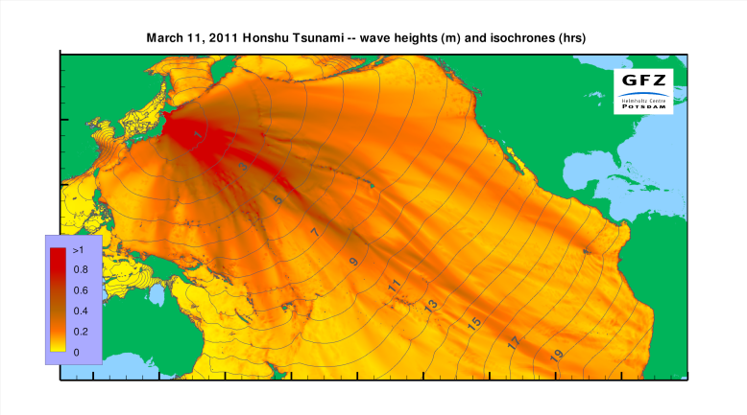
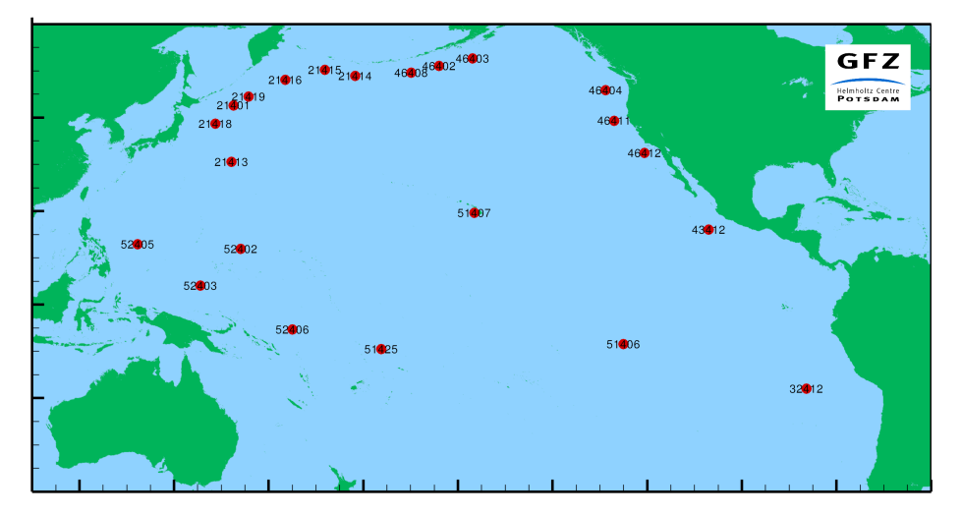
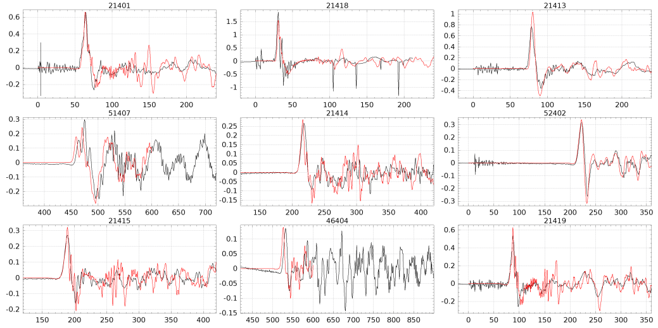
Forward modelling of tsunami
Model with max. 25m slip
Did the fault slip exceed 50m?
Most likely!
Tsunami model by A. Babeyko (2011)
Model with max. 50m slip
The underestimate of fault rupture led to the underestimate of tsunami height: Less than 10m predicted instead of 20-30m observed!

Slide 14
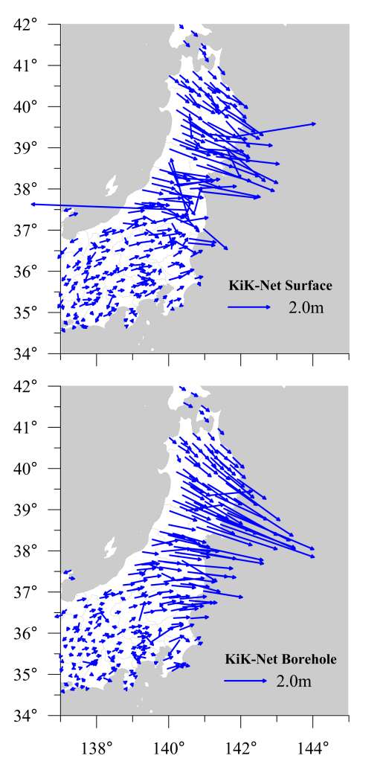
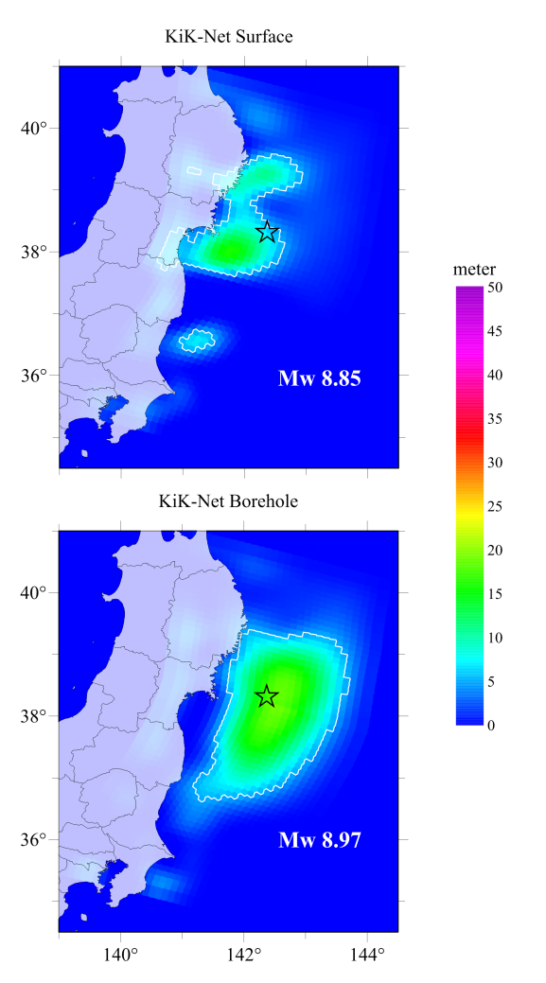
Slip models inverted
from SM-derived coseismic displacement data
Large uncertainties of the empirical baseline correction
⇒
Outliers in the derived displacements that may affect the
source inversion dramatically.

Slide 15
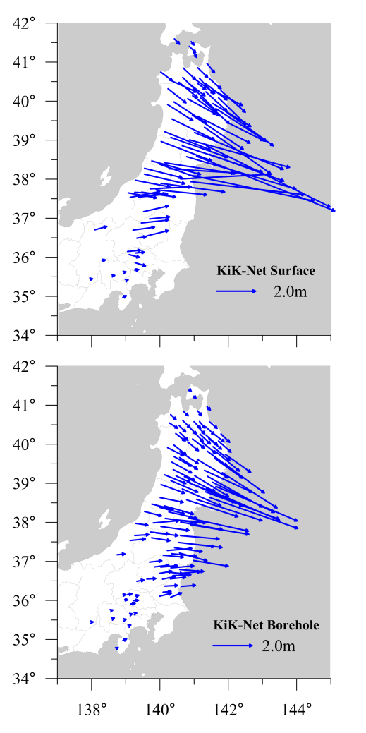
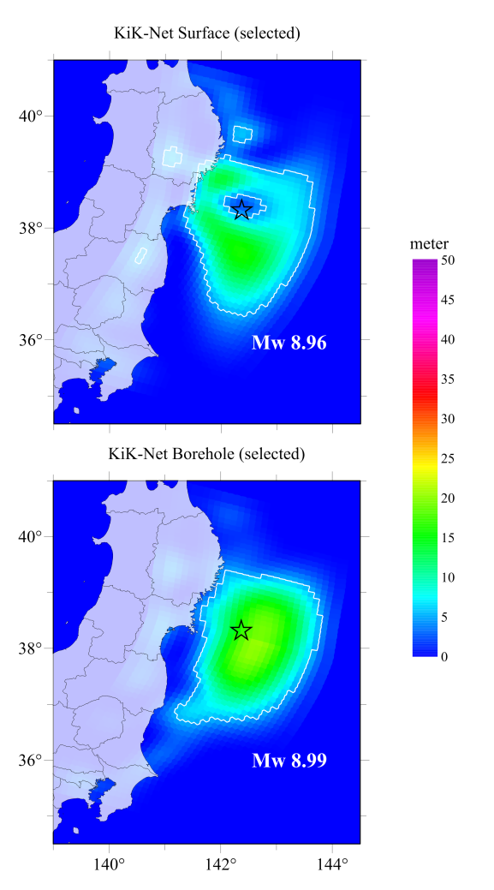
A model-based detection of outliers in the SM dataset
Definition:
An outlier is detected if it deviates from the preliminary model by larger than a given threshold (here 15º in direction)
Applicability:
Dense network
Isolated outliers, particularly in the far-field

Slide 16
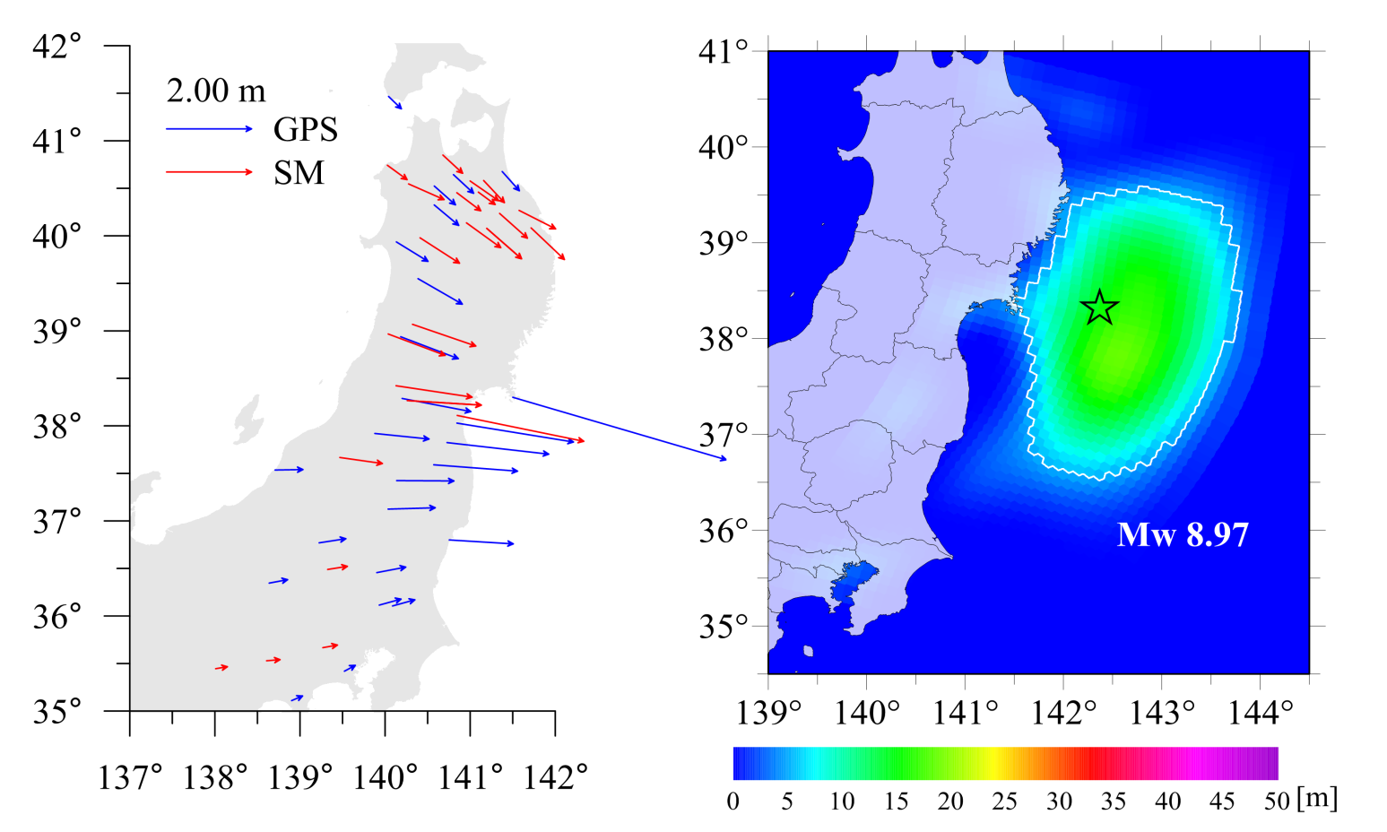
Joint inversion using the GPS and SM data
Only 10% of the data randomly selected
⇒
To simulate the situation in other regions with much sparser monitoring networks than in Japan.

Slide 17
Comparison
of strong-motion and high-rate GPS records and their
for the 2011 M9 9.0 Tohoku-Oki earthquake
-
Joint Data Processing

Slide 18
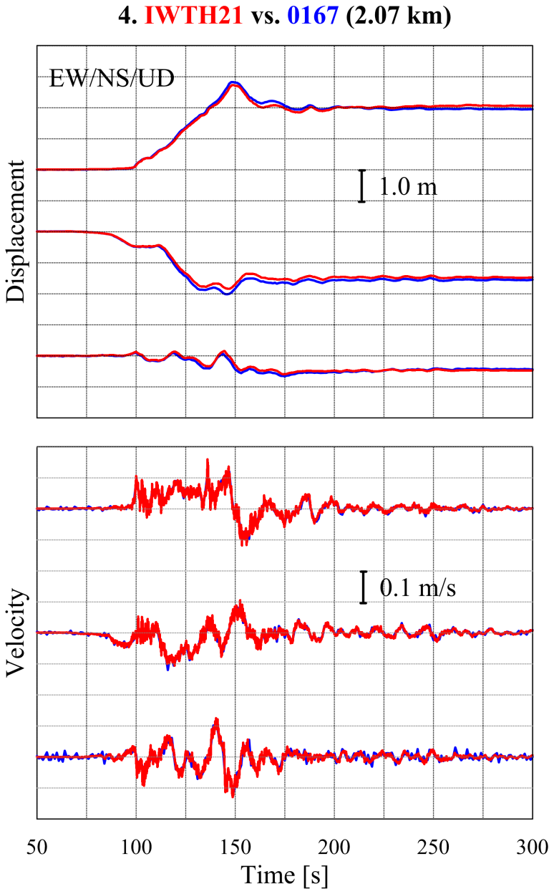
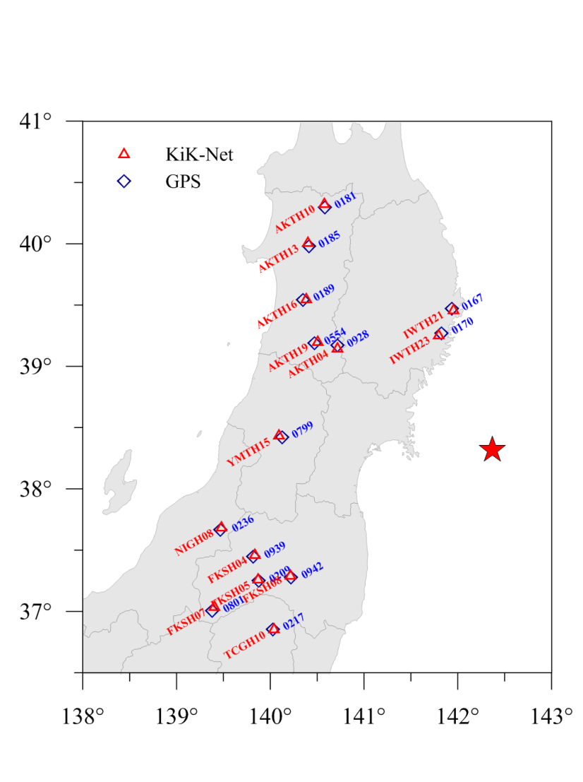
Strong-motion versus high-rate GPS
Example from a nearby GPS/SM station pair
14 nearby GPS/SM stations (≤ 4 km)

Slide 19
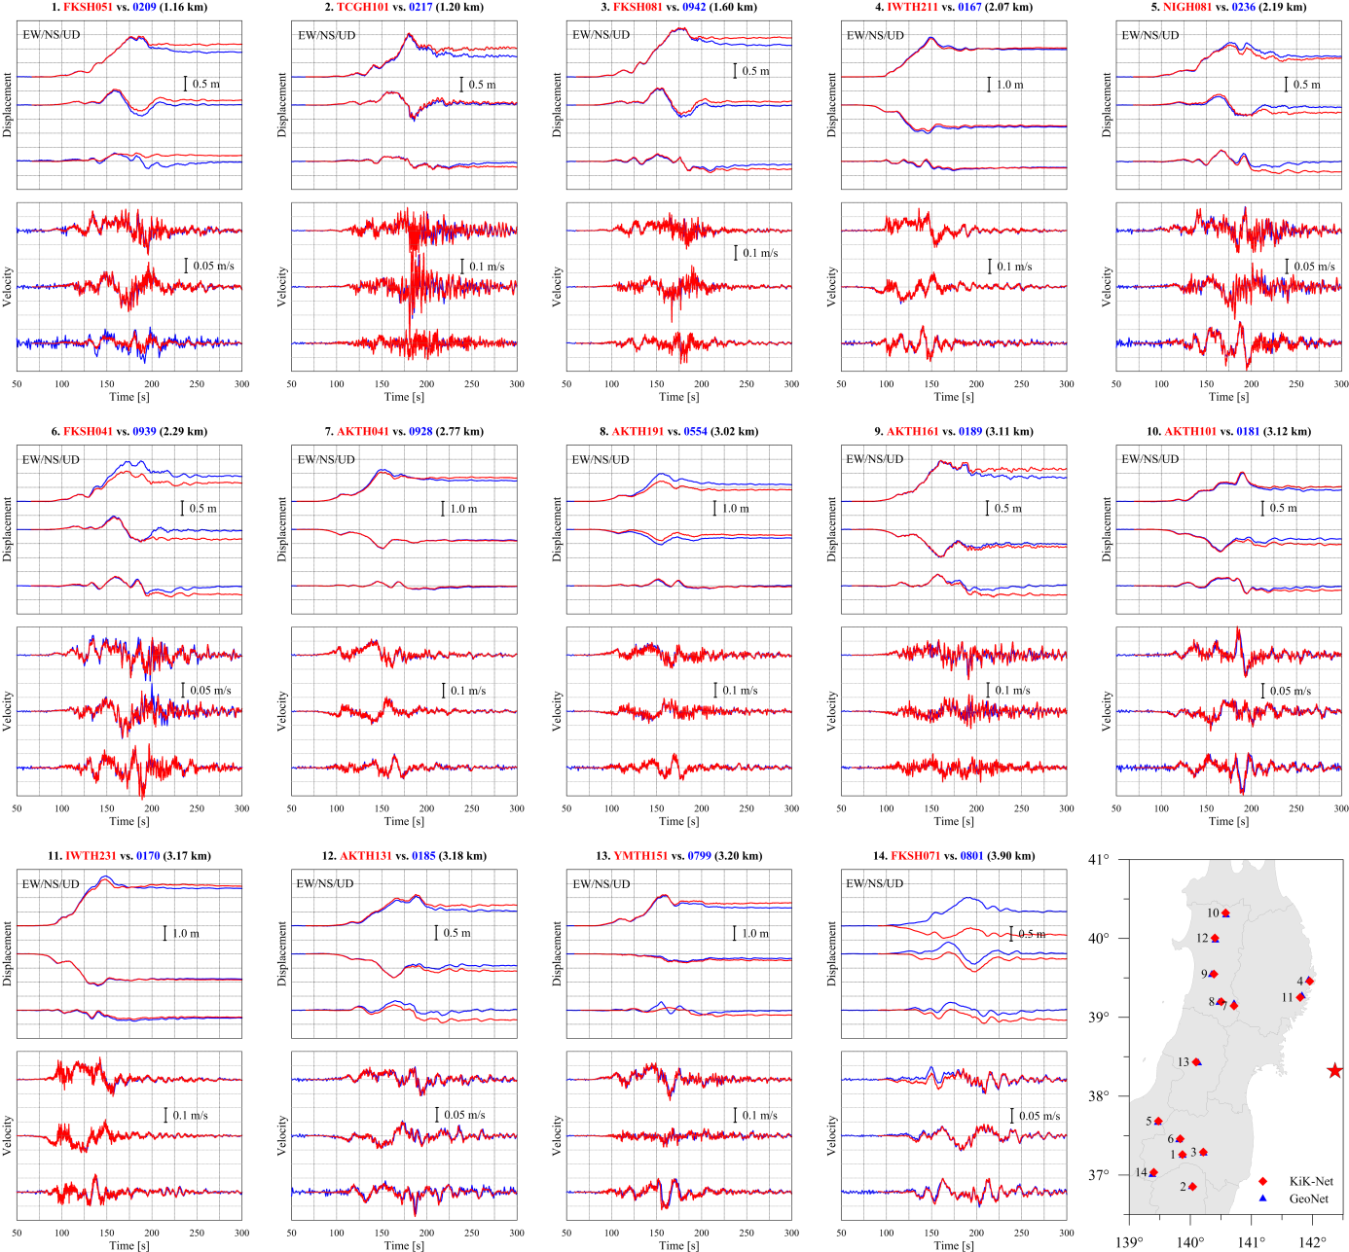
Strong-motion versus high-rate GPS
for all 14 nearby stations (≤ 4 km)

Slide 20
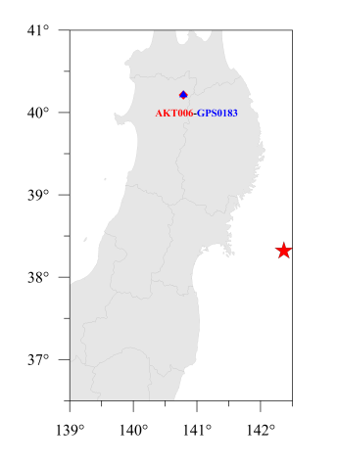
Complementary information from GPS/SM
High-rate GPS
Low sampling rate,
high-frequency noise
⇒
Late event detection,
underestimated ground shaking
20 m distance
Strong-motion data
Small baseline errors
⇒
Large displacement trend

Slide 21
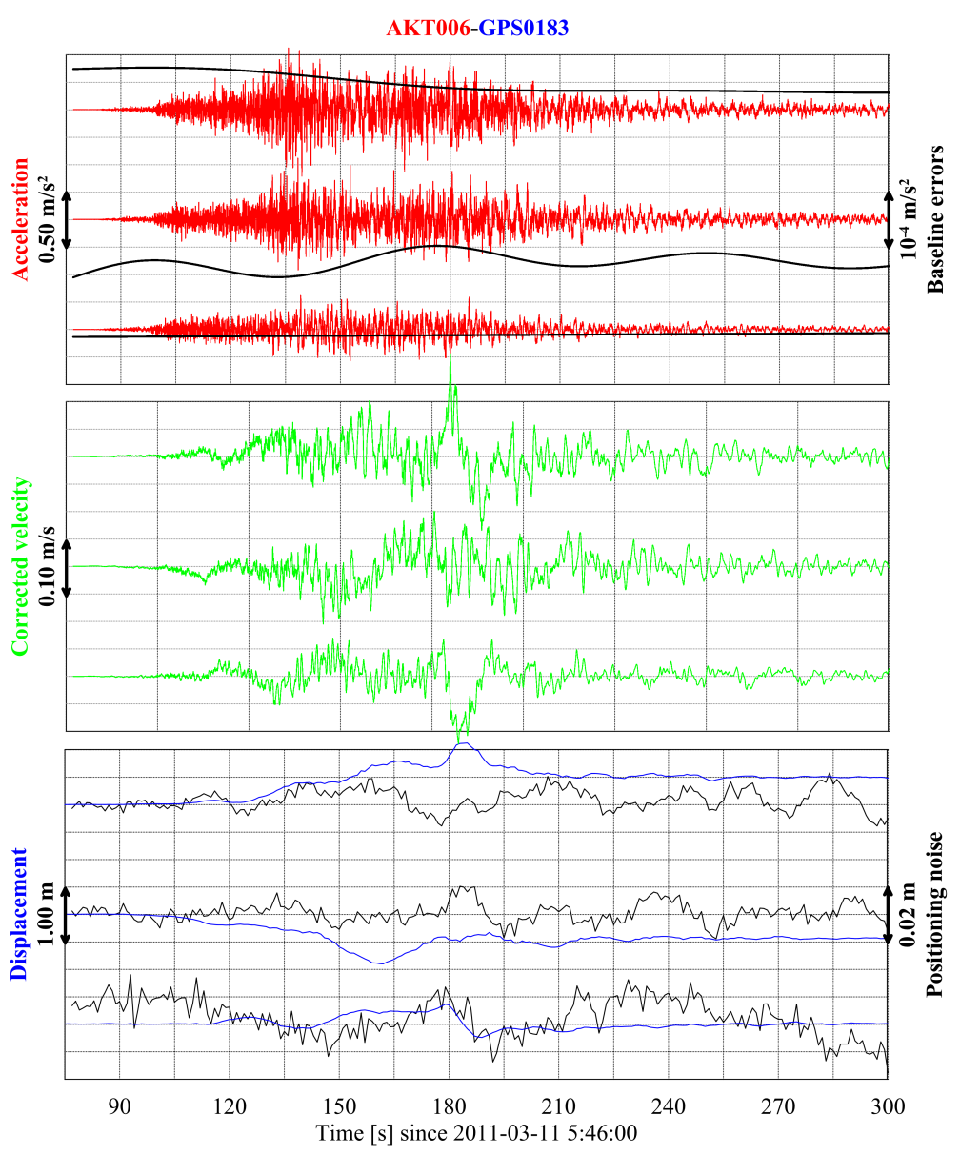
Joint processing of the GPS/SM data
Assume a low-order polynomial baseline error in the SM data
Determine the polynomial so that the derived displacement history after the baseline correction best fits the GPS data
Make the polynomial baseline correction
Integrate the corrected acceleration to velocity and displacement
Estimate the noise in the GPS data
“Tightly Integrated Processing of
High-Rate GNSS and Seismic Sensor Data”
A single-frequency GPS
co-installed with
A low-cost accelerometer
Near real-time and complete-band
ground motion information

Slide 22
Conclusions
Strong-motion derived coseismic displacement
Large uncertainties for stations at soft sediment sites, but
Stable results for borehole and hard-rock stations
Few outliers can be detected using the model-based approach, improving constraints on the source
Source inversion
High resolution using both onshore and offshore GPS data
Robust solution for magnitude, fault location and size can also be obtained using the SM-derived coseismic displacement data
It is evident that the fault slip exceeded 50m in places
Complementary information from strong-motion and high-rate GPS data
Complete-band (0 - 100Hz) ground motion information (displacement, velocity and acceleration) by combined data processing
Feasible using low-cost but co-installed GPS and strong-motion sensors
Useful for near real-time source reconstruction, i.e. soon after the earthquake or even during the rupture process is still going on (REAKT project WP4.1)

Slide 23
Thank you!

