Slide 1
Recognizing, Imperfectly Assessing, and Partially Mitigating Extreme Geohazards in the Presence of Deep Uncertainty
Seth Stein
Earth & Planetary Sciences, Northwestern University
Notes:
1

Slide 2
Society is playing a high-stakes game of chance against nature in a very uncertain world
Despite steady advances in hazard science & engineering
Often nature surprises us, when an earthquake, hurricane, or flood is bigger or has greater effects than expected from hazard assessments.
In other cases, nature outsmarts us, doing great damage despite expensive mitigation measures, or making us divert resources to address a minor hazard.

Slide 3

What’s going wrong?
Shallow uncertainty - we don’t know what will happen, but know the odds. The past is a good predictor of the future. We can make math models that work well.
This is what we assume in hazard planning

Slide 4
Deep uncertainties arise when the probabilities of outcomes are poorly known, unknown, or unknowable.
This occurs when we have multiple possible models with poorly known parameters, either because we do not adequately understand the system or it has inherently unpredictable elements.
In such situations, past events may give little insight into future ones.

Slide 5
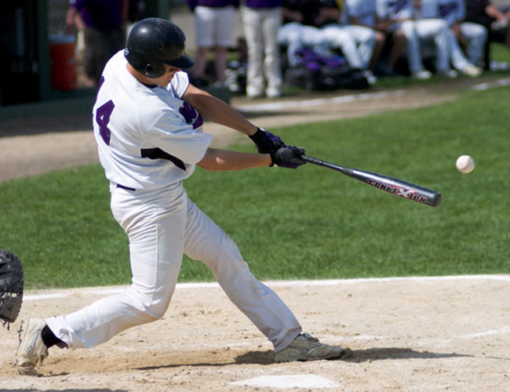
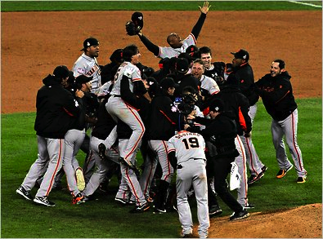
Shallow uncertainty is like estimating the chance that a batter will get a hit. His batting average is a good predictor.
Deep uncertainty is like trying to predict the winner of the World Series next baseball season. Teams' past performance give only limited insight into the future.

Slide 6
“Some of the most troubling risk management challenges of our time are characterized by deep uncertainties.
Well-validated, trustworthy risk models giving the probabilities of future consequences for alternative present decisions are not available
The relevance of past data for predicting future outcomes is in doubt; experts disagree about the probable consequences of alternative policies – or, worse, reach an unwarranted consensus that replaces acknowledgment of uncertainties and information gaps with groupthink
Policymakers (and probably various political constituencies) are divided about what actions to take to reduce risks
Passions run high and convictions of being right run deep in the absence of enough objective information to support rational decision analysis “
Cox (2012)

Slide 7
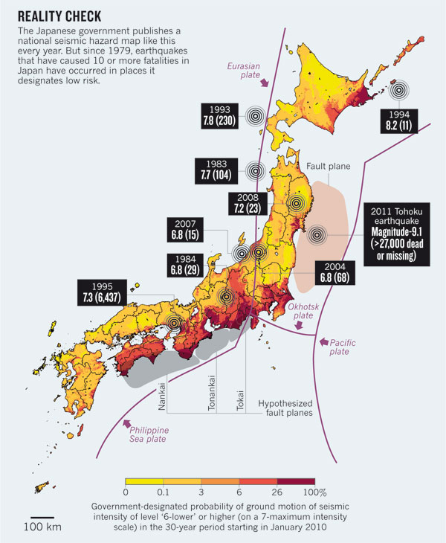
Hazard assessment failed
2010 map predicts probability of strong shaking in next 30 years
But: 2011 M 9.1 Tohoku, 1995 Kobe M 7.3 & others in areas mapped as low hazard
In contrast: map assumed high hazard in Tokai “gap”
Geller 2011

Slide 8
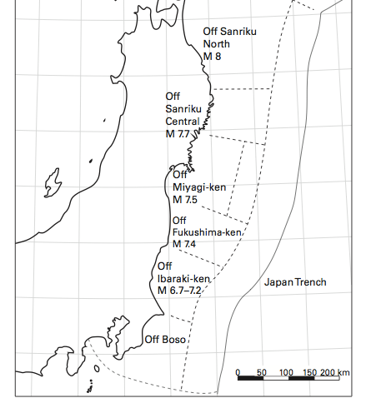
Hazard model divided trench into segments
These were assumed to break individually in future earthquakes
Expected Earthquake Sources
50 to 150 km segments
M7.5 to 8.2
(Headquarters for Earthquake Research Promotion)

Slide 9
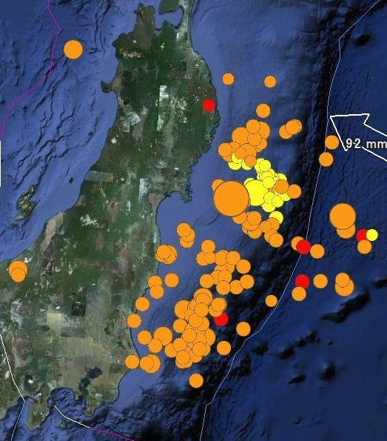
Giant earthquake broke many segments
Expected Earthquake Sources
50 to 150 km segments
M7.5 to 8.2
(Headquarters for Earthquake Research Promotion)
2011 Tohoku Earthquake
450 km long fault, M 9.1
(Aftershock map from USGS)
J. Mori

Slide 10
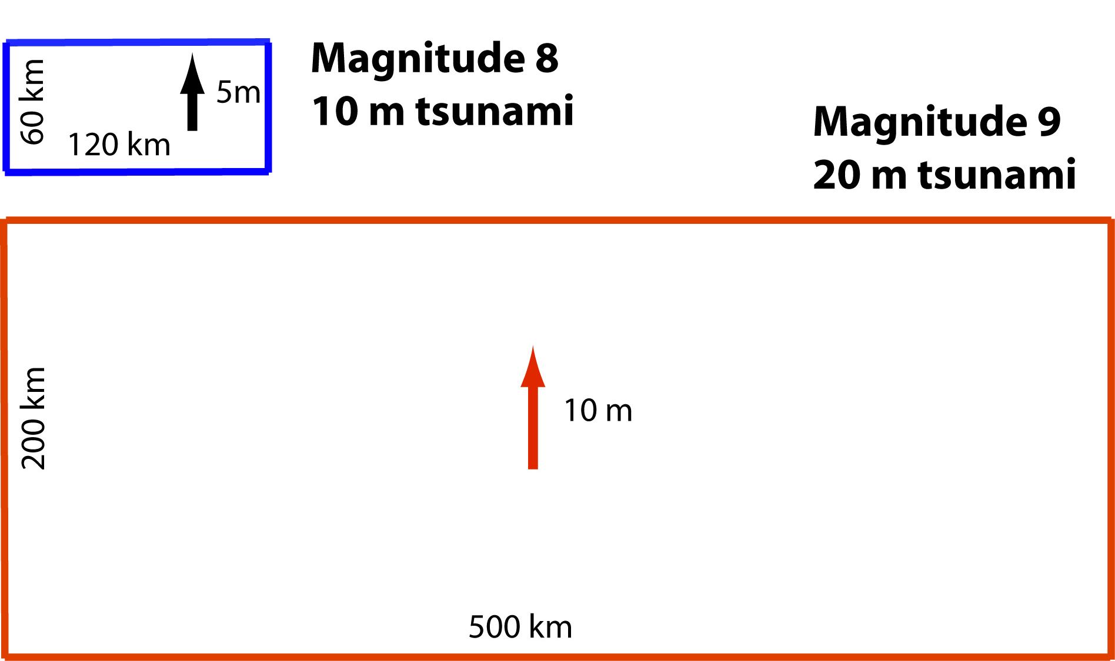
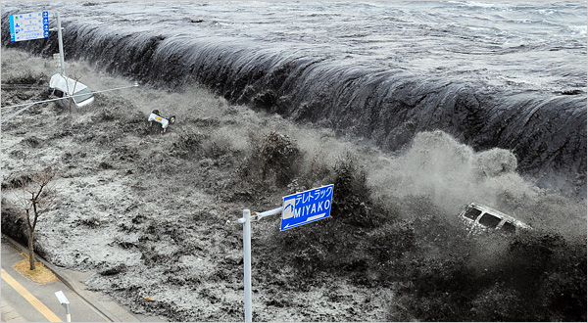
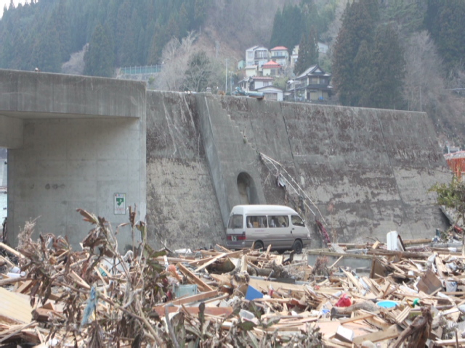
Planning assumed maximum magnitude 8 Seawalls 5-10 m high
Stein & Okal, 2011
NYT
Tsunami runup approximately twice fault slip (Plafker, Okal & Synolakis 2004)
M9 generates much larger tsunami
CNN

Slide 11
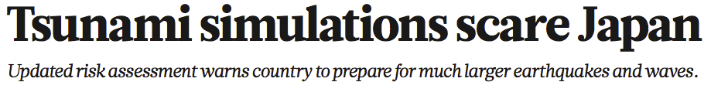
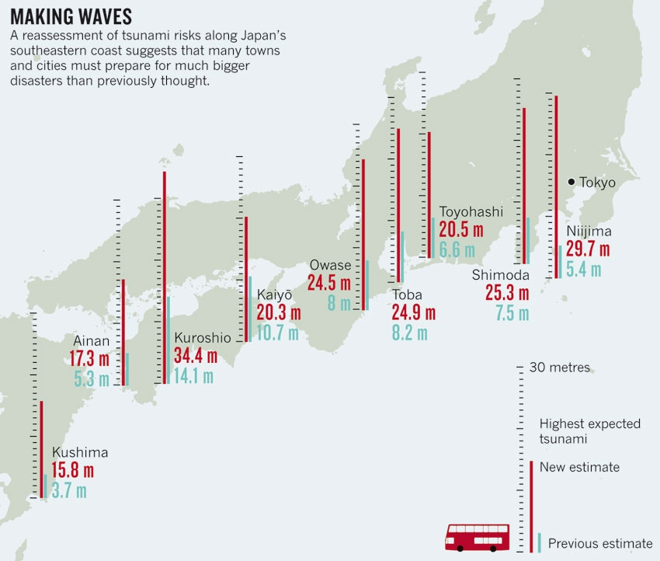
Since M9 happened off Tohoku, how about to the south?
No evidence this ever happened
No reason to doubt that it could
Global impact
Nature 484 141-3 2012

Slide 12
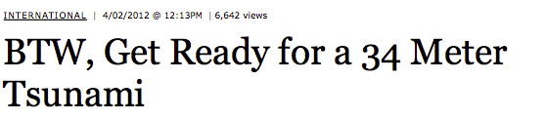
Forbes
The policy question, in the words of Japanese economist H. Hori, is
“What should we do in face of uncertainty? Some say we should spend our resources on present problems instead of wasting them on things whose results are uncertain. Others say we should prepare for future unknown disasters precisely because they are uncertain.”

Slide 13
APPROACH FROM NATIONAL DEFENCE Defending a nation against enemies has many similarities to defending against natural hazards.
For most nations, natural disasters cause much more damage and loss of life than military conflicts.
However, most nations’ structures for dealing with natural hazards are much less well developed than for defending against human enemies.

Slide 14
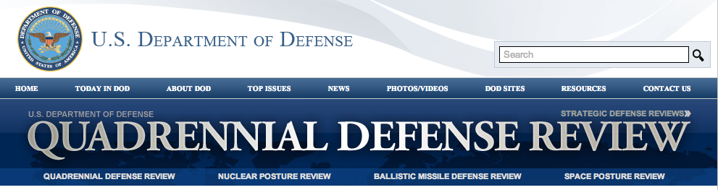
The US Department of Defense conducts a major study every four years called the Quadrennial Defense Review.
The QDR assesses likely requirements in the coming years and how US strategy, programs, and resources should be planned and allocated to meet them.
It recognizes that strategies should change as situations change, and considers budgetary constraints.

Slide 15
QDR accepts deep uncertainty
“We are likely to be surprised— pleasantly and unpleasantly—by the speed of technology proliferation, increasingly sophisticated systems being developed by potential state adversaries, the cleverness and persistence of terrorists, the ability to adapt our own acquisition programs and capabilities, and the vitality of the U.S. technology and economic cycle.
Estimations of how and where we would fight a war or militarily intervene will also probably be largely wrong. “
(2004 QDR)

Slide 16
RECOMMENDATION
An international structure should be created, under UN auspices, to conduct quadrennial natural hazard reviews
The process should seek to anticipate hazards larger than addressable at national levels, and suggest approaches to learning more and developing mitigation
Process could be similar to IPCC, but would consider “what if?” issues and recognize large deep uncertainties

