Slide 1
Role for Science in the Global Management of Extreme Geohazards
Deborah Brosnan

Slide 2
Or
Communication and Translation of Science
Deborah Brosnan

Slide 3
Assumptions/Givens
Extreme geohazard events are natural hazards that we need to prepare for on global and national levels.
They are poorly understood. They’ve had major environmental, economic and political, consequences throughout history, but previously, impacts and consequences have been less “shared”
Modern Life: population density, globalization, and living in hazard zones all raise the stakes.
Globalization has increased the scope and speed for contagion in a disaster, and impacts spread rapidly and unevenly across sectors and borders.
.

Slide 4
Assumptions/Givens
Scientific studies continue to provide valuable and more accurate information on historic events, their frequencies, probabilities, and likely consequences. This is often ignored until an event happens.
The cost of response is beyond the financial capabilities of an individual country to respond Consequently an international geopolitical response will be required
Coordinated scientific monitoring, reporting, facilitating science-based actions to protect people and the planet makes sense.
An international scientific monitoring/advisory body that is connected with the international geopolitical response.
Creating this scientific service, especially in a world where “growth and progress” often increases risks and vulnerabilities, and where the audience is not convinced to take action.

Slide 5
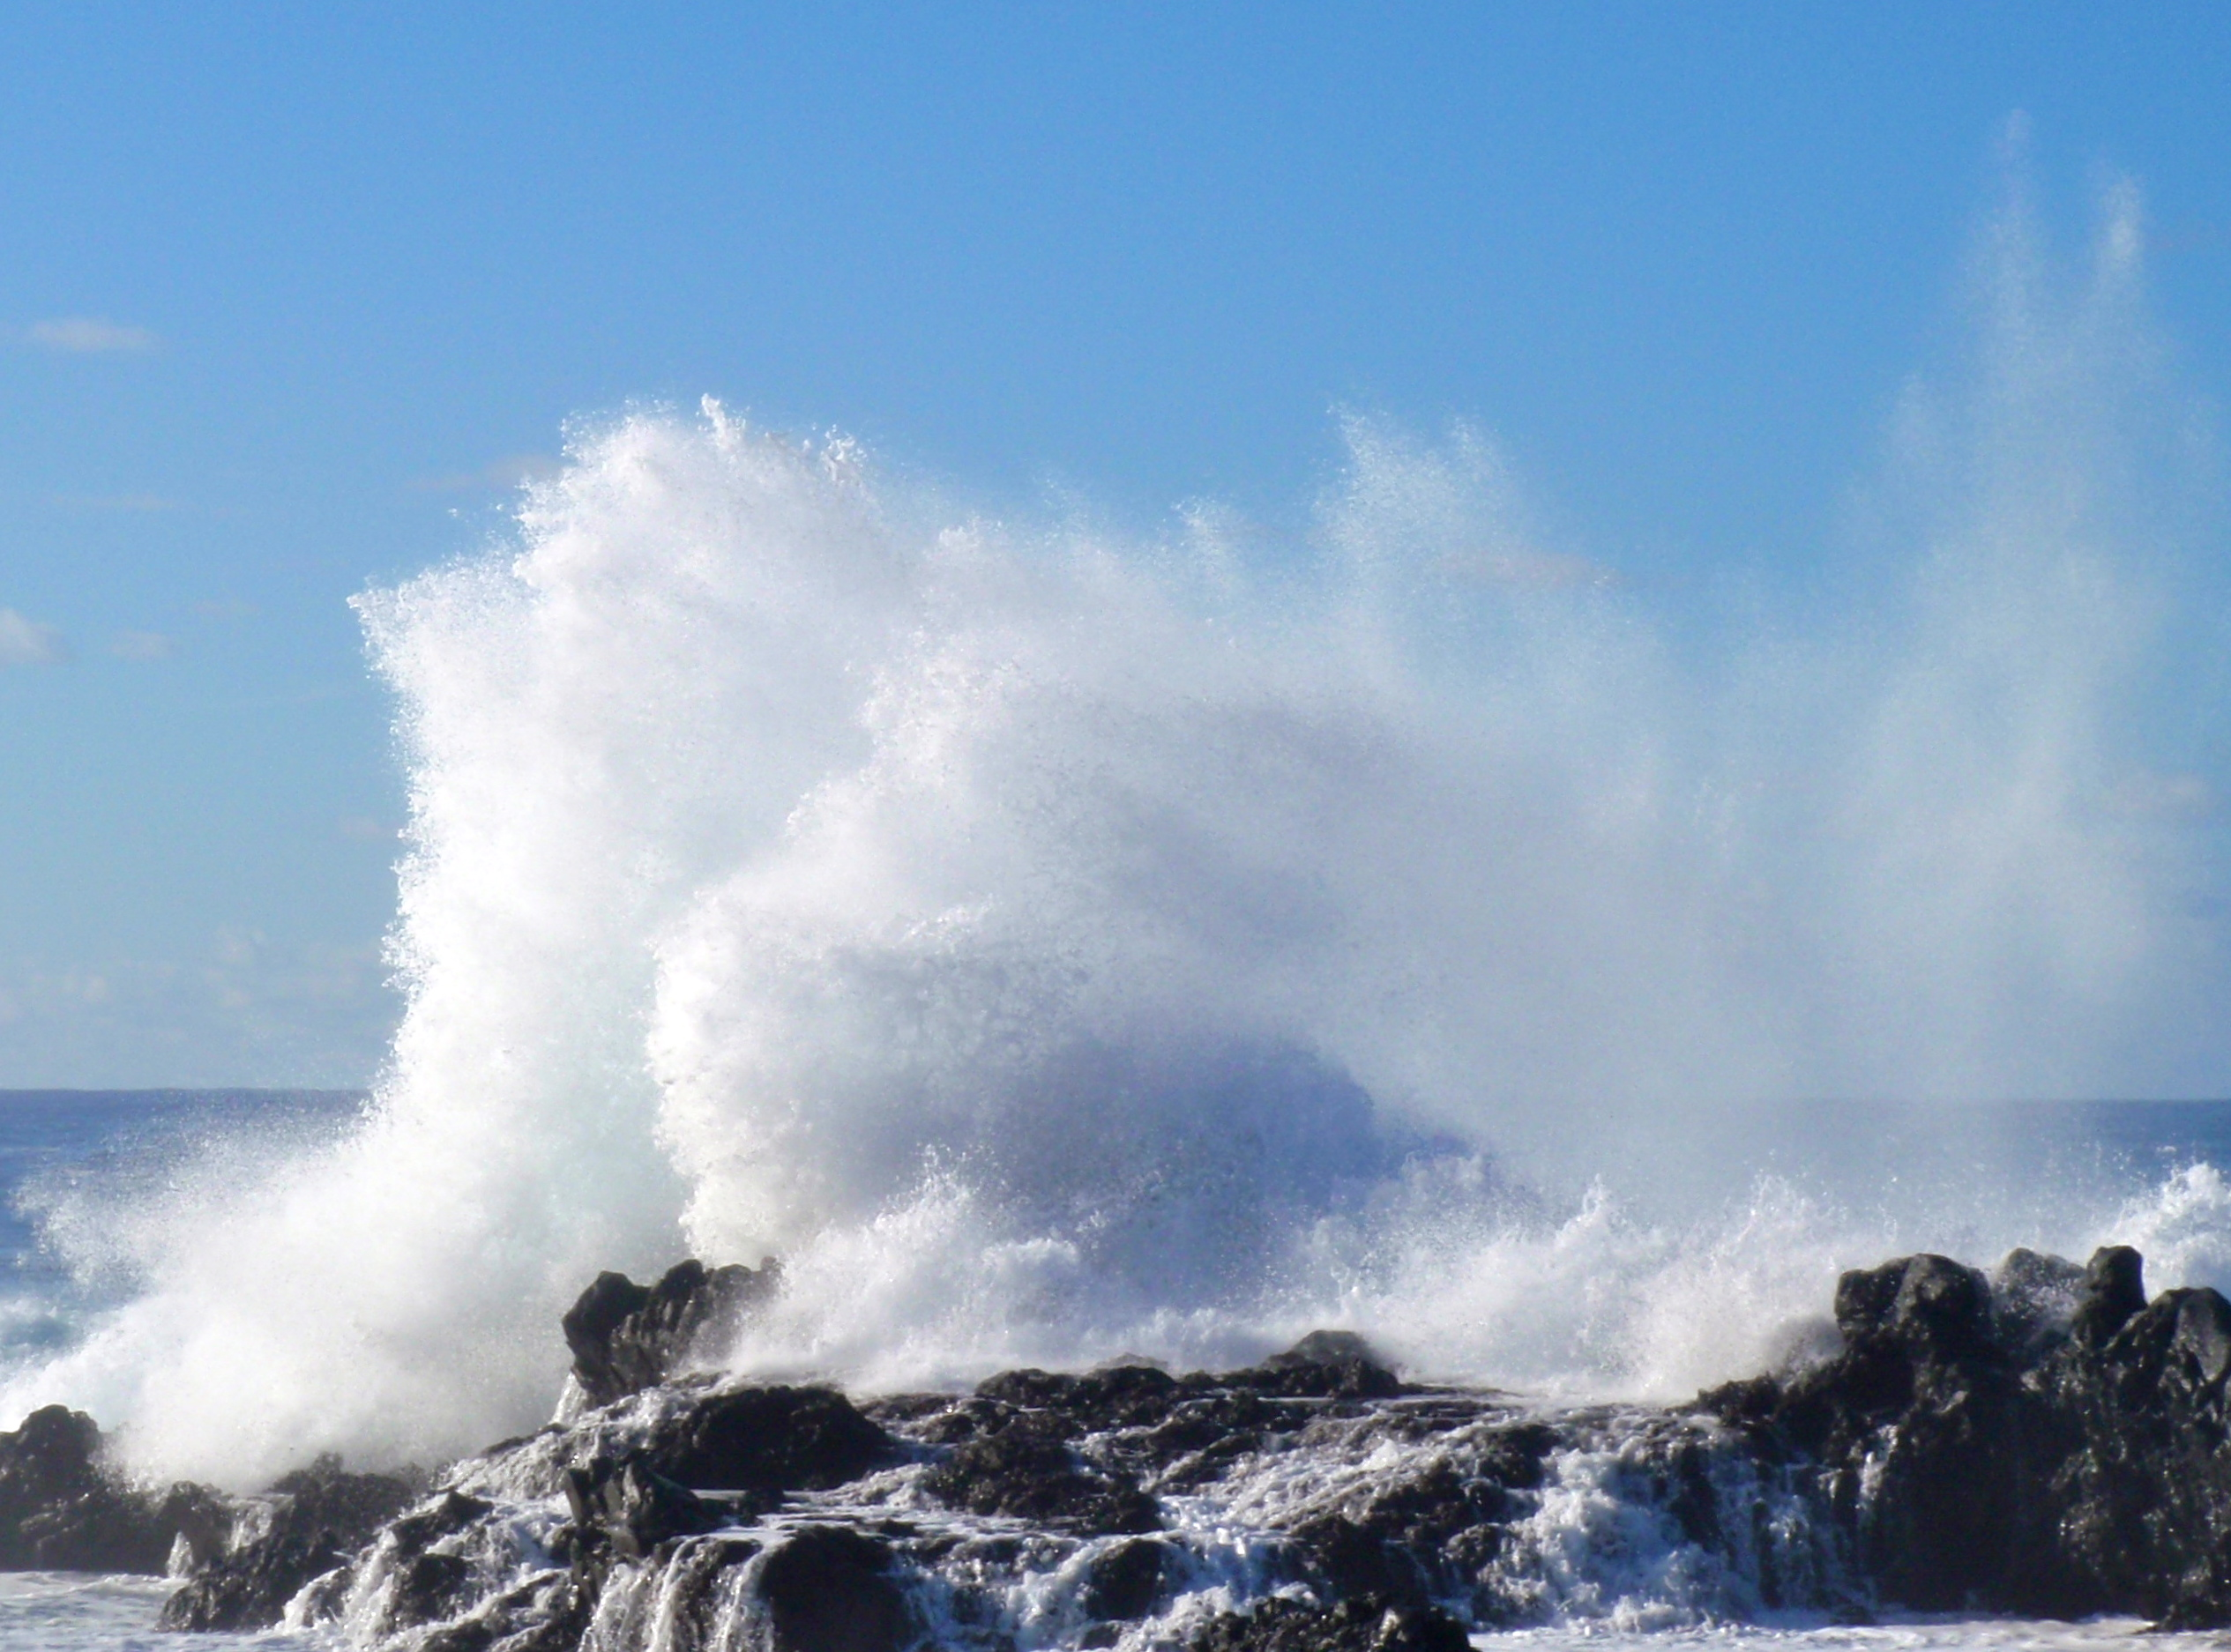
Science Role
Science and monitoring are generally excellent
Needs are:-
Communicating the science and the need for the science
TRANSLATING the meaning of scientific results to a diverse audience that varies in it’s interests, abilities, resources

Slide 6
IPCC Model
Established 1988 by the United Nations Environment Program and the World Meteorological Organization
Conduct periodic assessments of the state of knowledge concerning global climate change, e.g. scientific information, environmental impacts, response strategies, and more. 3 working groups
I: Climate System and Climate Change- state of the science concerning what is current and projected to happen to the climate system.
II: Climate Change: Impacts, Adaptation, and Vulnerability- state of the science concerning regional, sectoral and cross-sectoral impacts of, and adaptation to, climate change, including the social dimensions (e.g., equity) and economic costs and benefits.
III: Mitigation of Climate Change- addresses the state of science on mitigation of climate change, including the social aspects and economic costs and benefits, and methodological aspects of cross-cutting issues.
It’s an excellent operational model. But there are differences with extreme geohazards.

Slide 7
Climate Change v Extreme Geohazard
It is happening. It is a current disaster/crisis not a preparation.
Climate Changes, IPCC science and IPCC assessments, AND Government and other sector responses are evolving together.
Climate change will not trigger an extreme geohazard, although it will contribute to the consequences.
Climate change adaptation is not extreme geohazard adaptation.

Slide 8
“The exceptions that only apparently confirm the rule must be the focus of attention” Ulrich Beck
1. Black Swan Events –unimaginable and largely non-quantified
2. Known but unprepared for: Rare events identified as potential threats but where little to no action is taken to prevent or mitigate the impacts. Tsunami+Fukushima; 2010 Icelandic ash cloud.
Why unprepared? - Low perceived likelihood; low political sensitivity; a disconnect between the scientific communities and decision-makers; socially acceptable consequences (relative to cost of preparing); belief that consequences are so extreme that preparedness is futile.
(note not lack of science)

Slide 9
Observation on communicating science of extreme events
Politicians and Private Sector ( in order of interest)
Scientific analysis of likelihood and severity of event
Cost and consequences
c. Difficulty to implement or integrate measures into existing frameworks
d. Science Knowledge.
Scientists order: d.knowledge a.probability, some b.consequences
Public
Respond to knowledge and explanations first, and the numbers (probability estimates) second.

Slide 10
Science message and audience meaning
Scientists are more effective when they understand the framework in which science is heard and interpreted.
For example:
Scientific Information: Likely severity and duration of event
Audience Relevance: “Just in time” c. one week
Volcanic eruption (Icelandic 2010) – likely duration is key relevant information.

Slide 11
Scientific Translation
Science: Similar to IPCC model of 3 working groups and 5 year reports. Change in risks, uncertainties, and consequences etc. Based on monitoring, data analysis, models etc.
Address gaps in scientific capacity that exist among countries, around events and how they can be mitigated and addressed.
Information that helps for black swan events, leads to more generic versus specific extreme hazard planning.
2. Science based alerts on global threats to the global community, and that are linked to actions.
3. Rapid Response Science. Critical Science
.

Slide 12
Rapid Response/Critical Science
3. Rapid Response Science. Critical Science
There is high uncertainty in all elements of these events, including how they will unfold.
Decisions will need to be made rapidly; updated science and analysis will be needed continually.
Scientists will be asked to respond to non-science questions using their experience and expertise- professional judgment.
Scientists will have to respond to consequences of poor decisions, and political course changes, made during the event.
Scientists will need to address scientific disagreements e.g. on probabilities, that arise among different scientists and “in real time”.
Communication strategy- vital during an event.

Slide 13
Lao Tzu
The journey of a thousand miles begins with one step

Slide 14
Make it Real
Scenarios: Table-top scenarios:
Identify Extreme Geohazard Event
Identify and articulate the scientific knowledge and forecasts (including variability)
Go through the state of the science and the event exercise, with Government and Identified Stakeholders (e.g. from existing response mechanisms)

Slide 15
Make it Real
Scenarios: Table-top scenarios:
Identify Extreme Geohazard Event
Identify and articulate the scientific knowledge and forecasts (including variability)
Go through the state of the science and the event exercise, with Government and Identified Stakeholders (e.g. from existing response mechanisms)
Studies show that “the exposure and vulnerability of the global economy, environment and society are sometimes not fully recognized until a disruption becomes persistent. Recovery becomes more complex as networks and systems stall or fail.”
Science driven scenarios expose these vulnerabilities and demonstrate the value of scientific monitoring/communication.

