Slide 2
Anticipating and Addressing the Global Risk Associated with Very large Volcanic Eruptions
Hans-Peter Plag (1), Sean Brocklebank, Deborah Brosnan, Paola Campus, Sierd Cloetingh, ShelleyJules-Plag, Seth Stein
Supported by:
Geohazards Community of Practice of the Group on Earth Observations (GEO)
European Science Foundation (ESF)
Contents
Introduction
Community Science Position Paper
Extreme Geohazards
Volcanic Eruptions
Cost Benefit-Analysis
Conclusions and Recommendations
Epilogue
(1) Mitigation and Adaptation Research Institute, Old Dominion University, Norfolk, VA, USA

Slide 3
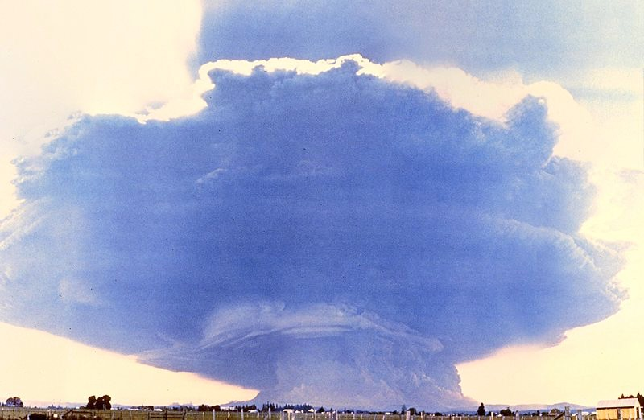
INTRODUCTION: Terminology
Extreme Events:
Extinction Level Events: more than a quarter of all life on Earth is killed and major species
extinction takes place.
Global Catastrophes: more than a quarter of the world human population dies and that
place civilization in serious risk.
Global Disasters: global-scale events in which a few percent of the population die.
Major Disasters: disasters exceeding $100 Billion in damage and/or causing more
than 10,000 fatalities.
Modified from Hempsell (2004)

Slide 4
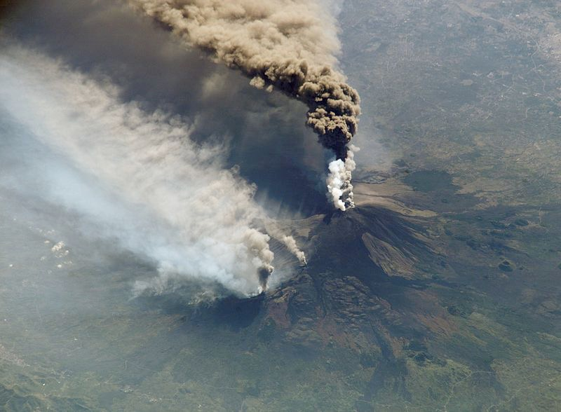
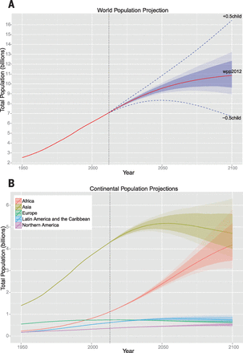
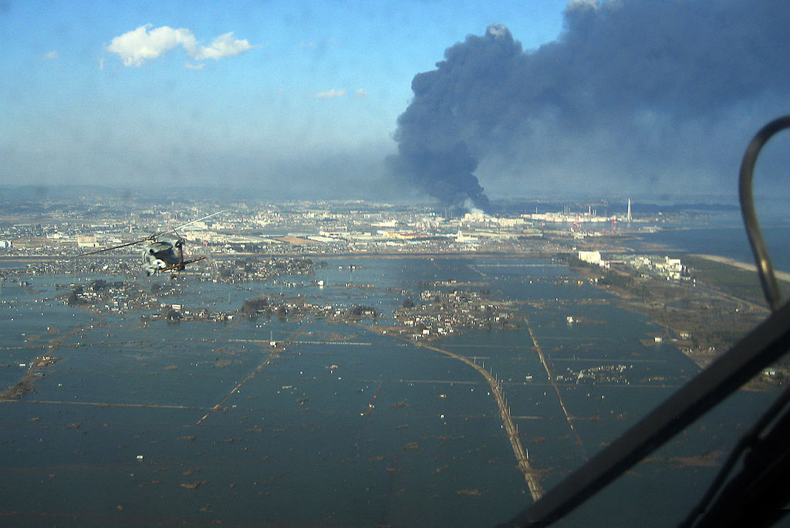
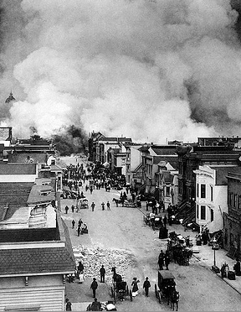
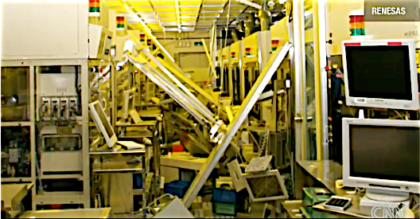
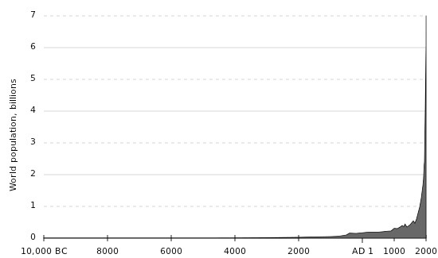
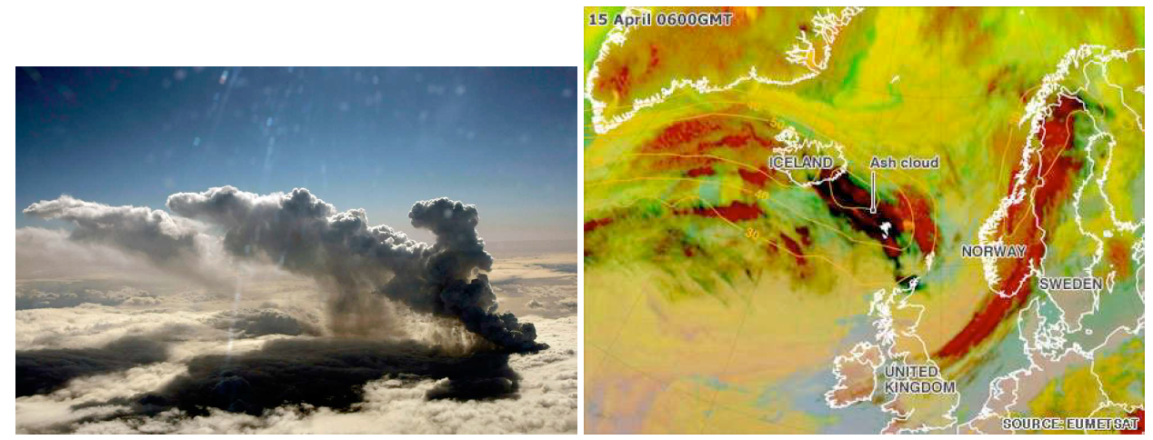
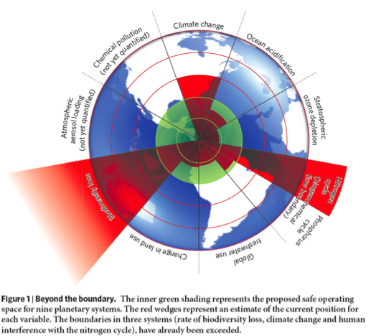
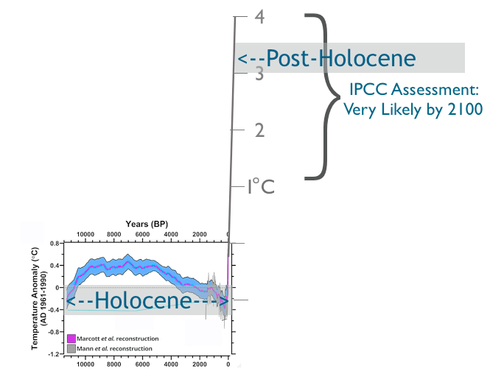
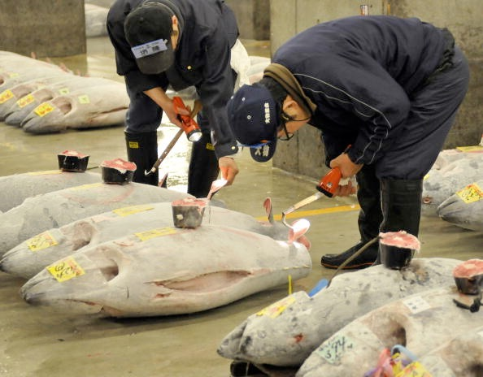
INTRODUCTION: Why Focus on Extreme (Geo)Hazards?
Increasing disaster risk due to:
- more exposure of a growing population;
- reduced resilience due to interconnection,
reduced redundancy, and just-in-time services
12
- direct and indirect impacts (domino-effects)
increase risk of a global catastrophe caused by
extreme natural hazards.
Extreme hazards occurred in the past;
little exposure often limited the disaster.
Being able to handle frequent hazards doesn’t mean we can handle the less-frequent extreme events
Complexity of modern societies leads to more indirect, cascading effects
Sustainability crisis reduces resilience
The Global Boundaries of the “safe operating space for humanity” (Rockström et al., 2009)

Slide 5
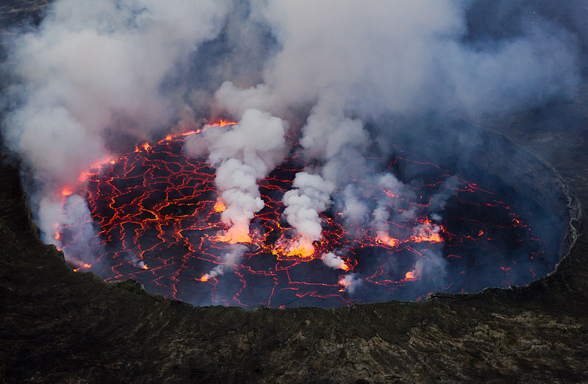
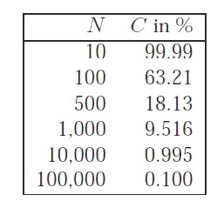
INTRODUCTION: Extreme (Geo)Hazards
The problems:
- knowledge of rare events is limited
- know better the “why” and “how” but not the “when”
- probability is difficult to assess
risk = probability x vulnerability x exposure
- risk assessment is challenged
Poisson distribution; Chance that one or more
“1 in N years” events occur in a century:
Assessing impacts: X-ness (Casti, 2012):
X: X-ness
δE: Impacted ensemble (population, GDP, ...)
U: Unfolding time
I: Impact time
In the 20th century we have been lucky ...

Slide 6
INTRODUCTION: Extreme (Geo)Hazards
The problems:
- knowledge of rare events is limited
- know better the “why” and “how” but not the “when”
- probability is difficult to assess
risk = probability x vulnerability x exposure
- risk assessment is challenged
Poisson distribution; Chance that one or more
“1 in N years” events occur in a century:
In the 20th century we have been lucky ...

Slide 7
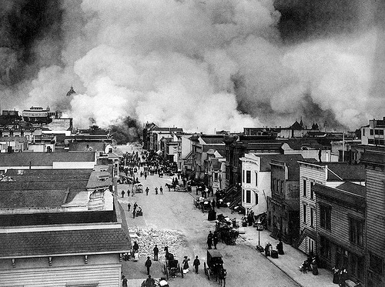
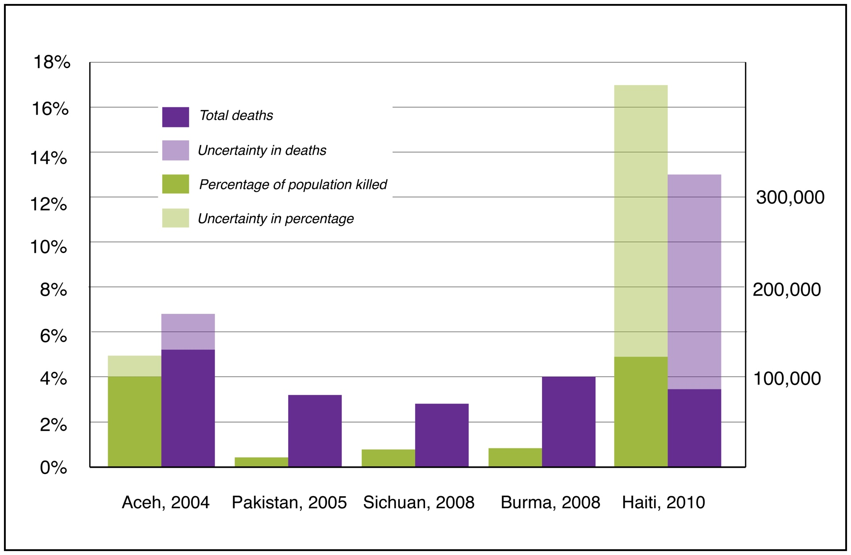
INTRODUCTION: Measuring Impacts
Tsunami
Earthquake
Earthquake
Cyclone
Earthquake

Slide 8
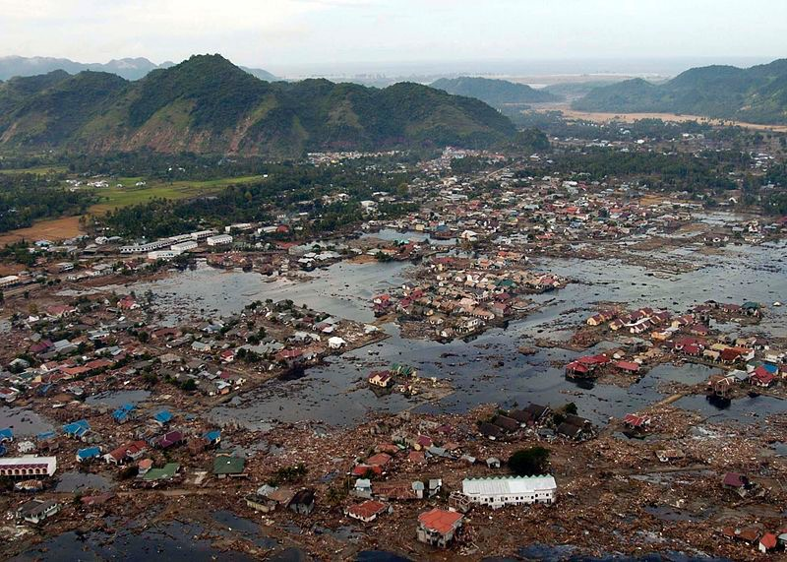
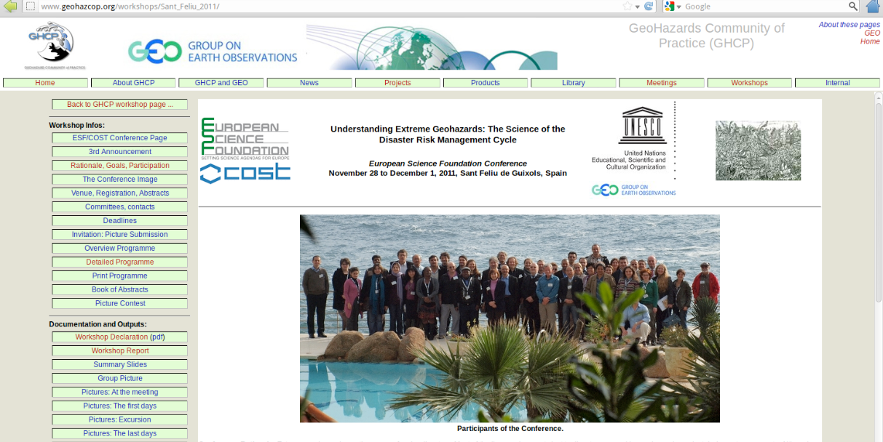
Community Science Position Paper
Declaration on Extreme Geohazards
and the Reduction of Disaster Risks
1 Introduction
2 Global Disasters and Catastrophes
3 Extreme geohazards
4 Disaster Risk, Resilience, Antifragility, and Adaptive Capacity
5 Cost/Benefit Analysis of Planning for Extreme Geohazards
6 Confronting Disaster Risks for Extreme Geohazards
7 Conclusions and Recommendations
Acknowledgments
Acronyms
References
Appendices
Resulted in two main activities:
- Global Geohazards Information System for Disaster Risk Reduction (GGIS-DRR)
- White Paper on Extreme Geohazards

Slide 9
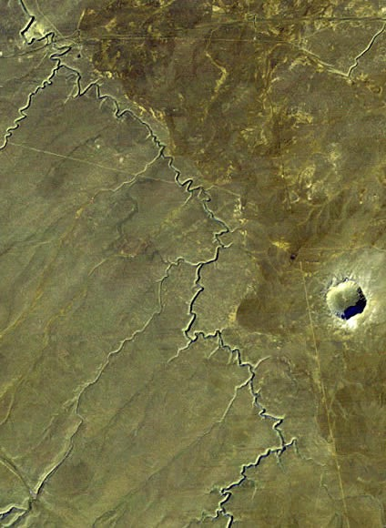
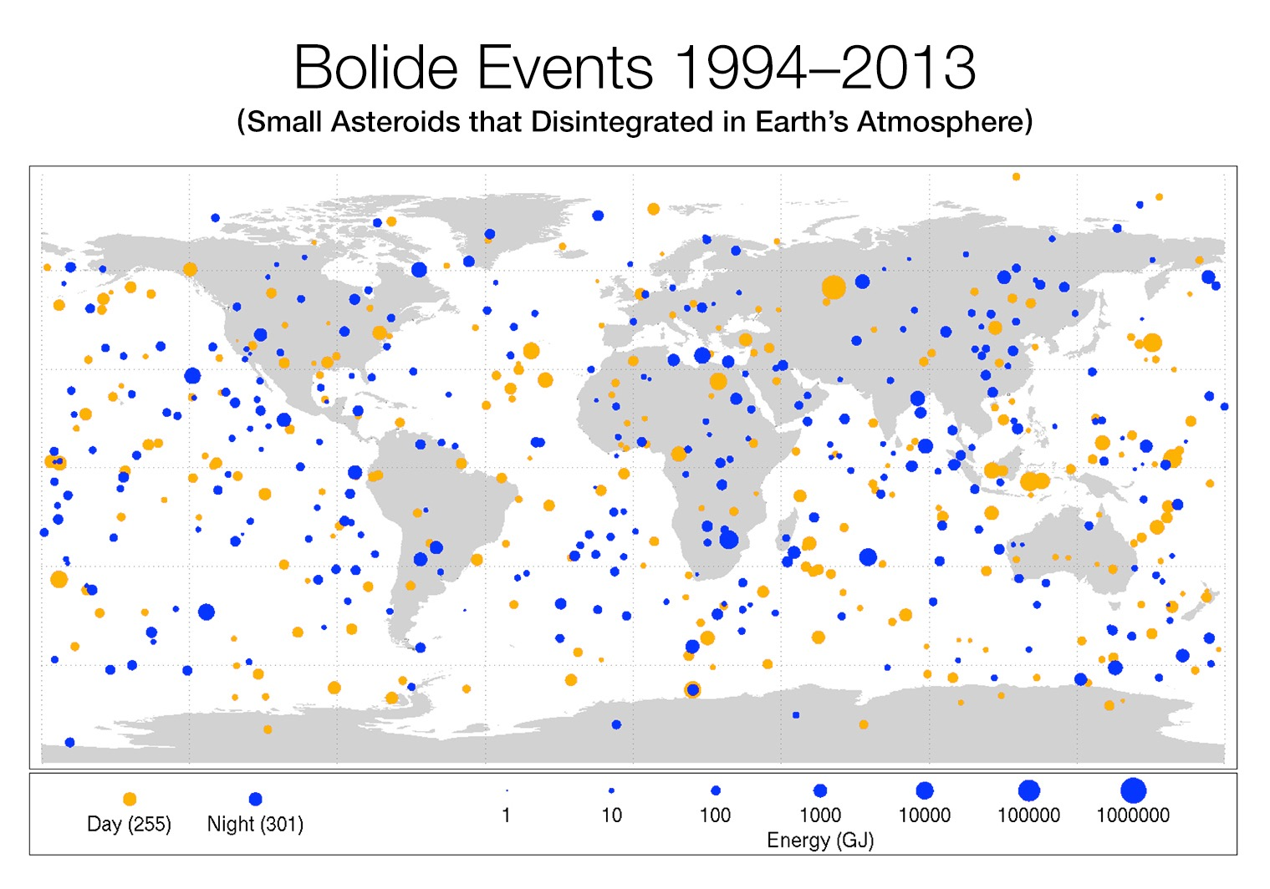
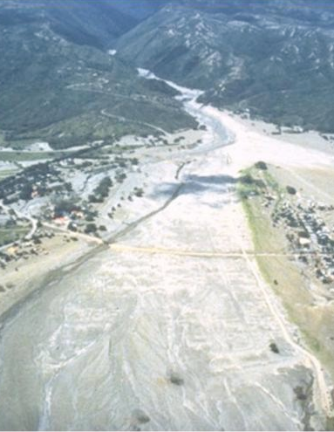
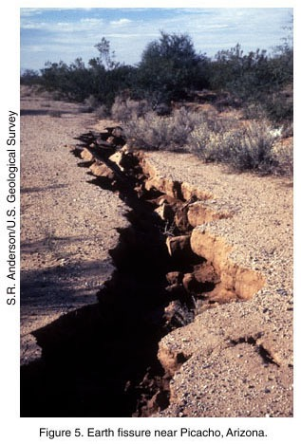
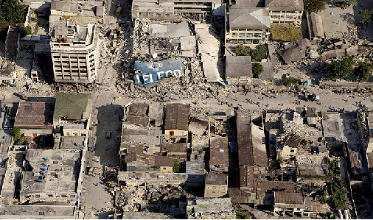
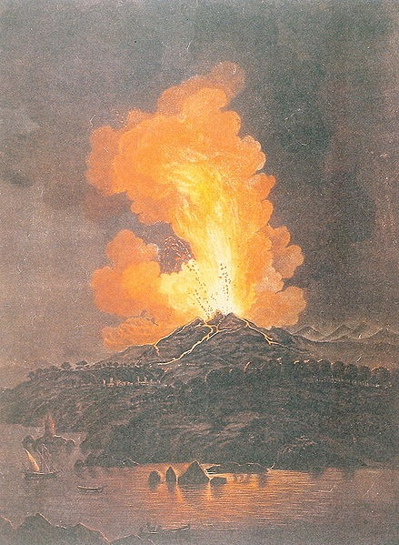
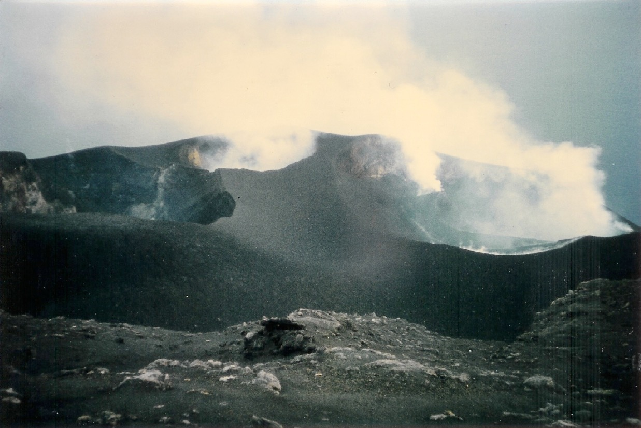
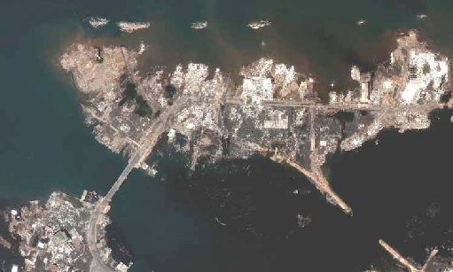
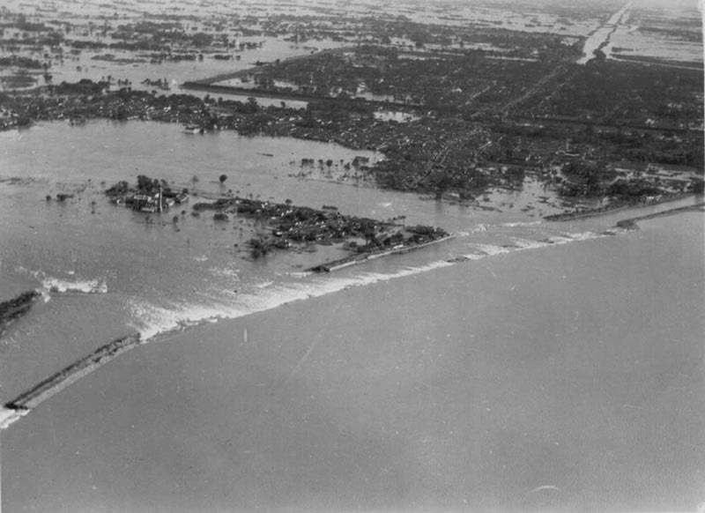
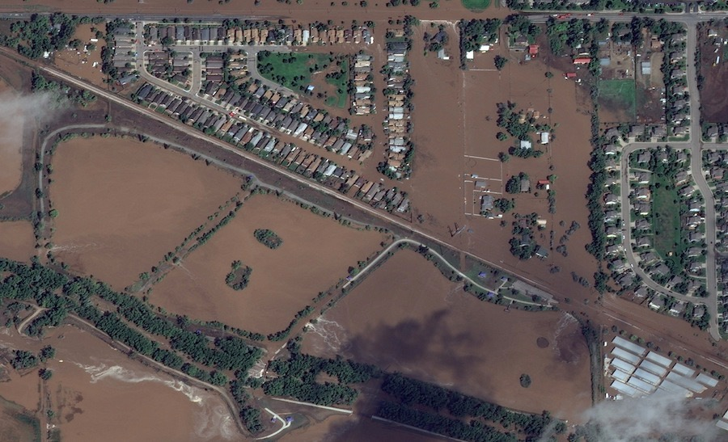
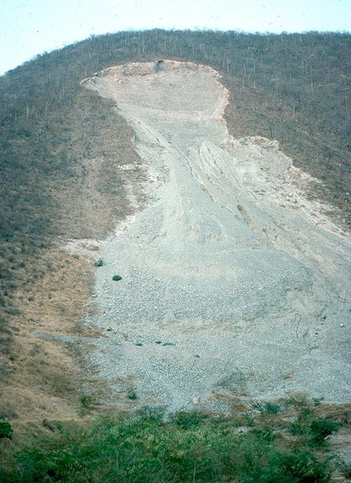
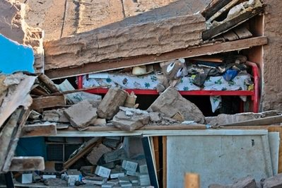
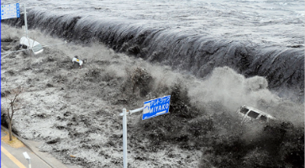
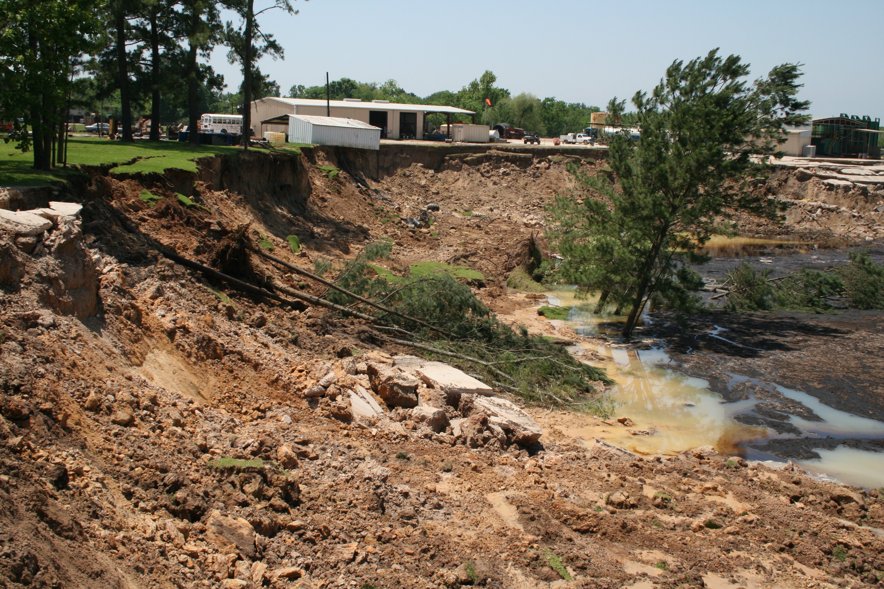
GEOHAZARDS
- landslides
- tsunamis
- earthquakes
- volcanic eruptions
- bolides
- surface deformations
- floods and droughts

Slide 10
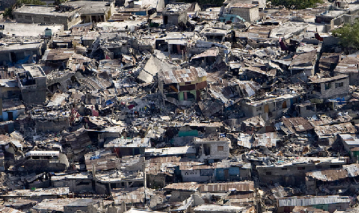
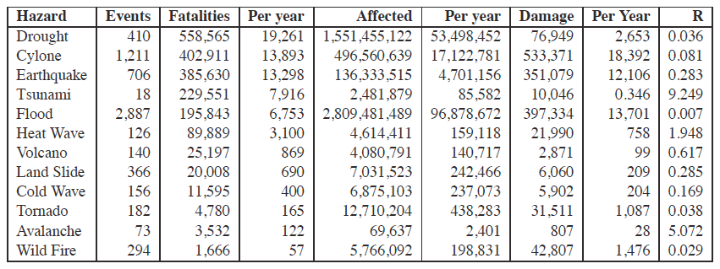
GEOHAZARDS
1980 - 2008
1980 - 2013
http://www.emdat.be/advanced search/.
http://www.preventionweb.net/english/professional/statistics/

Slide 11
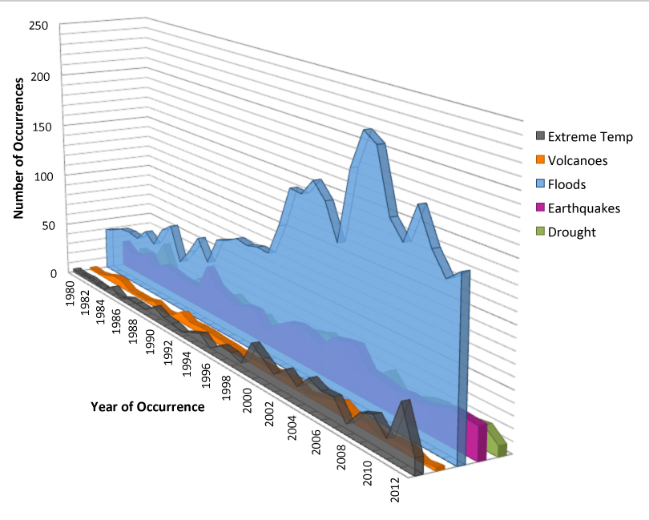
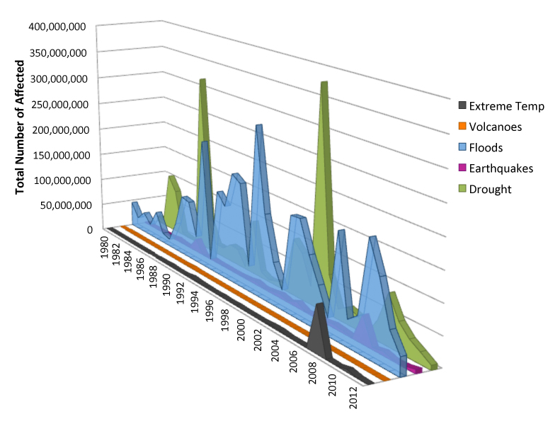
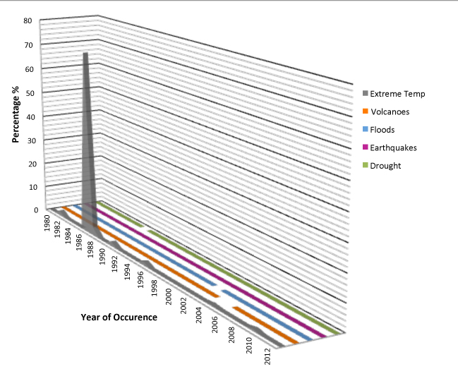
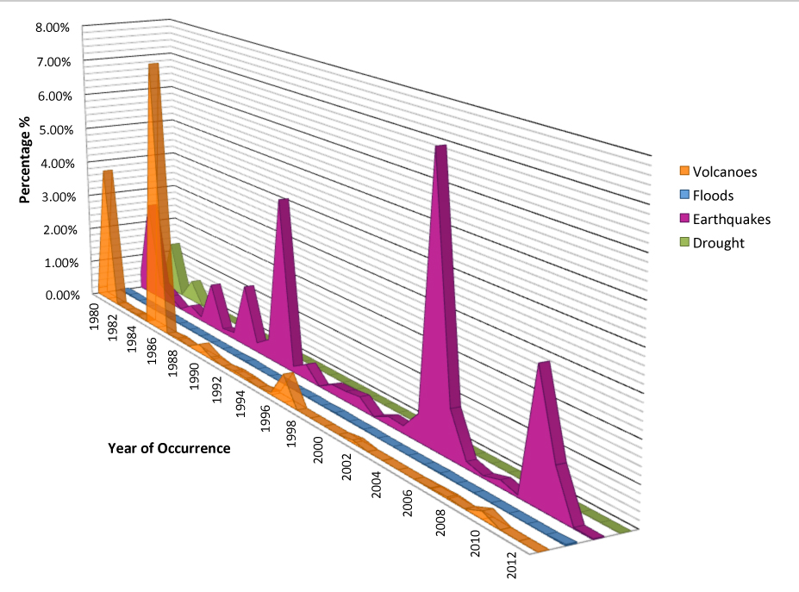
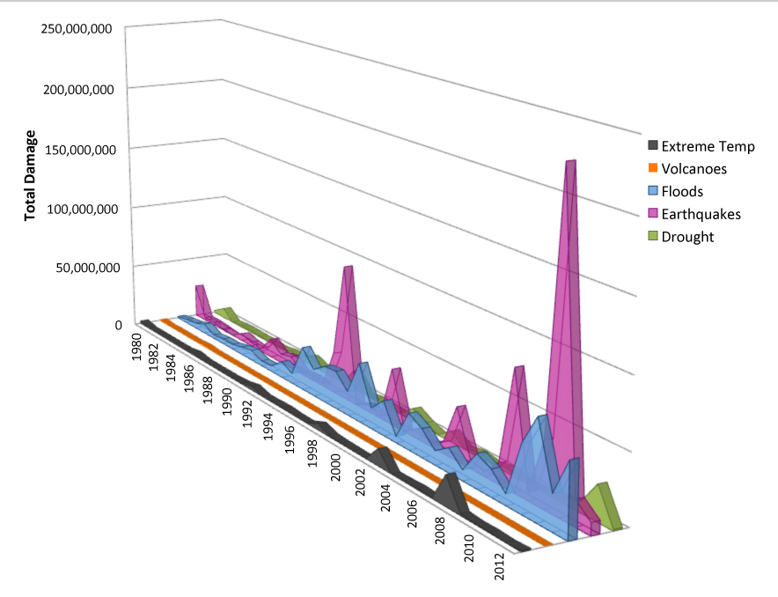
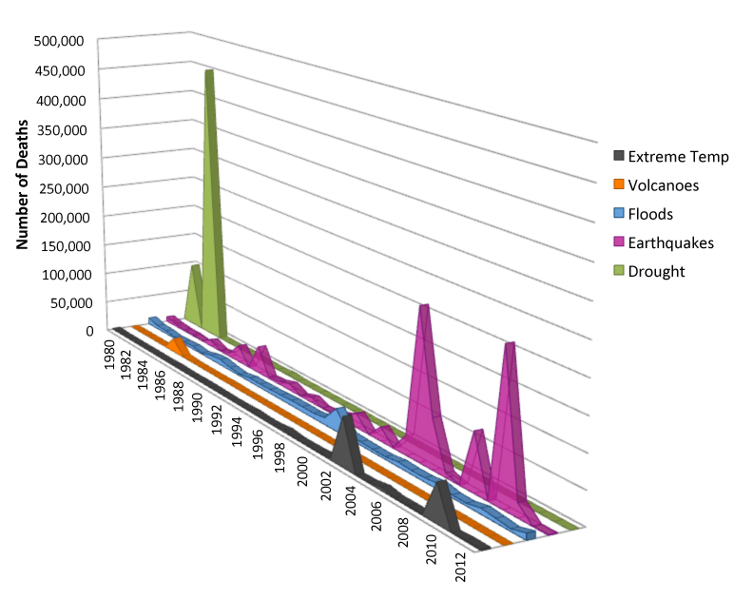
GEOHAZARDS: ASSESSING THE IMPACTS
Occurrences
Affected
Ratio of Death/Affected
Damage
Death
International Disaster Database
http://www.emdat.be/advanced search/.

Slide 12
GEOHAZARDS: ASSESSING THE IMPACTS
Occurrences
Affected
Ratio of Death/Affected
Damage
Death
International Disaster Database
http://www.emdat.be/advanced search/.

Slide 13
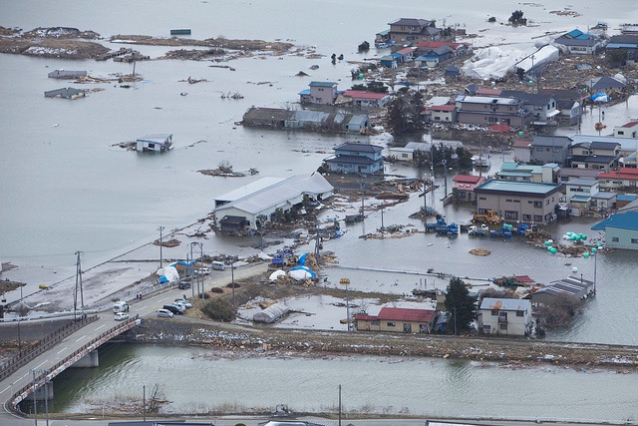
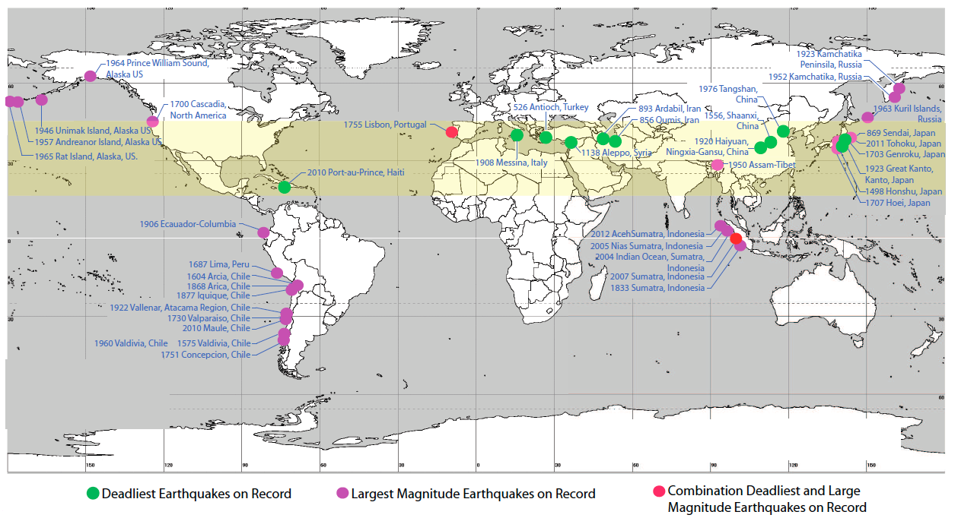
GEOHAZARDS: Earthquakes
We need to distinguish between the hazard and
the processes that lead from hazard to disaster

Slide 14
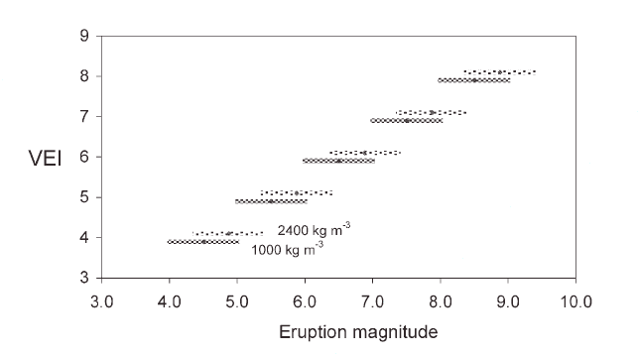
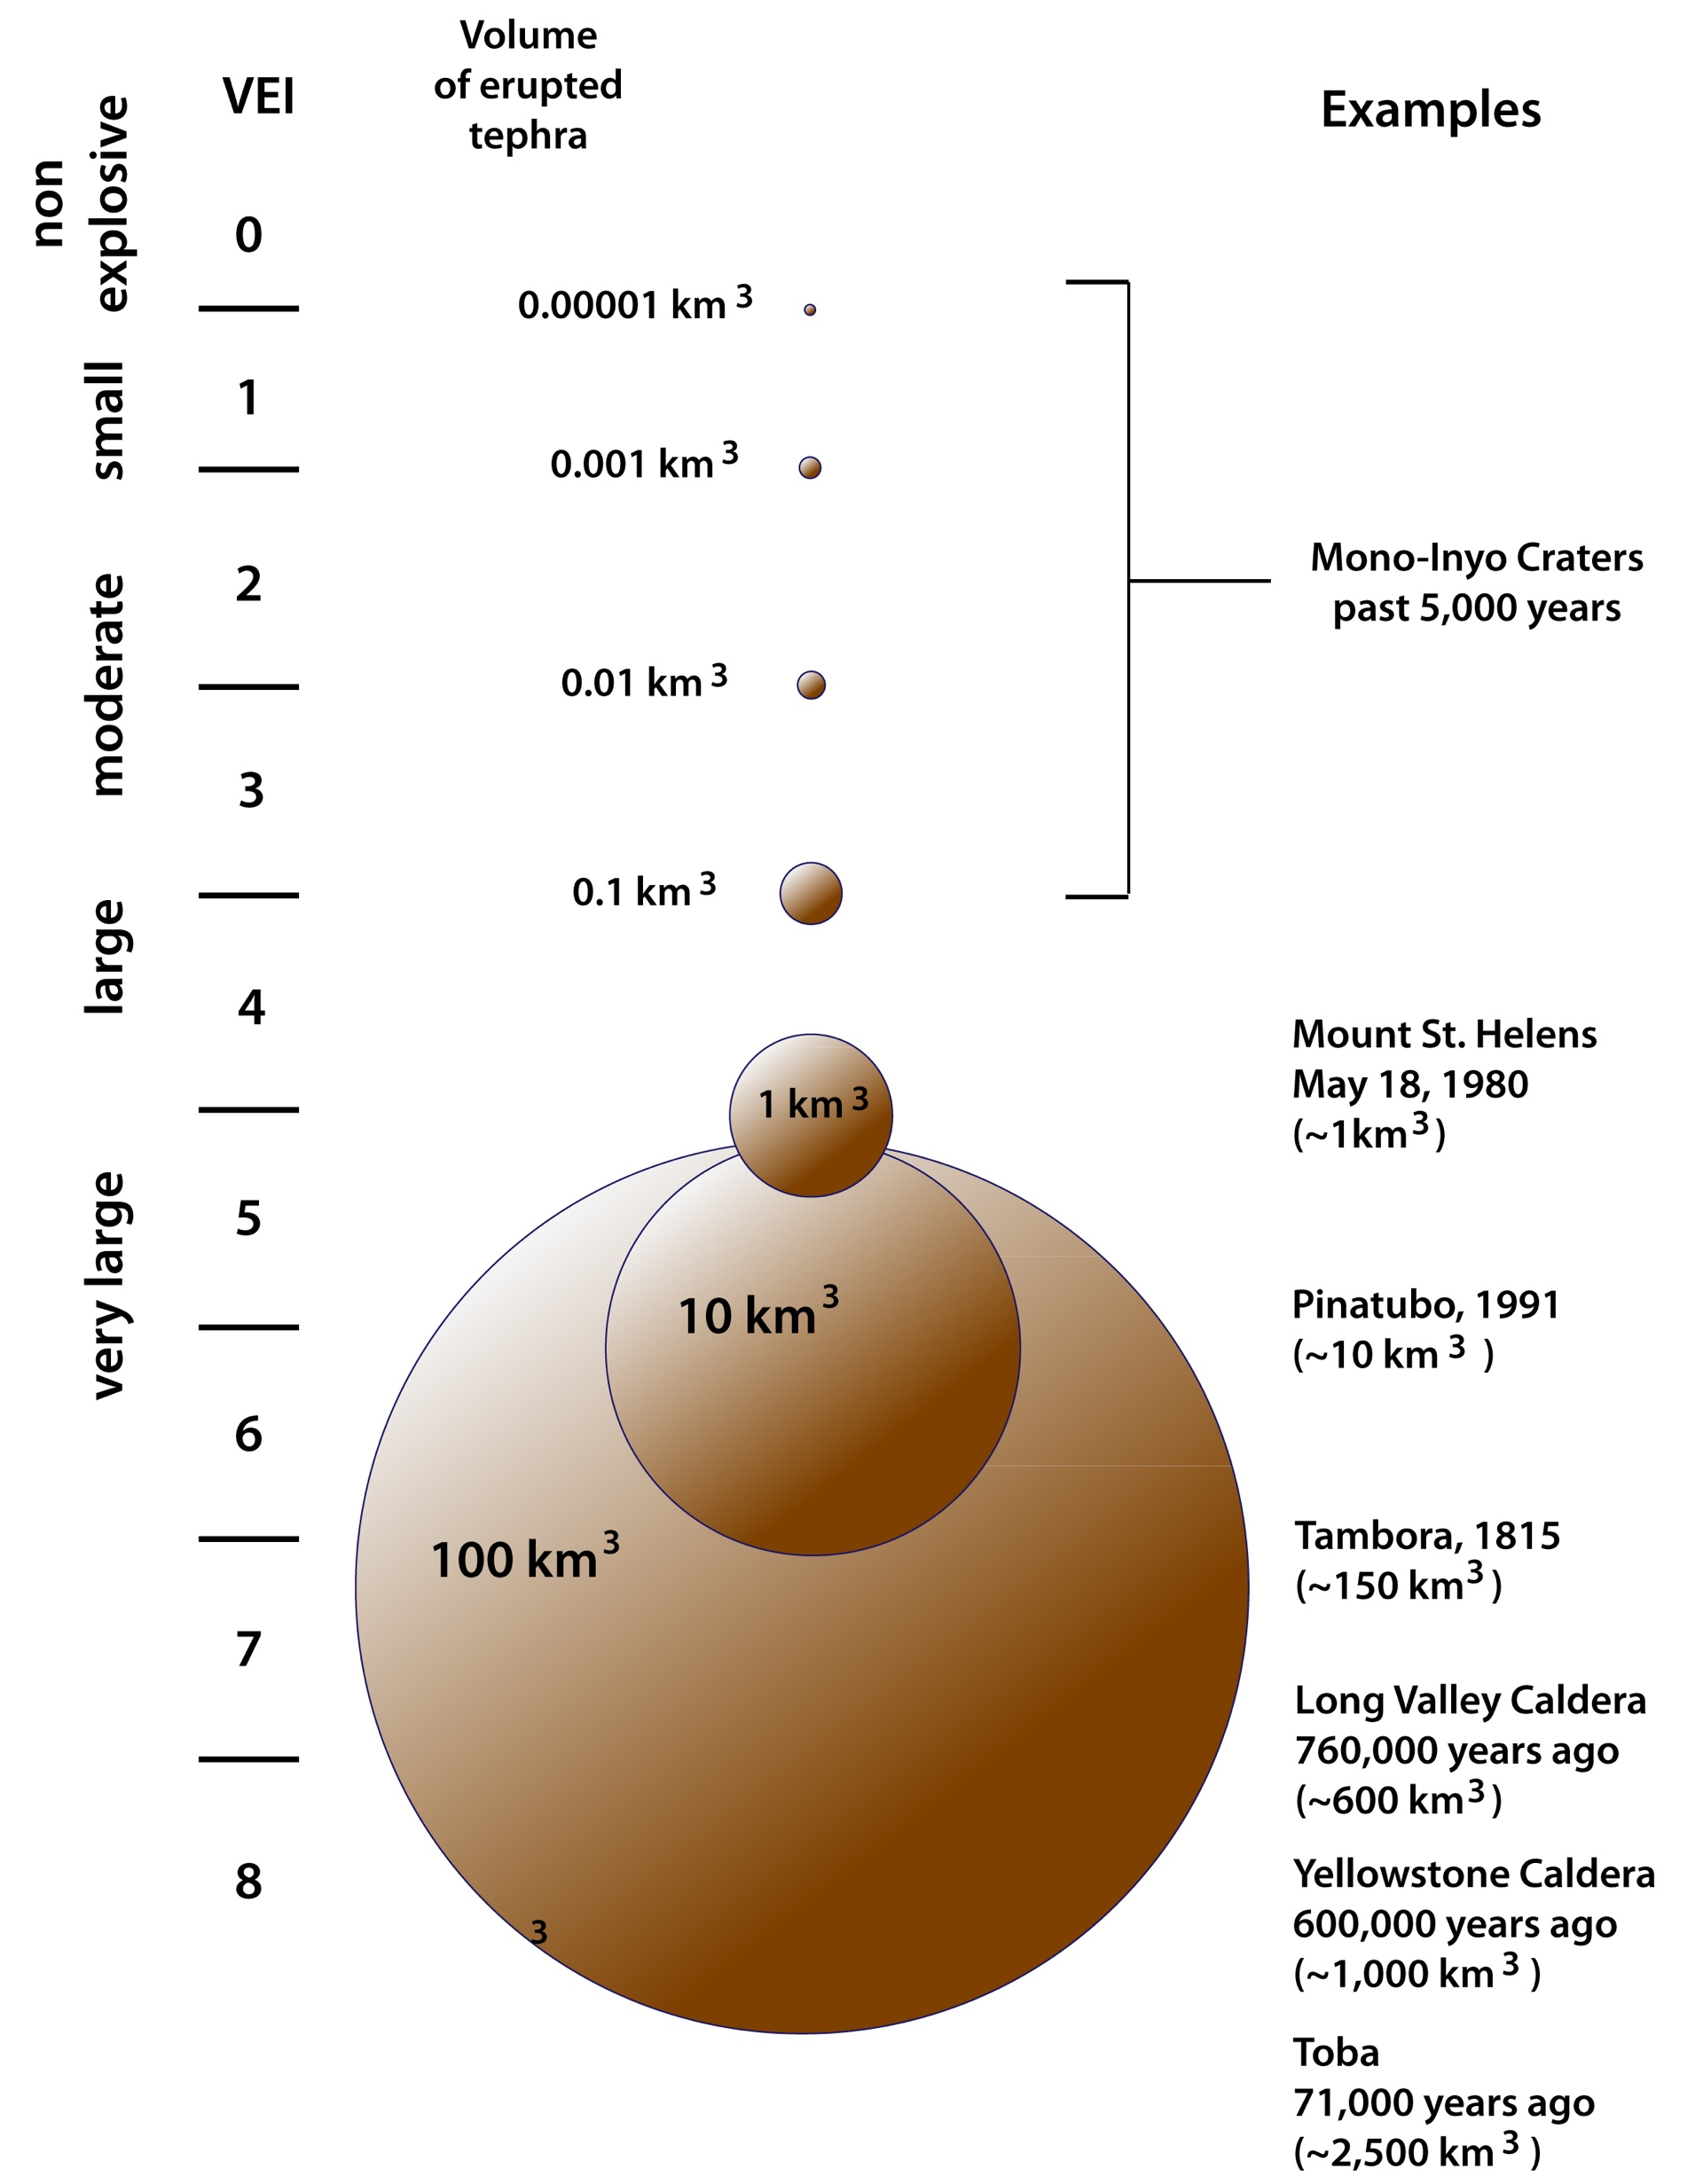
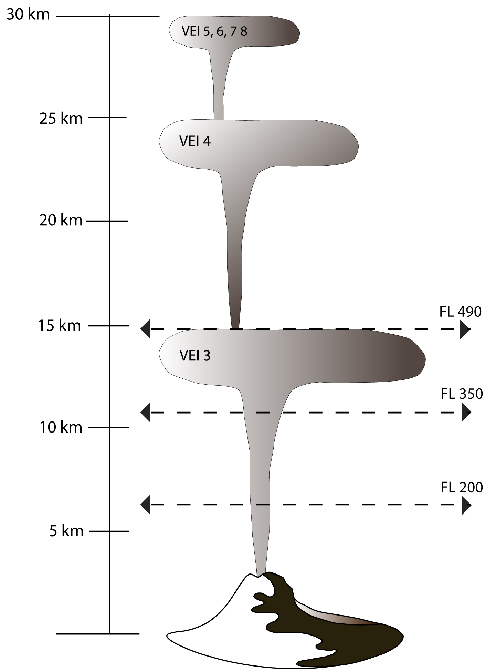
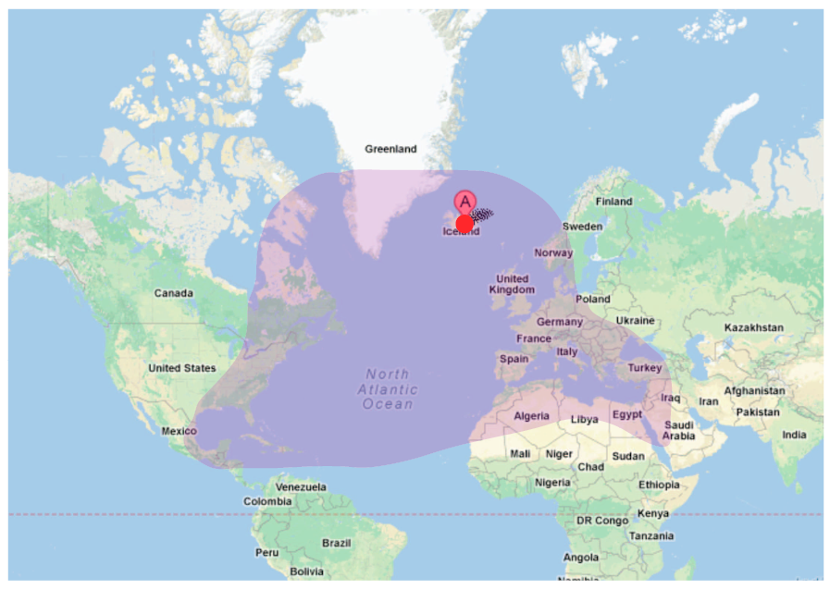
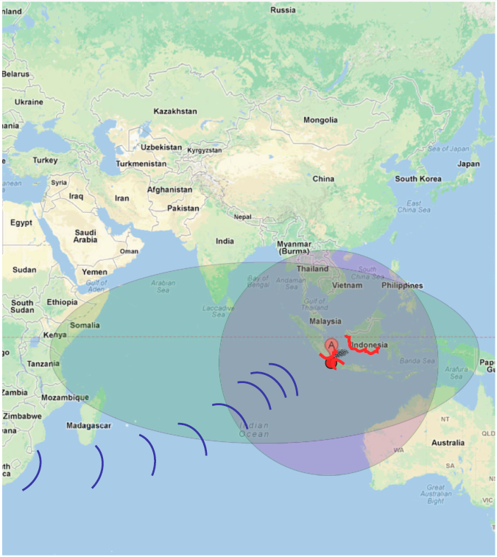
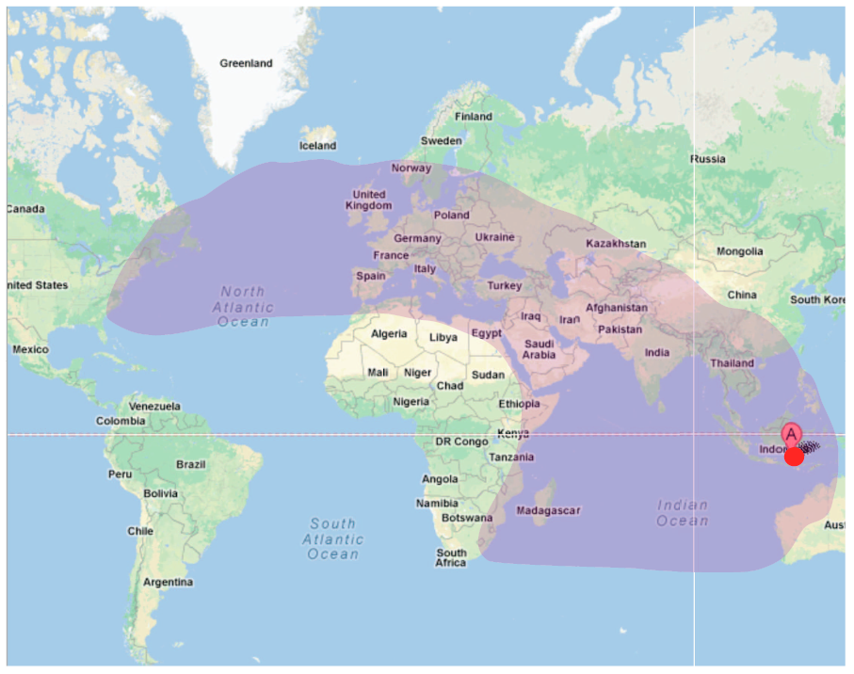
GEOHAZARDS: Volcanic Eruptions
M = log10(m) - 7.0
1 in 45,000 years to
1 in 720,000 years event
(Mason et al., 2004)

Slide 15
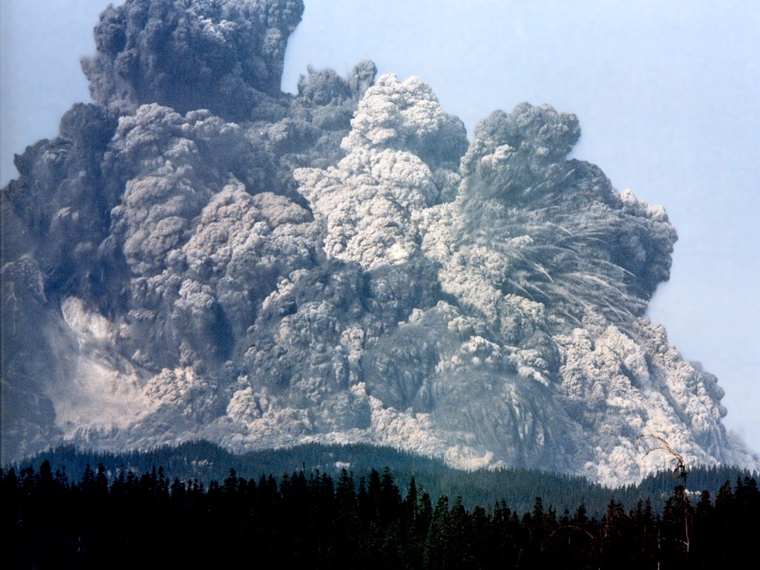
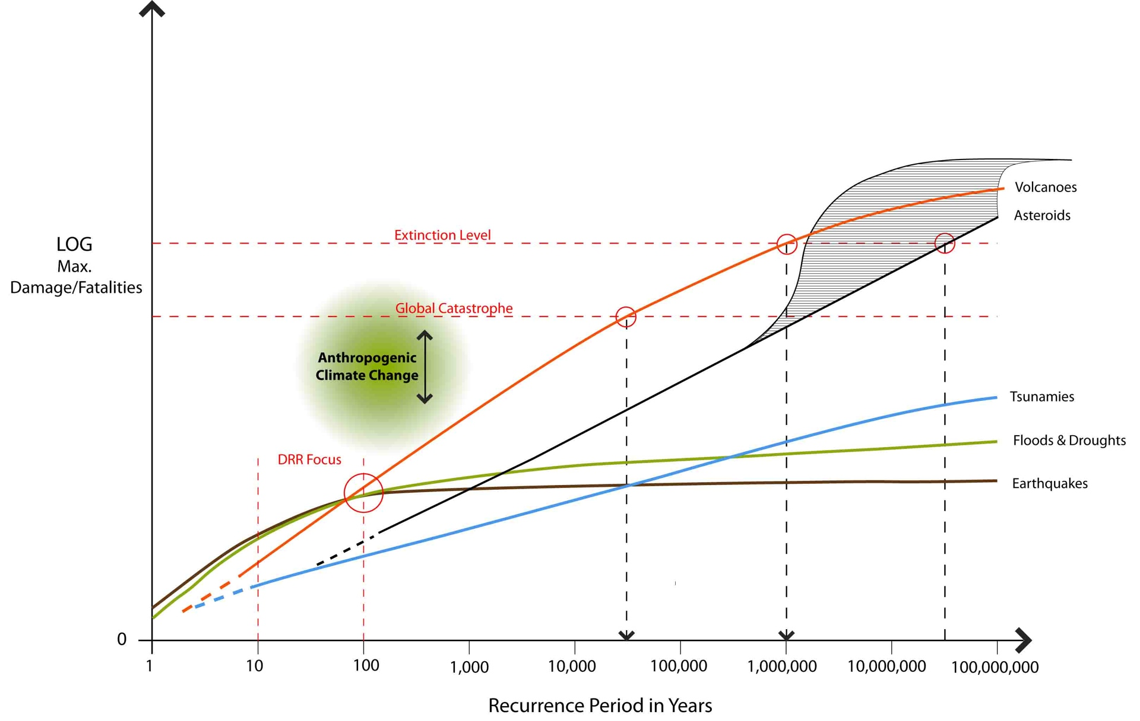
GEOHAZARDS: The Big Picture
Other potential X-Events (see, e.g., John Casti, 2012):
Pandemics: Black Death killed 30-60% of the population in impacted areas
Despots: Genghis Khan eliminated 11.1% of global population
Solar Storms: could take out major parts of the power grids
Loss of Internet: Could have extreme societal and economic consequences
...
Disaster Risk Reduction
Is climate change the most extreme hazard?

Slide 16
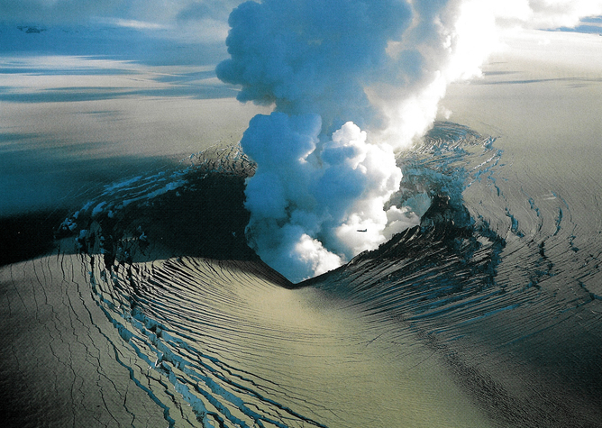
Volcanic Eruptions
VEI 8 / M 8: 45 events identified in the last 36 Ma (Mason et al., 2004), not equally distributed in time
- 1.4 events/Ma to 22 events/Ma
- largest, high-intensity terrestrial phenomena

Slide 17
Volcanic Eruptions
VEI 8 / M 8:
- 1.4 events/Ma to 22 events/Ma
- largest, high-intensity terrestrial phenomena
VEI 7 / M 7:
- on timescales of ~100 ka, M7-M8 eruptions have greater energy release than the largest expected impactors
- M7 are relatively frequent ...
VEI 7 / M 7:
- at least seven events in the
Holocene
- ~5% - 10% chance that this will
happen in the 21st century
- Will have very different impact
than previously

Slide 18
Volcanic Eruptions
12 Billion by 2100
Population growth may offsets DRR efforts
VEI 7 Eruptions
Tambora, 1815
Kurile, ~5550 BC
Santorini, ~1610 BC
Changbai, ~970
Crater Lake, ~5680 BC
Kikai, 2350 BC
Taupo, 230

Slide 19
Volcanic Eruptions and Modern Society
50% of World GDP crosses borders

Slide 20
Volcanic Eruptions and Modern Society

Slide 21
Volcanic Eruptions and Modern Society
Agricultural Water Stress

Slide 22
Cost-Benefit Analysis
Toba, ~75,000 years ago, VEI 8, ~2,800 km³; killed up to 60% of human population
Impacts:
- ash layer, several million square kilometers
- destroying one or two seasons of crops for two billion people
- reducing global temperature by 5-15ºC
- substantial physical damage to infrastructure
Death comparable to other global disasters:
Denghis Khan: 11.1% of the global population
1918 Spanish flu: 3% - 5% of global population
World War 2: 2.3% of global population
We assume:
- 10% of global population is killed if VEI 8 volcano eruption comes as a surprise

Slide 23
Cost-Benefit Analysis
Toba-type eruption: 1 in 45,000 to 714,000 years:
Probability of M8 or larger in any given year: between 2.2 · 10⁻⁵ and 1.4 · 10⁻⁶
Fatalities 10%:
Probability of a random person dying in any particular year: 2.2 · 10⁻⁶ and 1.4 · 10⁻⁷.
- Value of statistical life (VSL): $2.22 million
- Average person should be willing to pay $0.16 to $1.0 per year to eliminate the risk.
Global population over 7 billion: $1.1 to $7 billion/year.
Eliminating half of the risk is worth $0.5 to $3.5 billion/year.
2014 USGS Budget: $24.7 million for volcano monitoring
Same level globally: $370 million
Benefit to Cost ratio > 1.5 to 10!
Details will not change the main conclusion:
Spending on the order of $1 Billion/year on risk reduction for major volcanic eruptions makes economically sense based on standard cost-benefit analysis
Would have many positive side effects not considered

Slide 24
Conclusions and Recommendations
Global Simulation Experiment for Tambora/Laki Type of Eruption to better understand interdependencies, cascading effects, and response
The largest volcano eruptions of the Holocene (1 in 1000 years events):
- today would threaten an already stressed food security
- challenge the crucial global transportation network
- could easily lead to a global catastrophe.
Chance of a major eruption (order VEI 7, 100 km³) in the 21st century: 5-10%:
- severe implications for food security, public health, transportation, global economy and stability.
Steps towards risk reduction and increased resilience:
World Economic Forum
(1) Risk assessment and risk awareness:
- Frequent review of global risk knowledge with IPCC-like process
(2) Early Warning (EW):
- core element: elaborate, comprehensive volcano observation system;
- cost-benefit analysis: should be willing to spend > $1 B/year;
- Group on Earth Observations’ (GEO) Geohazards Community of Practice is reviewing observation
requirements
(3) Response to Early Warning:
- dedicate research to understand societal response to EWs on time scales of years
also important for EWs of abrupt climate change impacts

Slide 25
Conclusions and Recommendations
The largest volcano eruptions of the Holocene (1 in 1000 years events):
- today would threaten an already stressed food security
- challenge the crucial global transportation network
- could easily lead to a global catastrophe.
Chance of a major eruption (order VEI 7, 100 km³) in the 21st century: 5-10%:
- severe implications for food security, public health, transportation, global economy and stability.
Steps towards risk reduction and increased resilience:
(1) Risk assessment and risk awareness:
- Frequent review of global risk knowledge with IPCC-like process
(2) Early Warning (EW):
- core element: elaborate, comprehensive volcano observation system;
- cost-benefit analysis: should be willing to spend > $1 B/year;
- Group on Earth Observations’ (GEO) Geohazards Community of Practice is reviewing observation
requirements
(3) Response to Early Warning:
- dedicate research to understand societal response to EWs on time scales of years
also important for EWs of abrupt climate change impacts
World Economic Forum
Global Simulation Experiment for Tambora/Laki Type of Eruption to better understand interdependencies, cascading effects, and response

Slide 26
Conclusions and Recommendations
The largest volcano eruptions of the Holocene (1 in 1000 years events):
today would threaten an already stressed food-water-energy security
have severe global health impacts
challenge the crucial global transportation network
could easily lead to a global catastrophe.
Chance of a major eruption (order VEI 7, >100 km³) in the 21st century: 5-10%:
- severe implications for food security, public health, transportation, global economy and stability.
Consequences:
- We need to account for extreme risks at low-probability end
- Focus on improved global general resilience
It’s not the hazard, it’s the process that lead from hazard to disaster

Slide 27
Likelihood
Conclusions and Recommendations
Steps towards risk reduction and increased resilience:
Develop a global scientific framework for strategic extreme (geo)hazards:
- should be able to deliver tactical science response to (extreme) hazards;
- should seamlessly integrate into warning, preparedness and mitigation;
- could learn from NEO tracking in terms of monitoring and IPCC in terms of
knowledge assessment;
- carry out frequent assessments of global risks and threats;
Gordon McBean
World Economic Forum
(2) Better understanding of the interrelation between topography, surface deformations, geohazards, and environment.
Impacts
(3) Scenario contingency planning to understand threats and risks:
- global simulation experiments for Tambora/Laki type of eruptions;
- identify cascading hazards and outcomes;
- inform measure to increase resilience;

Slide 28
Conclusions and Recommendations
Steps towards risk reduction and increased resilience:
(4) Increase risk awareness in the population through dissemination of concise and clear information and training to cope with emergency scenarios.
(5) Establish a global monitoring system with the goal to provide early warning for emerging extreme volcanic eruptions - and to support research on geohazards:
- core element: elaborate, comprehensive volcano observation system;
- cost-benefit analysis: should be willing to spend > $1 B/year;
- Group on Earth Observations’ (GEO) Geohazards Community of Practice is reviewing observation
requirements.
David Green
(6) Develop an informed global governance that could respond to emerging global risks and coordinate global measures to increase preparedness and resilience and reduce the risk of global disasters.
Immediate step: Extend the “Disaster Charter” to early warning (and preparedness) applications
David Green

Slide 29
Conclusions and Recommendations
Post-Hyogo Framework of Action
- Understanding that we need to account for extreme risks at low-probability end
- Focus on improved global general resilience
It’s not the hazard, it’s the process that lead from hazard to disaster
Post-2015
- Improve monitoring that could provide early warning for emerging global risks
- Establish an International/Intergovernmental Panel for Global Risk (IPGR)
- Develop a convention/body for global risks to act before the hazard
Integrate (general) Resilience and Disaster Risk Reduction ==> RDRR

Slide 30
Epilogue
It is all about energy (and entropy) …

Slide 31
Holocene: stability
20th and 21st Century:
cataclysmic change
Future:
new epoch,
post cataclysm

Slide 32
Being out of scale: Human energy use makes each human equivalent to two elephants
Being out of scale: Human energy use makes each human equivalent to two elephants
Scaling law for metabolic rate:
Y = Y0 * M^{(3/4)}
Metabolic Rate
human: Y = 50 -100 Watt
Extended metabolic rate:
YE = Y + CE
(CE: total energy consumption)
Energy consumption per capita:
Global Average: YE = 2,735 Watt
M = 10 metric tons
Worst case: YE = 22,000 Watt
M = 170 metric tons
Mass
Humanity has an extended metabolic rate equivalent to 14 billion elephants
How do 14 billion elephants compare to extreme (geo)hazards?
14 billion elephants: a heavy “load’ for Earth
Blue Whale

Slide 33
Being out of scale: Human energy use makes each human equivalent to two elephants
Scaling law for metabolic rate:
Y = Y0 * M^{(3/4)}
Metabolic Rate
human: Y = 50 -100 Watt
Extended metabolic rate:
YE = Y + CE
(CE: total energy consumption)
Energy consumption per capita:
Global Average: YE = 2,735 Watt
M = 10 metric tons
Worst case: YE = 22,000 Watt
M = 170 metric tons
Humanity has an extended metabolic rate equivalent to 14 Billion elephants
(2.7 Billion for the U.S. alone)
Mass
14 Billion elephants: a heavy “load’ for Earth

Slide 34
Being out of scale: Human energy use makes humanity an “extreme hazards”
22
Physical Geography: a sudden and violent physical action producing changes in the earth's surface.
2 km
impactor
“Anthropogenic
Cataclysm”
VEI 8
Toba-Type
Eruption
10¹⁶ W lasting 10⁵ s
21
Humanity
2.10¹³ W
20
19
Energy Log (Joules)
VEI 7
Tambora-Type
Eruption
M = 9.5
Earthquake
10¹⁷ W lasting
100 s
18
17
Integrated Disaster Risk Science: Accounting for Extremes:
Is humanity the most important extreme we need to account for?
16
15
0
1
2
3
4
5
6
7
Recurrence Log (Years)

Slide 35
A growth-addicted humanity is heading for the equivalent of >30 billion elephants
IGNORANCE
IN ACTION
RISK BASED
PLANNING
SOCIAL & POLITICAL
INERTIA
SCIENTIFIC INQUIRY
AND PROJECTION
30 billion elephants: a load too heavy for Earth?

Slide 36
“Sustainable Development is a development that meets the needs of the presence while safeguarding Earth’s life support systems, on which the welfare of current and future generations depends.” (Griggs et al., 2013)
Economy is the link between humanity and Earth’s life-support system
Economy against humanity:
An economy that meets our needs by burning fossil fuels and destroying Earth’s life-support system is like a doctor who practices medicine by killing the patients.
Economy for humanity:
“An economy that meets our needs while safeguarding Earth’s life-support system,
on which the welfare of current and future generations depends.”
“What is good for Earth’s life support system is good for humanity”

